Slide 1
Questions of Identity
Windows Single Sign-On to the Oracle Database with Kerberos

Slide 2
WHO am I?
Oracle DBA based in Hong Kong
HKOUG Co-Founder and Executive Committee member
https://jolliffe.hk/
@jolliffe
https://www.linkedin.com/in/jolliffe/

Slide 3
WHO am I?
WHY this talk?
WHAT is Kerberos?
WHAT’s it got to do with Oracle & Windows?
HOW to get it working? (Demo)
WHEN it doesn’t work? (Quiz)
Any (more) questions?

Slide 4

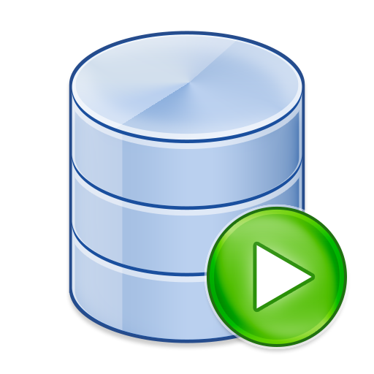





WHY this talk?
C:\> sqlplus app/SharedPass@ORADB
sql> create user patrick identified by SecretPass;
C:\> sqlplus patrick/SecretPass@ORADB
sql> alter user app grant connect through patrick;
C:\> sqlplus patrick[app]/SecretPass@ORADB
sql> alter user patrick identified externally as ‘patrick@WINDOWS.DOMAIN’;
c:\> sqlplus /@ORADB
c:\> sqlplus [app]/@ORADB

Slide 5

WHAT is Kerberos?
Kerberos (after the three-headed guard dog of Hades) is a computer network authentication protocol that works on the basis of tickets to allow nodes communicating over a non-secure network to prove their identity to one another in a secure manner
Notes:
Developed by MIT, version 4 published in the late 1980s (versions 1-3 internal only)
Version 5 published 1993

Slide 6





Kerberos Realm
@EXAMPLE.COM
Kerberos Server
Key Distribution Center (KDC)
host1.example.com
Kerberos User
Kerberos Service
host2.example.com
keytab
patrick@EXAMPLE.COM
User Principal Name (UPN)
HTTP/webserver.example.com@EXAMPLE.COM
Service Principal Name (SPN)

Slide 7
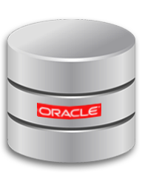
WHAT’s it got to do with Oracle?
An available authentication protocol for Oracle database since (at least) Oracle 7
Initially part of Advanced Networking/Security ($$$)
From Oracle 12c included with SE licence, license change backported to 11g
Doc ID 2145731.1 has instructions for 11g Standard Edition
Oracle Database can be a Kerberos Service

Slide 8

WHAT’s it got to do with Windows?
Kerberos is the authentication protocol for Active Directory
A Windows Domain Controller is a Kerberos Server (KDC)
A Windows Domain User is a Kerberos User

Slide 9


Windows Domain
@WINDOWS.DOMAIN
Windows Domain Controller
1
2
ora18_sa@WINDOWS.DOMAIN
1
2
Windows Domain User
Linux Database Server
1
patrick@WINDOWS.DOMAIN
oracle/lnx-ora18.windows.domain@WINDOWS.DOMAIN

Slide 10

HOW to get it working?
[Link to pre-recorded version]

Slide 11
And WHEN it doesn’t work?
Many components needed to configure; many things to go wrong
Generic Error message not very helpful, one of:
ORA-12638: Credential retrieval failed
ORA-12631: Username retrieval failed
ORA-01017: invalid username/password

Slide 12
And WHEN it doesn’t work?
SQLNET Trace at level SUPPORT (lots of data)
TRACE_LEVEL_CLIENT
TRACE_LEVEL_SERVER
Packet Trace (Wireshark) between Windows Client and Domain Controller; use KERBEROS display filter
Kerberos Troubleshooting Guide (Doc ID 185897.1)
Case Study: Configuring the Kerberos Adapter in a Windows Environment (Doc ID 370357.1)

Slide 13

ORA-01017: invalid username/password
{client trace}
nam_gnsp: Reading parameter "sqlnet.authentication_services" from parameter file
nam_gnsp: Found value "KERBEROS"
nautab contains the following services:
Nau_gettab: KERBEROS5
nau_fme: unable to locate authentication adapter "KERBEROS" in adapter list
Na_tns: Authentication is not active

Slide 14
ORA-12638: Credential retrieval failed
{client trace}
nam_gnsp: Reading parameter "sqlnet.kerberos5_cc_name" from parameter file
nam_gnsp: Found value "OMSFT:"
nauk5ainit: CC pathname: OMSFT:.
NAUK5C_CC_GET_PRINCIPAL: NAUK5C_CC_GET_PRINCIPAL: File permissions incorrect

Slide 15
ORA-12631: Username retrieval failed
{server trace}
nauk5y2_kt_get_entry: Searching for keytype=23 ,kvno=3;Current keytype=23,kvno=2
nauk5y2_kt_get_entry: Returning 114: Key table entry not found

Slide 16
ORA-12631: Username retrieval failed
{server trace}
nauk5y2_kt_get_entry: Searching for keytype=23 ,kvno=2;Current keytype=23,kvno=2
nauk5ky_rd_req_decoded: Returning 31: Decrypt integrity check failed
nauk5avalidate: nauk5a3recvclientauth() failed to process the request
nau_scn: credential validation function failed

Slide 17
ORA-12631: Username retrieval failed
{server trace}
snaumgh_gethostinfo: Hostname: lnx-ora122.windows.domain
snaumgh_gethostinfo: Full name: : lnx-ora122
nacomer: error 12638 received from Authentication service
nacomer: failed with error 12638

Slide 18

Reduced DBA time managing user passwords
No passwords (or even usernames) for end-users to remember
Works great with Proxy Authentication
Increased DBA effort to configure
Collaborate with AD team
Needs (Instant) Client
(not JDBC thin)
Configured account only usable via Kerberos ticket

Slide 19
Thank You!
Any Questions?

