Slide 1
Jason, meet Oracle database
Priit Piipuu

Slide 2
WHOAMI: Priit Piipuu
Started as a DBA twenty years ago, moved to the development side a few years ago
Currently database performance engineer at Kindred Group
Main job is to help developers use Oracle technologies in the best way possible
© Kindred Group plc 2017
2

Slide 3
In this presentation…
What is JSON and where you can find it
Dot notation and SQL/JSON path expressions
Functions for accessing JSON
How to turn JSON into relational data
Indexes and JSON
JSON data guide
PL/SQL object types for JSON

Slide 5
Storing JSON in the database (I)
JSON can be stored either as VARCHAR2, CLOB, BLOB
JSON datatype in 21c
Notes:
JSON always uses Unicode, in Oracle needed charset conversation is automatic
Oracle uses UTF-8 internally, JSON and BLOBs never undergo charset conversion

Slide 6
Storing JSON in the database (II)
JSON data is always in Unicode
Oracle uses UTF-8 internally while processing JSON
Character set conversion isn’t needed when
JSON data is stored as a BLOB or JSON data type
Database charset is AL32UTF8
JSON data is stored as a CLOB with AL16UTF16 charset
Notes:
When SQL/JSON function or a PL/SQL function returns data in varchar2 or clob and database charset isn’t utf8, charset conversion will happen even if result is stored as JSON or BLOB

Slide 7
What our document looks like
Generated with JSON_QUERY function
Has pretty printing option

Slide 8
JSON data types (I)
Notes:
Appearences can be deceiving, even if number looks like int, in JSON it is float

Slide 9
JSON data types: (II)
Notes:
Appearences can be deceiving, even if number looks like int, in JSON it is float

Slide 10
JSON data types (III)

Slide 11
Dot notation
SELECT
c.customer.id,
c.customer.birthday.date()
FROM
customers c
WHERE
c.customer.first_name = 'Jason’;
Notes:
Designed for easy, general use. Common use cases do not need SQL/JSON query functions
Works only with well-formed data, if type is not JSON column must have constraint
JSON data types are not useful in SQL -> data type conversion
Date() -> item method
w/o item method, with JSON data type return type is JSON, with character data return type is varchar2(4000)
Any error -> null is returned
Table alias is mandatory?
Path expressions are case sensitive!

Slide 12
Dot notation
SELECT
c.customer.id,
c.customer.birthday.date()
FROM
customers c
WHERE
c.customer.first_name = 'Jason’;

Slide 13
SQL/JSON path expressions (I)
JSON_EXISTS checks if a particular value is present or not
Supports error handlers (ERROR ON ERROR, FALSE ON ERROR, TRUE ON ERROR)
Can handle empty values
ERROR ON EMPTY, TRUE ON EMPTY, FALSE ON EMPTY

Slide 14
SQL/JSON path expressions (II)
Path expression can be either absolute or relative
Absolute path expression starts with $
This matches the context item for the expression
Expression is evaluated for each SQL expression passed to the function or condition

Slide 15
SQL/JSON path expressions (III)
Array elements can be specified either by *, array indexes, or ranges

Slide 16
SQL/JSON path expressions (IV)
Filter expression applies predicates to its arguments
Possible predicates
Logical conditions and EXISTS
Comparisions: HAS SUBSTRING, STARTS WITH, LIKE, LIKE_REGEX

Slide 17
SQL/JSON path expressions (V)
Relative path expressions are used inside filter expressions
Represents current filter item

Slide 18
SQL/JSON path expressions (VI)
Type conversion functions
string, stringOnly(), number, numberOnly(), date(), timestamp(), boolean(), booleanOnly()
RETURNING clause in the SQL/JSON functions allows for length and precision
Other functions
ceiling(), floor(), length(), size(), type(), etc.

Slide 19
SQL/JSON path expressions (VII)

Slide 20
JSON conditions
IS JSON
Checks if the expression is/is not a well-formed JSON snippet
JSON_EQUAL
Compares two JSON values, returns TRUE is equal
Ignores whitespace and object member order
Supports ERROR ON ERROR, FALSE | TRUE ON ERROR clauses. Default is FALSE on ERROR
JSON_EXISTS
Can return the default value, or NULL, or ERROR if no match is found
JSON_TEXTCONTAINS
Can be used if Oracle Text JSON index is defined on the column

Slide 21
SQL/JSON functions: JSON_VALUE (I)
Can return either scalar, SQL collection type, or SQL object type
Expects exact match between JSON fields and SQL object attributes
JSON booleans
Can return PL/SQL boolean type
In SQL returns either VARCHAR2 or NUMBER
JSON null type: returns NULL
No way to tell if the value is null or missing

Slide 22
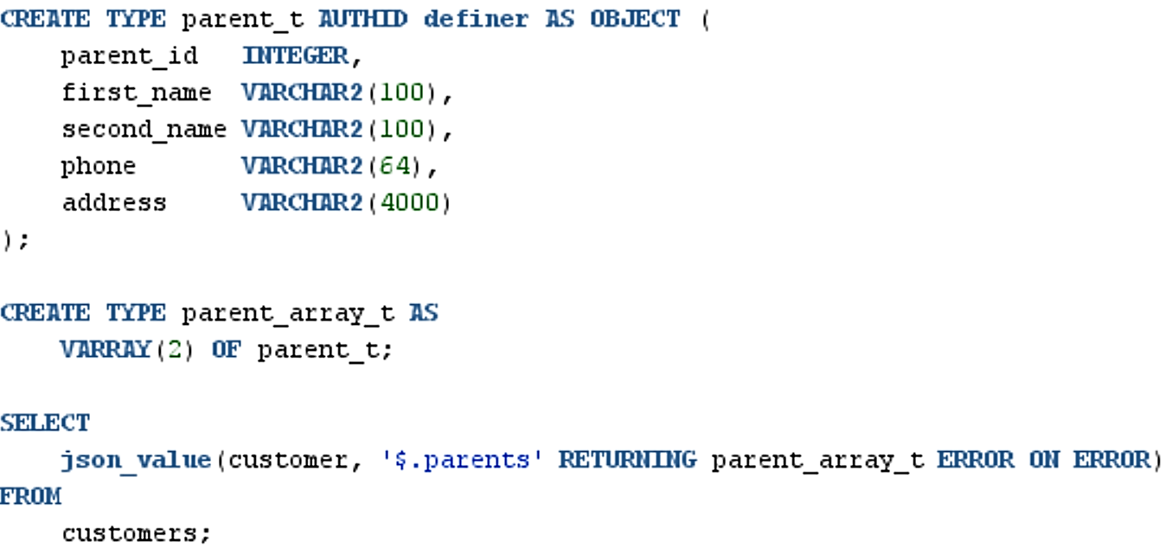
SQL/JSON functions: JSON_VALUE (II)

Slide 23
SQL/JSON functions JSON_QUERY
Retrieves fragments from JSON documents

Slide 24
SQL/JSON functions: JSON_TABLE (I)
Projects JSON data into SQL columns and data types
Acts as a row source
Maps schema into JSON data, exposes data that conforms to the specific schema
Mostly used with lateral join or left outer join

Slide 25
SQL/JSON functions: JSON_TABLE (II)

Slide 26
SQL/JSON functions: JSON_TABLE (III)

Slide 27
SQL/JSON functions: JSON_TABLE (IV)

Slide 28
SQL/JSON functions: JSON_TABLE (V)

Slide 29
SQL/JSON functions: JSON_TABLE (VI)

Slide 30
Other SQL/JSON functions
JSON_SERIALIZE
Turns JSON data into textual representation (VARCHAR2)
JSON_OBJECT and JSON_ARRAY
Construct objects and arrays from input expressions
JSON_OBJECTAGG and JSON_ARRAYAGG
Aggregate multiple rows into a single object or array
JSON_MERGEPATCH
Transforms specific part of the JSON document
JSON_TRANSFORM
Updates data in JSON document

Slide 31
JSON and indexes
Function based indexes for scalars
JSON_VALUE can be used with b-tree and bitmap indexes
With JSON data type JSON_EXSIST can be used
JSON search index for ad-hoc queries
Oracle Text index
Useful for both queries looking for a particular value, and conditions with JSON_EXISTS

Slide 32
Indexes with dot notation
Equivalent to
JSON_VALUE("CUSTOMER" FORMAT JSON , '$.id.number()' RETURNING NUMBER NULL ON ERROR)
In this example
Missing values are fine
Non-numeric data is fine

Slide 33
Indexes with JSON_VALUE
In this example
Non-numeric data creates an error
Missing data is still fine
This index is usable with dot-notation queries that access that particular scalar value
Indexes with ERROR ON ERROR clause are useful for JSON_TABLE as well
For the predicates in WHERE clause

Slide 34
JSON search indexes
Defaults
Synchronize on commit
DATAGUIDE is ON
SEARCH_ON is set to TEXT_VALUE
Can be changed through PARAMETERS section

Slide 35
JSON data guide (I)
Contains metadata about the structure and content of JSON objects
Can be used to generate views or virtual columns on JSON data
Dataguide can be flat or hierarchical
Flat data guide is an array of JSON objects, good for querying
Hierarchical data guide is an object with nested JSON data
For a single document, function JSON_DATAGUIDE produces data guide for its argument

Slide 36
JSON data guide (II)
Ways to access:
{USER|ALL|DBA}_JSON_DATAGUIDES
One data guide per column with JSON data
{USER|ALL|DBA}_DATAGUIDE_FIELDS
One row per item from JSON document

Slide 37
JSON data guide (II)
Beginning of the flat data guide
From USER_JSON_DATAGUIDES view
Contains preferred column name
Important when generating views and virtual columns with DBMS_JSON
Data types and lengths are derived from the actual data

Slide 38
Package DBMS_JSON (I)
Gives another way to retrieve data guide as a CLOB
Can create views and virtual columns
Either for the whole document or for specific JSON path expression
Data types will come from the data guide
If data types change, views and columns might need updating
Can create materialized views as well
If data types or column names need to be adjusted, this has to be done manually

Slide 39
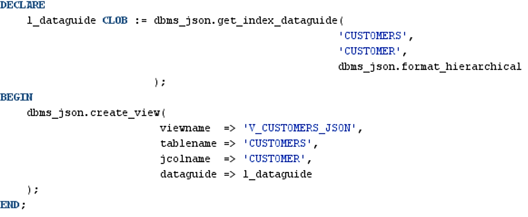
Package DBMS_JSON (II)

Slide 40
Package DBMS_JSON (III)

Slide 41
JSON and PL/SQL
SQL functions and conditionsavailable in PL/SQL
JSON_VALUE
JSON_QUERY
JSON_EXISTS
SQL functions and conditions NOT available in PL/SQL
JSON_ARRAYAGG
JSON_DATAGUIDE
JSON_MERGEPATCH
JSON_EQUAL
JSON_OBJECTAGG
JSON_TABLE
JSON_TEXTCONTAINS
JSON_TRANSFORM

Slide 42
PL/SQL types for JSON (I)

Slide 43
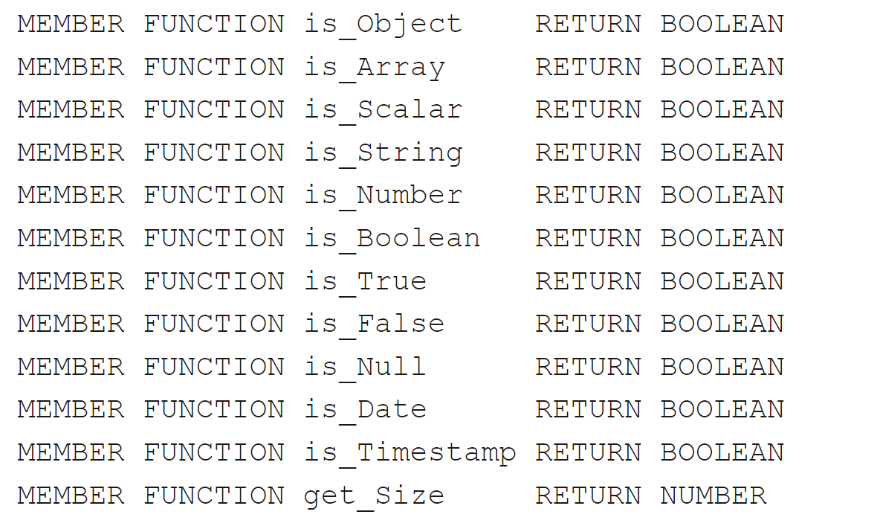
JSON_ELEMENT_T
Created from the existing JSON document
With member function PARSE from character data
Using member function LOAD with JSON data type
Has introspection methods

Slide 44
JSON_ARRAY_T and JSON_OBJECT_T
Can be constructed directly, or through PARSE and LOAD functions
Both have getters (GET_*) and setters (PUT*)
Introspection for JSON_OBJECT_T
Elements can be removed, and elements in objects can be renamed
Both types can be cloned

Slide 45
PL/SQL types for JSON (II)

Slide 46
PL/SQL types for JSON (III)

Slide 47
PL/SQL types for JSON (IV)

Slide 48
PL/SQL types for JSON (V)

Slide 49
PL/SQL types for JSON (VI)

Slide 50
PL/SQL types for JSON (VII)

Slide 51
PL/SQL types for JSON (IX)

