Slide 1
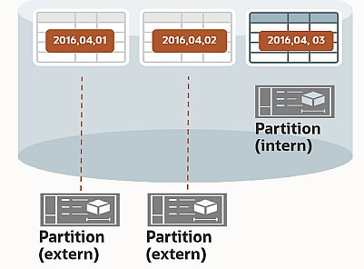
Outsource your tables using Hybrid Partitioning!
Dejan TOPALOVIĆ
ORACON GmbH
@oradeto

Slide 2



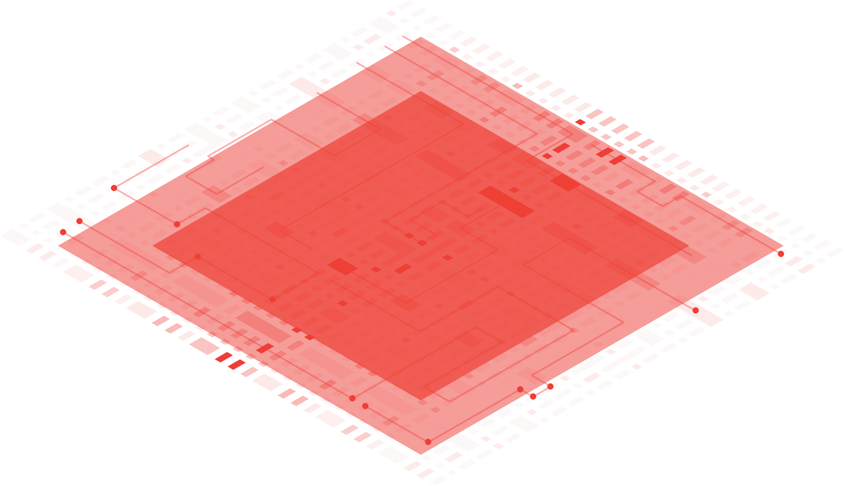
About me
OCM (Oracle Certified Master)
OCE (Oracle Certified SQL Expert)
Oracle ACE
@oradeto | E: dejan@oracon.at
Running two companies in Vienna, Austria:
  ORACON GmbH
  Finee GmbH (Co-founder)
Customers:
  Raiffeisen Bank
  Erste Bank
  Deutsche Bank
  Allianz
  Blackrock
  Goldman Sachs
  etc.
→ Agenda

Slide 3
Agenda
Why? (10 minutes)
Introduction to Hybrid Partitioning & Hybrid Storage (15-20 minutes)
Benefits of Hybrid Partitioning (5 minutes)
Gotchas & Restrictions (5 minutes)
Questions & Answers (no time! ;-))
→ Why? DB Size

Slide 4
Why? DB size
Database growth not scalable, size increasing ca. 25% yearly!
Daily new data loads
A lot of tables partitioned by date/timestamp
Data Size Used space Free space
---------- ---------- -----------
33 TB 32 TB 1 TB
→ Why? DB size query

Slide 5
Why? DB size
select allocated_storage as “Allocated storage in GB”,
allocated_storage
* 0.0805 /* Price GB/month */
* 12 /* multiplied by 12 months */
* 4 /* 4 envs: Prod, Standby, UAT and DEV */
as "Total cost in EUR/year“,
allocated_storage
* 0.0805 * 12 * 4
* 1.25 /* one more year: estimated growth by 25% */
as “Total cost in EUR/year next year"
from (
select round(sum(space_used.bytes) /1024/1024/1024)
as allocated_storage /* Allocated storage on
Exadata Storage Cells; in GBytes */
from
(select bytes from v$datafile
union all
select bytes from v$tempfile
union all
select bytes from v$log) space_used
);
Alllocated storage in GB
------------------------
36.987
Total cost in EUR/year
----------------------
142.917
Total cost in EUR/year next year
--------------------------------
178.647
→ Why? Storage costs

Slide 6
Why? Storage costs
Storage size increasing linearly with the database growth
4 environments: Production, Standby, UAT & DEV
Exadata storage cells + backup tapes
Fileshares (CIFS, ZFS, NFS) for source import files and export files/dumps (ZIP, CSV, DP Dumps)
→ Why? Backup time & size

Slide 7
Why? Backup time & size
Backup time & size increasing linearly with the database growth
Operational risk: Big impact on the whole infrastructure (Network, CPU, storage drives)
Backup costs increasing
RTO (Recovery Time Objective) increasing linearly with the database growth
Operational risk: SLA violated
Btw. you should review your SLA & RTO!
→ Why? AVG Backup time

Slide 8
Why? Backup time
SELECT INPUT_TYPE as "Backup Type",
round(avg( ELAPSED_SECONDS/60))
as “Average backup duration in minutes”
FROM V$RMAN_BACKUP_JOB_DETAILS
where start_time > add_months(sysdate, -1)
group by input_type;
Backup Type Average backup duration in minutes
------------- ----------------------------------
ARCHIVELOG 24
DB INCR 207
→ Why? MAX Backup time

Slide 9
Why? Backup time
SELECT INPUT_TYPE as "Backup Type",
round(max( ELAPSED_SECONDS/60))
as “Max. backup duration in minutes”
FROM V$RMAN_BACKUP_JOB_DETAILS
where start_time > add_months(sysdate, -1)
group by input_type;
Backup Type Max. backup duration in minutes
------------- -------------------------------
ARCHIVELOG 99
DB INCR 478
→ Why? Backup size

Slide 10
Why? Backup size
select min_checkpoint_time as "Start time",
max_checkpoint_time as "End Time",
input_bytes_display as "Bytes read from the database",
output_bytes_display as "Bytes written to backup storage"
from V$BACKUP_DATAFILE_SUMMARY;
Start time End time Bytes read from the DB Bytes written to the backup storage
---------- ---------- ---------------------- -----------------------------------
25.02.2022 08.04.2022 2.08P 96.75T
select to_char(start_time, 'ww') as "Week No",
to_char(round(sum(bytes)/1024/1024/1024/1024)) "TBytes per week"
from V$BACKUP_PIECE_DETAILS
group by to_char(start_time, 'ww')
order by to_char(start_time, 'ww’);
Week No Tbytes per week
-------- ----------------
08 5
09 20
10 11
11 21
12 11
13 22
14 6
→ Why? Cloning

Slide 11
Why? Cloning
Cloning time & size increasing linearly with the database growth
Current cloning duration is ca. 10 hours
Development & deployment delays: developers & testers have to wait longer for a database if cloning fails
→ And what now?

Slide 12
And what now?
?
→ Hybrid partitioning: In & Ex data storage

Slide 13




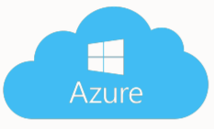

Hybrid Partitioning: Internal & External data storage
Access to external partitions supports all existing table types and the following access drivers:
ORACLE_LOADER, ORACLE_DATAPUMP, ORACLE_HDFS, ORACLE_HIVE, and ORACLE_BIGDATA.
→ Hybrid Partitioning: Lifecycle

Slide 14

Hybrid Partitioning: Lifecycle
Dumpfile compressed + checksum calculated
2021
01
02
03
04
05
06
07
08
09
10
11
12
2022
01
02
03
04
05
06
07
08
09
10
11
12
2023
01
02
03
04
05
06
07
08
09
10
11
12
01.01.2021
01.01.2021
02.01.2021
03.01.2021
04.01.2021
… after 1 year …
29.12.2021
30.12.2021
31.12.2021
31.12.2021
→ Hadoop feat. Oracle DB

Slide 15
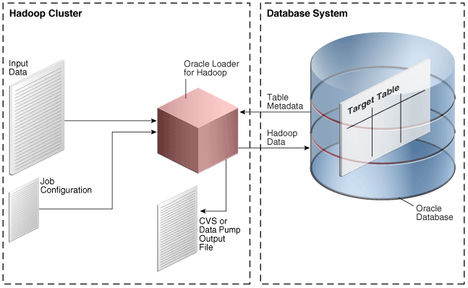
Hybrid Partitioning: Hadoop feat. Oracle DB
→ Hybrid Partitioning: Cloud Object Stores

Slide 16
Hybrid Partitioning: Cloud Object Stores
Since 19c data in object store can be stored and accessed in:
Oracle Object Store
Azure Blob Storage
Google cloud Storage
Amazon S3-Compatible
Access using explicit authentication or pre-authenticated URIs.
CREATE TABLE orders ( order_id number, order_date DATE, … )
EXTERNAL PARTITION ATTRIBUTES
( TYPE oracle_datapump DEFAULT DIRECTORY data_dir
ACCESS PARAMETERS (
CREDENTIAL 'CLOUD_CREDENTIAL')
) REJECT LIMIT unlimited
PARTITION BY RANGE(order_date)
( partition q1_2015 values less than (‘2015-04-01’)
LOCATION ('https://swiftobjectstorage.eu_frankfurt-1/EAM/WM/2021/WM20150401.dmp'),
partition q2_2015 values less than (‘2015-07-01’)
LOCATION (‘...’),
partition q3_2015 values less than (‘2015-10-01’)
LOCATION (‘...’),
partition q4_2015 values less than (‘2016-01-01’)
);
→ Hybrid Partitioning: On-Premises

Slide 17
Hybrid Partitioning: On-premises
CREATE TABLE app_schema.SOME_TABLE
(
LOAD_DTS TIMESTAMP(6) NOT NULL,
ISIN VARCHAR2(12 CHAR),
…
VALUE VARCHAR2(4000 CHAR)
)
PARTITION BY LIST (LOAD_DTS)
(
PARTITION P0 VALUES (TO_TIMESTAMP('13.02.2021 21:15:18,002698', 'DD.MM.YYYY HH24:MI:SS,FF'))
);
CREATE OR REPLACE DIRECTORY HYPA_202102 AS '/path/to/ZFS/2021/02';
GRANT READ, WRITE, EXECUTE ON DIRECTORY HYPA_202102 TO app_schema;
ALTER TABLE SOME_TABLE
ADD EXTERNAL PARTITION ATTRIBUTES
(TYPE ORACLE_DATAPUMP
DEFAULT DIRECTORY HYPA_202102
ACCESS PARAMETERS (
FIELDS TERMINATED BY ';'
(LOAD_DTS, ISIN,…, VALUE)
)
);
→ Hybrid Partitioning: On-Premises

Slide 18
Hybrid Partitioning: On-premises
CREATE OR REPLACE DIRECTORY HYPA_202102 AS '/path/to/ZFS/2021/02';
GRANT READ, WRITE, EXECUTE ON DIRECTORY HYPA_202102 TO app_schema;
CREATE TABLE app_schema.SOME_TABLE
(
LOAD_DTS TIMESTAMP(6) NOT NULL,
ISIN VARCHAR2(12 CHAR),
…
VALUE VARCHAR2(4000 CHAR)
)
EXTERNAL PARTITION ATTRIBUTES
(
TYPE oracle_datapump
DEFAULT DIRECTORY HYPA_202102
)
PARTITION BY LIST (LOAD_DTS)
(
PARTITION P0 VALUES (TO_TIMESTAMP('13.02.2021 21:15:18,002698', 'DD.MM.YYYY HH24:MI:SS,FF'))
);
→ Hybrid Partitioning: On-Premises

Slide 19
Hybrid Partitioning: On-premises
alter table some_table modify partition p0 read only;
create table app_schema.hypa_20210213
organization external
(
type oracle_datapump
default directory HYPA_202102
location ('hypa_20210213.dmp')
)
as
select *
from SOME_TABLE
WHERE load_dts = TO_TIMESTAMP('13.02.2021 21:15:18,002698', 'DD.MM.YYYY HH24:MI:SS,FF');
alter table app_schema.SOME_TABLE drop partition for (TO_TIMESTAMP('13.02.2021 21:15:18,002698', 'DD.MM.YYYY HH24:MI:SS,FF'));
alter table app_schema.SOME_TABLE
add partition p20210213
VALUES (TO_TIMESTAMP('13.02.2021 21:15:18,002698', 'DD.MM.YYYY HH24:MI:SS,FF'))
EXTERNAL DEFAULT DIRECTORY HYPA_202102 LOCATION ('hypa_20210213.dmp');
drop table app_schema.hypa_20210213;
→ Hybrid Partitioning: Oracle Cloud

Slide 20
Hybrid Partitioning: Oracle Cloud
SQL> SET DEFINE OFF -- to disable the "&" if contained within the password
SQL> BEGIN
DBMS_CLOUD.CREATE_CREDENTIAL(
credential_name => 'HYPART_CRED',
username => 'dejan@oracon.at',
password => 'hyp:XyZ123+&90a(!sl’
);
END;
/
SQL> alter database property set default_credential = 'ORACON.HYPART_CRED';
SQL> select owner, credential_name, enabled
from dba_credentials
where credential_name = 'HYPART_CRED';
OWNER CREDENTIAL_NAME ENABLED
---------- -------------------- -------------------
ORACON HYPART_CRED TRUE
→ Hybrid Partitioning: Oracle Cloud

Slide 21
Hybrid Partitioning: Oracle Cloud
SQL> BEGIN
DBMS_CLOUD.CREATE_HYBRID_PART_TABLE(
table_name => 'HYBRID_PART_TAB',
credential_name => 'HYPART_CRED',
format => json_object('type' VALUE DBMS_CLOUD.FORMAT_TYPE_DATAPUMP),
--format => json_object('type' VALUE 'CSV'),
column_list => 'load_date date, account_id number, account_name varchar2(64)',
partitioning_clause => q'[partition by list (load_date)
( partition p20211001 (TO_DATE('01.10.2021', 'DD.MM.YYYY HH24:MI:SS,FF')),
partition p20211002 (TO_DATE('02.10.2021', 'DD.MM.YYYY HH24:MI:SS,FF')),
partition p20211003 (TO_DATE('03.10.2021', 'DD.MM.YYYY HH24:MI:SS,FF'))
)]'
);
END;
/
-- validate hybrid partitioned table
SQL> execute DBMS_CLOUD.VALIDATE_EXTERNAL_TABLE (table_name => 'HYBRID_PART_TAB');
→ Hybrid Partitioning: Oracle Cloud

Slide 22
Hybrid Partitioning: Oracle Cloud
-- query dba_tables
SQL> select hybrid from dba_tables where owner = 'ORACON' and table_name = 'HYBRID_PART_TAB';
HYBRID
----------
YES
alter table some_table modify partition p20211001 read only;
-- export some partition
SQL> BEGIN
DBMS_CLOUD.EXPORT_DATA(
credential_name => 'HYPART_CRED',
file_uri_list => 'https://objectstorage.eu-frankfurt- 1.oraclecloud.com/n/oracon/b/ext_parts/o/demoacc20211001.dmp',
format => json_object('type' value 'datapump'),
query => q'[select * from HYBRID_PART_TAB where load_date = TO_DATE('01.10.2021', 'DD.MM.YYYY')]’
);
END;
/
→ Hybrid Partitioning: Oracle Cloud

Slide 23
Hybrid Partitioning: Oracle Cloud
alter table ORACON.HYBRID_PART_TAB drop partition for (to_date('01.10.2021','DD.MM.YYYY’));
alter table ORACON.HYBRID_PART_TAB add partition p20211001 VALUES (TO_DATE('01.10.2021', 'DD.MM.YYYY'))
LOCATION ('https://objectstorage.eu-frankfurt- 1.oraclecloud.com/n/oracon/b/ext_parts/o/demoacc20211001.dmp');
-- list the partitions
SQL> select partition_name, tablespace_name,
case read_only when 'YES' then 'external' else 'internal' end
AS partition_type
from dba_tab_partitions
where table_owner = 'ORACON' and table_name = 'HYBRID_PART_TAB'
order by partition_name;
PARTITION_NAME TABLESPACE_NAME PARTITION_TYPE
--------------- --------------- --------------------
P20211001 SYSTEM external
P2 DATA internal
P3 DATA internal
→ Hybrid Partitioning: Supported operations

Slide 24
Hybrid Partitioning: Supported operations
The following are operations supported on hybrid partitioned tables.
Creating single level RANGE and LIST partitioning methods
Using ALTER TABLE .. DDLs such as ADD, DROP, and RENAME partitions
Modifying for external partitions the location of the external data sources at the partition level
Altering an existing partitioned internal table to a hybrid partitioned table containing both internal and external partitions
Changing the existing location to an empty location resulting in an empty external partition
Creating global partial non-unique indexes on internal partitions
Creating materialized views on internal partitions
Creating materialized views that include external partitions in QUERY_REWRITE_INTEGRITY stale tolerated mode only
Full partition wise refreshing on external partitions
DML trigger operations on a hybrid partitioned table on internal partitions
Validating with ANALYZE TABLE ... VALIDATE STRUCTURE on internal partitions only in hybrid partitioned tables
Altering an existing hybrid partitioned table with no external partitions to a partitioned table with internal partitions only
An external partition can be exchanged with an external nonpartitioned table. Also, an internal partition can be exchanged with an internal nonpartitioned table.
→ Benefits

Slide 25
Benefits
Reducing of database size
  Less storage costs for all Envs: Prod, Standby, UAT & Dev, incl. Backup
  Reducing CPU & I/O -> less impact of database backup & cloning on the whole infrastructure
  Reducing Recovery time -> stable SLA
  Reducing Cloning time -> less delays
  Data Archiving + Read only dump files
→ Benefits: DB size

Slide 26
Benefits: DB size
select allocated_storage as “Allocated storage in GB”,
allocated_storage
* 0.0805 /* Price GB/month */
* 12 /* multiplied by 12 months */
* 4 /* 4 envs: Prod, Standby, UAT and DEV */
as "Total cost in EUR/year“,
allocated_storage
* 0.0805 * 12 * 4
* 1.05 /* one more year: estimated growth by 5% */
as “Total cost in EUR/year next year"
from (
select round(sum(space_used.bytes) /1024/1024/1024)
as allocated_storage /* Allocated storage on
Exadata Storage Cells; in GBytes */
from
(select bytes from v$datafile
union all
select bytes from v$tempfile
union all
select bytes from v$log) space_used
);
Alllocated storage in GB
------------------------
12.964
Total cost in EUR/year
----------------------
50.092
Total cost in EUR/year next year
--------------------------------
52.596
→ Benefits: AVG Backup time

Slide 27
Benefits: Backup time
SELECT INPUT_TYPE as "Backup Type",
round(avg( ELAPSED_SECONDS/60))
as “Average backup duration in minutes”
FROM V$RMAN_BACKUP_JOB_DETAILS
where start_time > add_months(sysdate, -1)
group by input_type;
Backup Type Average backup duration in minutes
------------- ----------------------------------
ARCHIVELOG 24
DB INCR 67
→ Benefits: MAX Backup time

Slide 28
Benefits: Backup time
SELECT INPUT_TYPE as "Backup Type",
round(max( ELAPSED_SECONDS/60))
as “Max. backup duration in minutes”
FROM V$RMAN_BACKUP_JOB_DETAILS
where start_time > add_months(sysdate, -1)
group by input_type;
Backup Type Max. backup duration in minutes
------------- -------------------------------
ARCHIVELOG 92
DB INCR 154
Data Size Used space Free space
---------- ---------- -----------
13 TB 11 TB 2 TB
→ Gotchas & restrictions

Slide 29
Gotchas & restrictions
It‘s not a silver bullet!
CIFS (Windows Fileshare) is not supported by DATAPUMP
You have to take care about data validity & uniqueness
You have to precreate directories
You have to check for an existance of partition & dump file
You have to take care about ZFS, especially if you have to clone or restore a database to another server
You have to automatize the whole process
You cannot mix DATAPUMP and LOADER types
Some restrictions (more details on next slide), like no Unique Index
→ Gotchas & restrictions

Slide 30
Gotchas & restrictions
The following are restrictions and limitations on hybrid partitioned tables.
Restrictions that apply to external tables also apply to hybrid partitioned tables unless explicitly noted
No support for REFERENCE and SYSTEM partitioning methods
Only single level LIST and RANGE partitioning are supported.
No unique indexes or global unique indexes. Only partial indexes are allowed, and unique indexes cannot be partial.
Only single level list partitioning is supported for HIVE.
Attribute clustering (CLUSTERING clause) is not allowed.
DML operations only on internal partitions of a hybrid partitioned table (external partitions are treated as read-only partitions)
In-memory defined on the table level only has an effect on internal partitions of the hybrid partitioned table.
No column default value.
Invisible columns are not allowed.
The CELLMEMORY clause is not allowed.
SPLIT, MERGE, and MOVE maintenance operations are not allowed on external partitions.
LOB, LONG, and ADT types are not allowed.
Only RELY constraints are allowed
→ Why? Storage costs

Slide 31

Thanks for
your attention!
Dejan TOPALOVIĆ
Oracle Consultant
ORACON GmbH
+43 650 305 45 45
dejan@oracon.at
https://oracon.at
Questions!?
→ END
Illustration: La Linea, Osvaldo Cavandoli

