Slide 1








QR Code Plug-in a Story of an APEX Plug-in Lifecycle
Zoran Tica

Slide 2

QR Code Plug-in - a Story of an APEX Plug-in Lifecycle

Slide 3



Agenda

Slide 4

Zoran Tica
Slovenia
Independent consultant and contractor
www.zt-tech.eu
Mid 80-ties - started with programming in
Mid 90-ties - Business Analysis, Database and IS Design, Software Development from
From 2000+ Oracle Technologies
OCP Advanced PL/SQL, Forms and Java SE developer
https://www.linkedin.com/in/zoran-tica/

Slide 5









A network of experts...

Slide 6

A little bit of History...

Slide 7

A little bit of History...
Synonyms add-in, add-on
Wikipedia: “A software component that adds a specific feature to an existing computer program”
mid 1970-ties (EDT text editor)
Oracle APEX Plug-ins introduced
in version 4.0 (June 2010)
??????????????????????????????????????

Slide 8

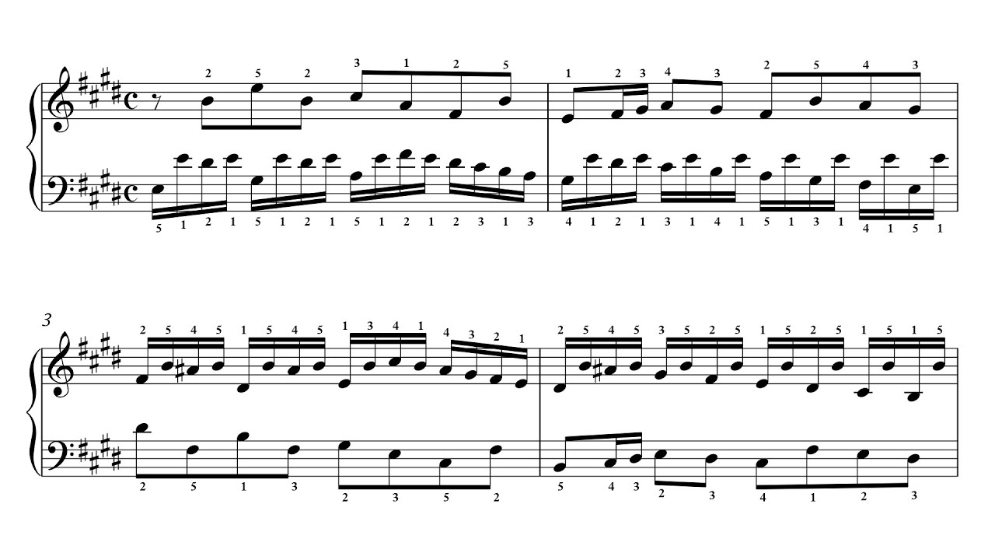
Prelude to QR Code Plug-in

Slide 9


Prelude to QR Code Plug-in
Database package for QR code calculations
APEX Demo app for QR code package usage
https://apex.oracle.com/pls/apex/f?p=zttechdemo

Slide 10
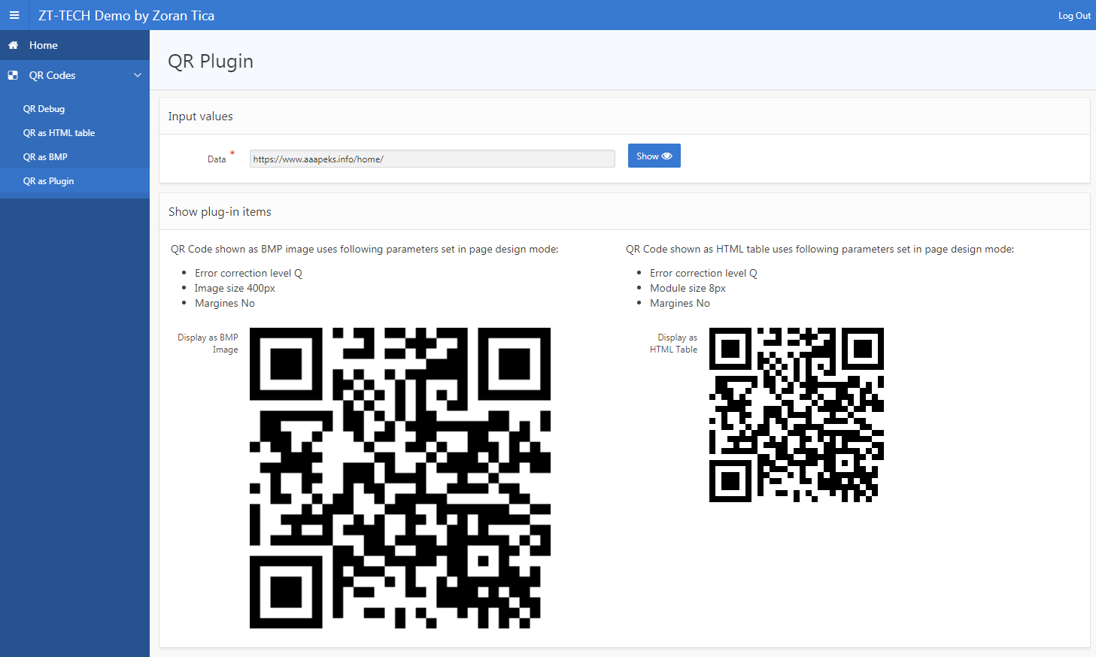
From User Perspective

Slide 11
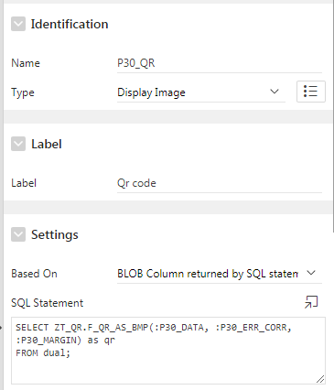
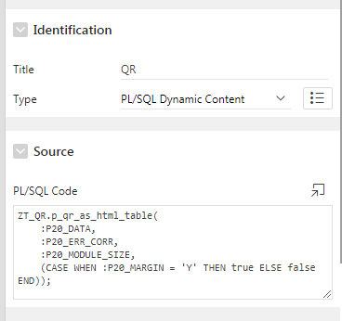
From Developer Perspective
PL/SQL dynamic region which calls database procedure
Image item based on BLOB column
Problems:
developer needs to call functions and procedures directly
change in proc/func parameters reflect through all pages and application(s)

Slide 12

Why?

Slide 13



Why to make a Plug-in?
to provide developers an easy way of new functionality implementation
to add new functionality to APEX applications
to enable re-usability through pages and applications

Slide 14

How?

Slide 15
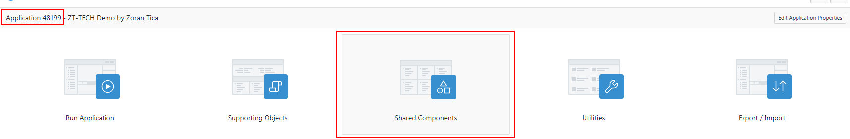
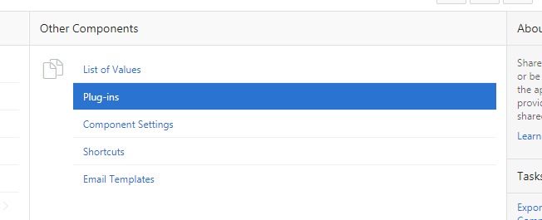
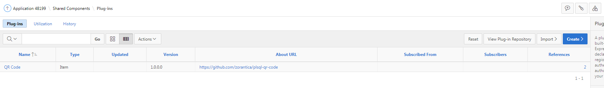
How to use plug-ins in APEX?
1. Import or create plugin

Slide 16
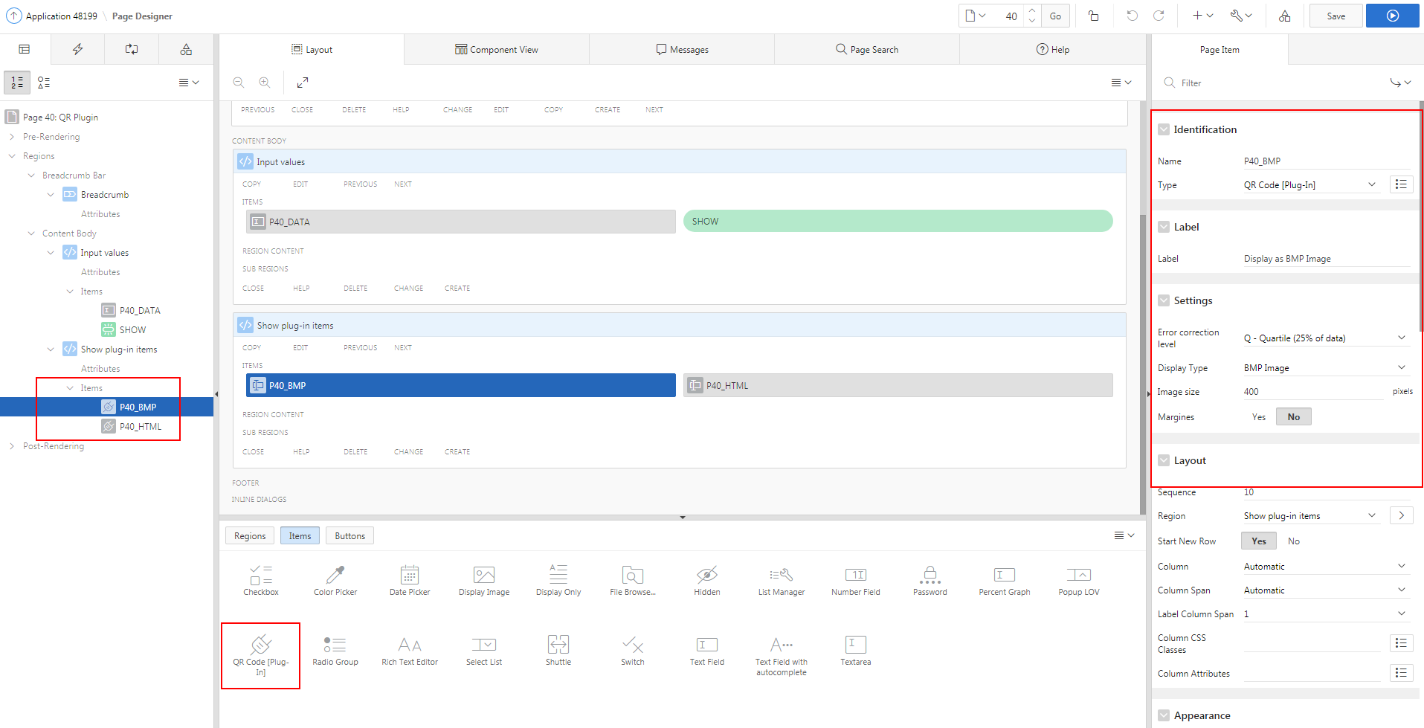
How to use plug-ins in APEX?
2. Use plug-in on pages

Slide 17
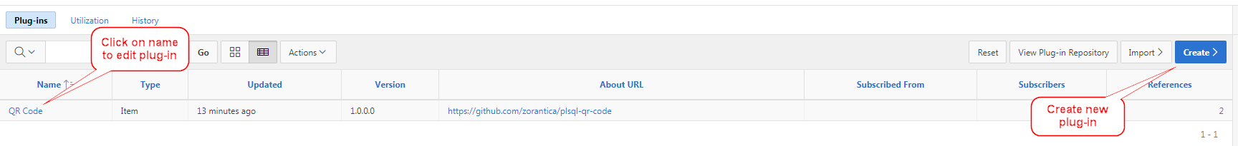
How to edit/create a plug-in?

Slide 18
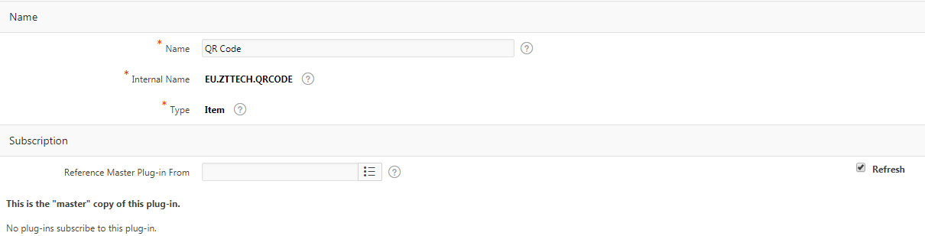
Name and Type
Name is shown in application
Item type and internal name can not be changed later
Internal name should be world-wide unique

Slide 19
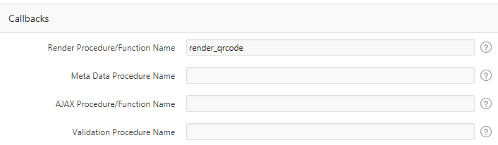
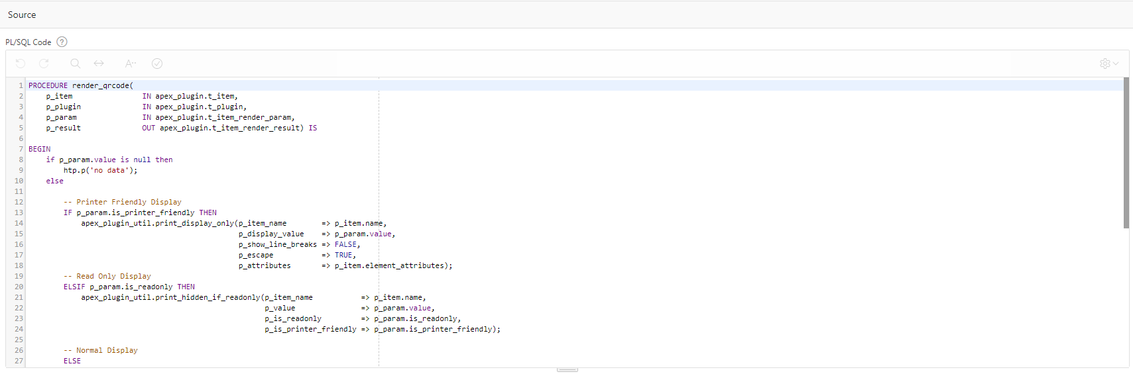
Callbacks and Source

Slide 20
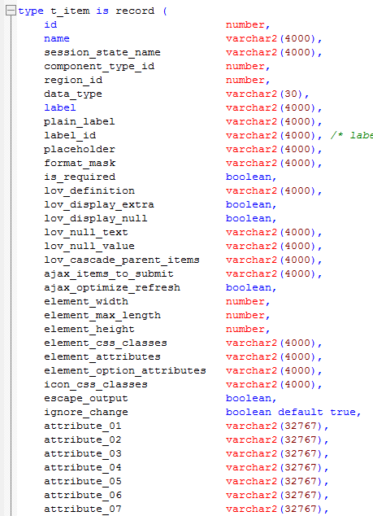
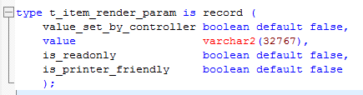

Procedure Parameters Structure
Render and Validate Item Procedure Parameters:
p_item IN apex_plugin.t_item,
p_plugin IN apex_plugin.t_plugin,
p_param IN apex_plugin.t_item_render_param,
p_result OUT apex_plugin.t_item_render_result

Slide 21
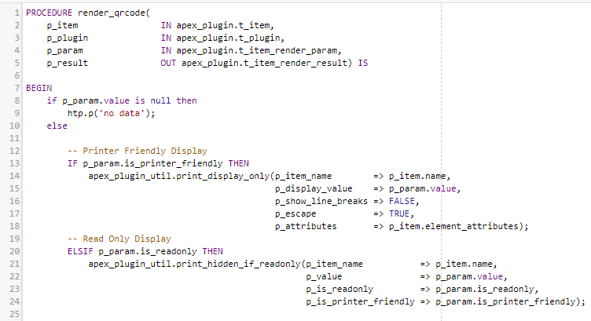
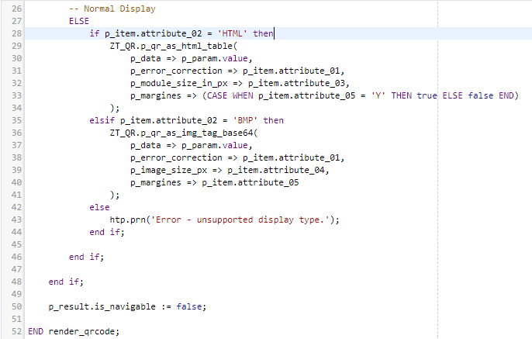
QR Code Render Procedure

Slide 22
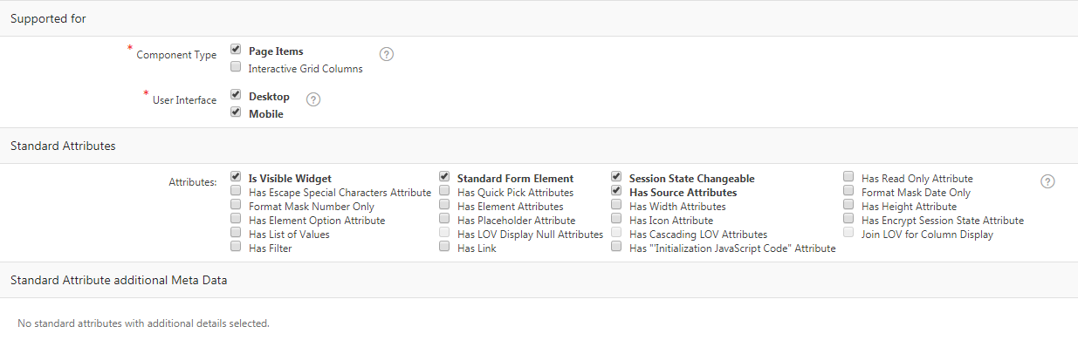
Supported for and St. Attributes

Slide 23
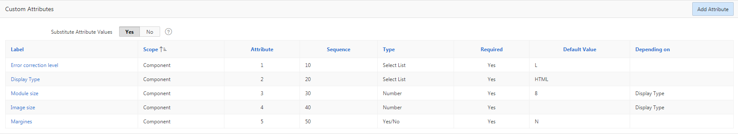
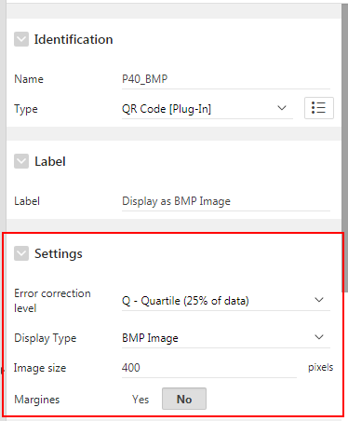
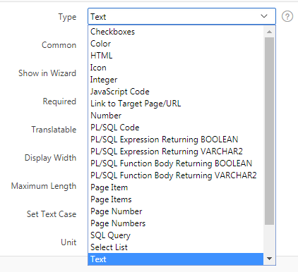
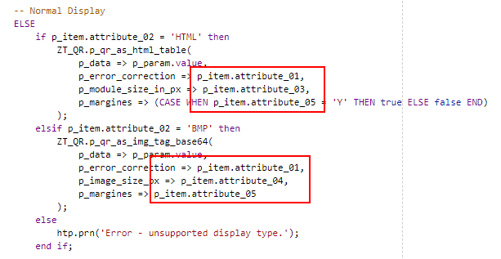
Custom Attributes

Slide 24
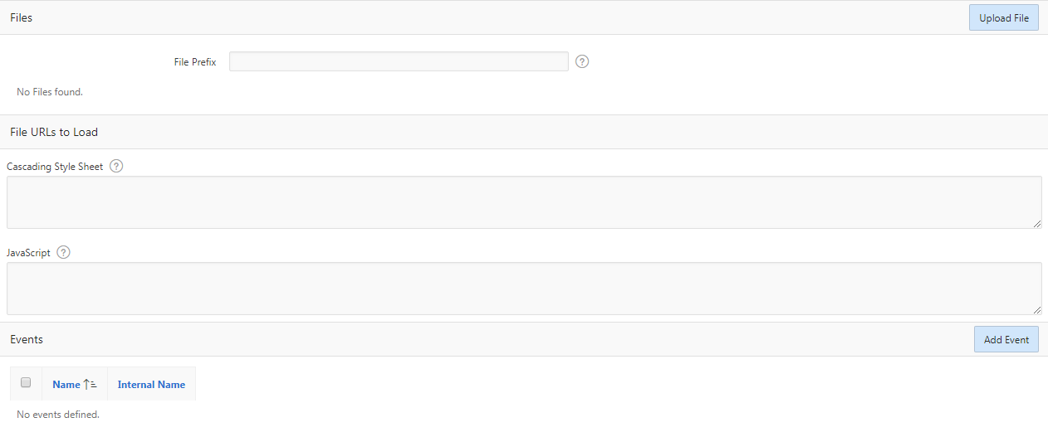
Plug-in Files and Events
References as #PLUGIN_FILES#main.js

Slide 25
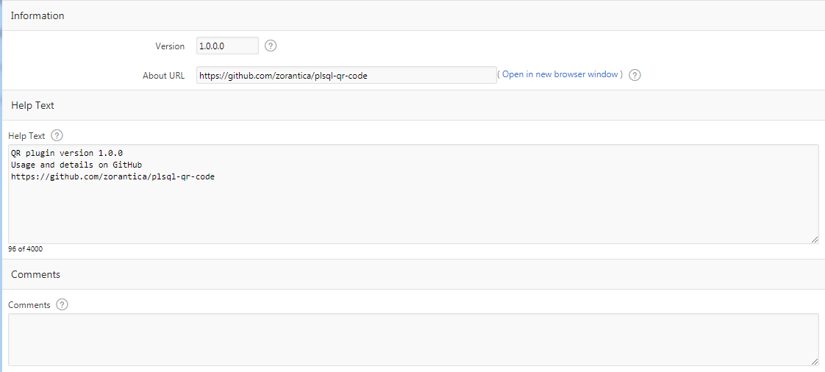
Info, Help and Comments

Slide 26
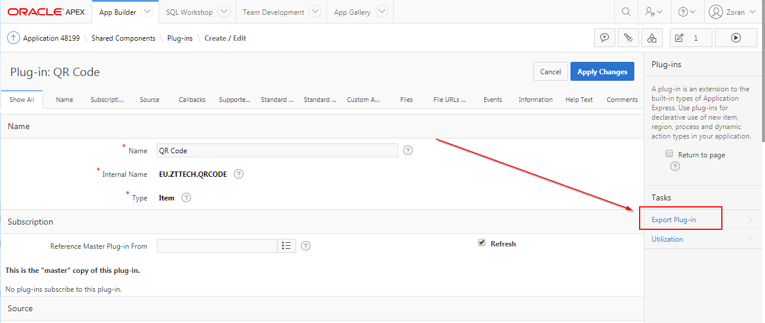
Export Plug-in

Slide 27
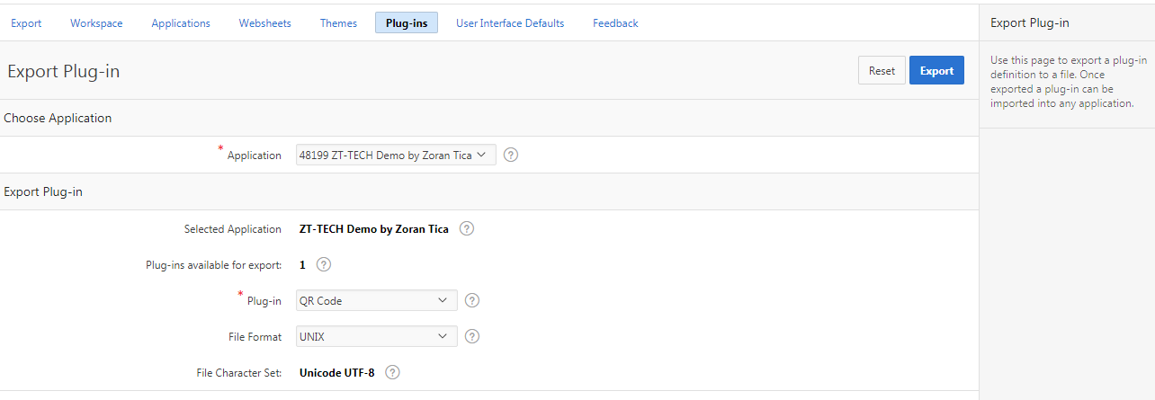
Export Plug-in
item_type_plugin_eu_zttech_qrcode.sql

Slide 28
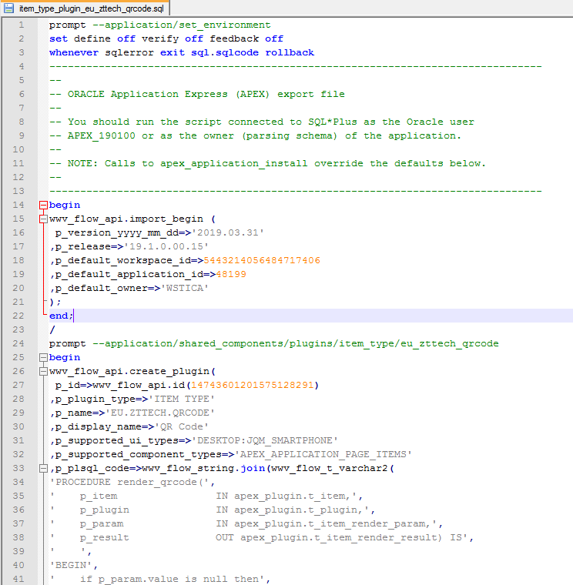
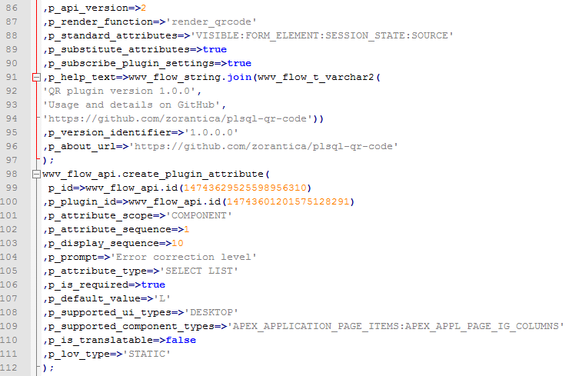
Export Plug-in

Slide 29

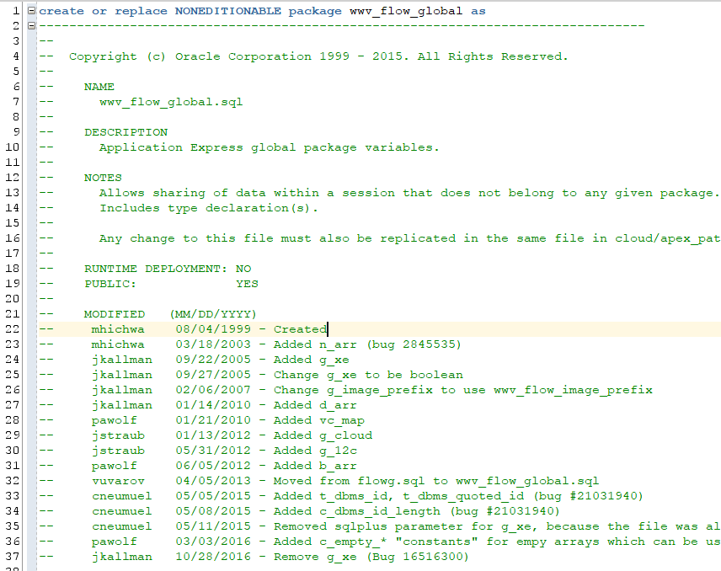

Intermezzo
?
?
?
?
?
?
?

Slide 30

What?

Slide 31



Three options

Slide 32




What to do...
Publish to web page
Publish to GitHub
Publish to apex.world
Publish to apex-plugin.com

Slide 33

Publish to web page
INTERNET
www.zt-tech.eu
developer in search of a plug-in

Slide 34
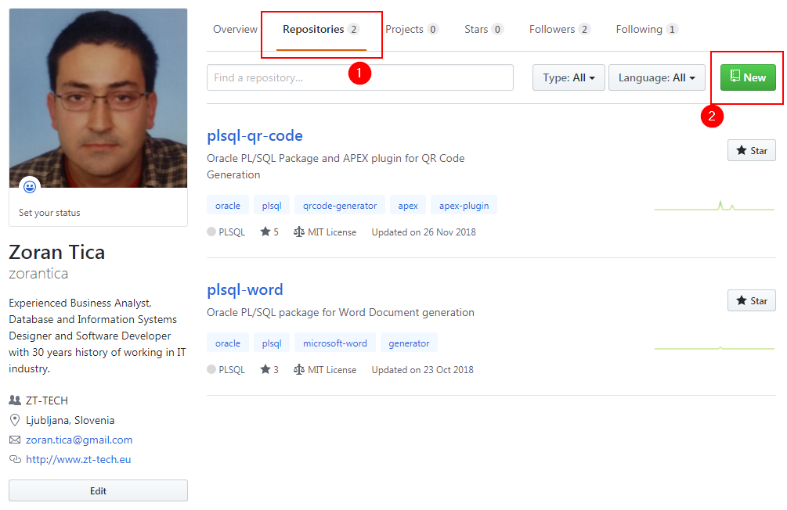
Publish to GitHub
https://github.com/

Slide 35
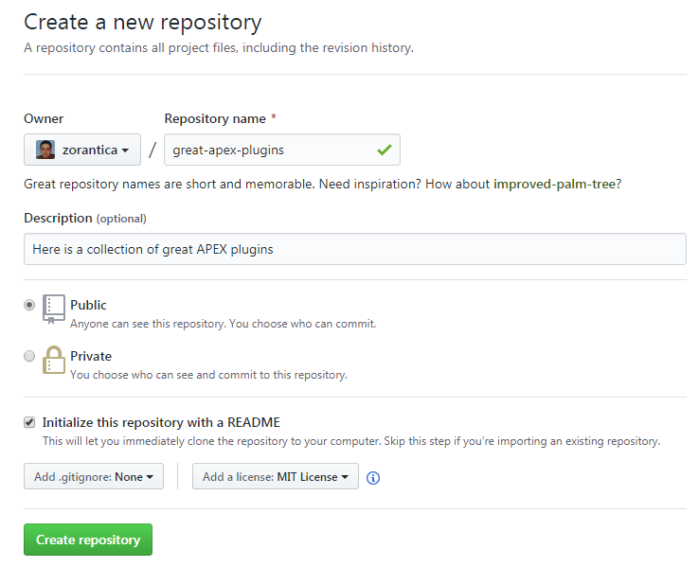
GitHub – New Repository
https://github.com/

Slide 36
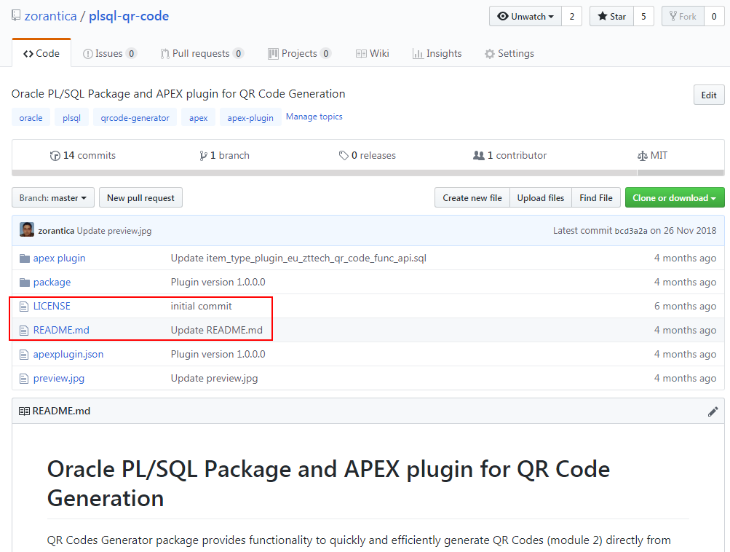
GitHub – QR Code Repository
https://github.com/

Slide 37
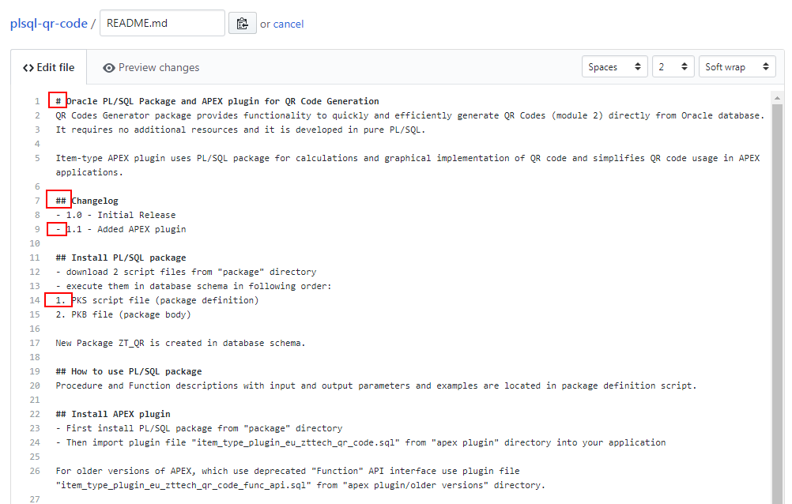
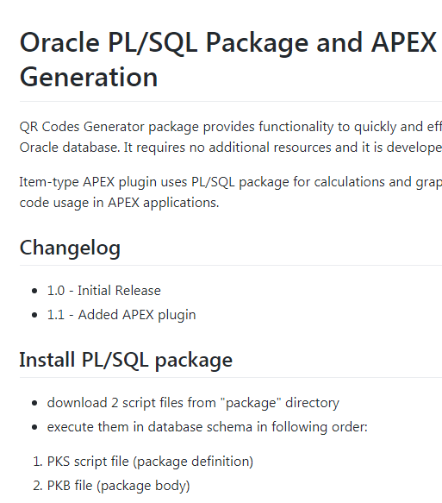
GitHub – Markdown Readme
https://github.com/
https://help.github.com/en/articles/basic-writing-and-formatting-syntax
https://www.makeareadme.com/

Slide 38
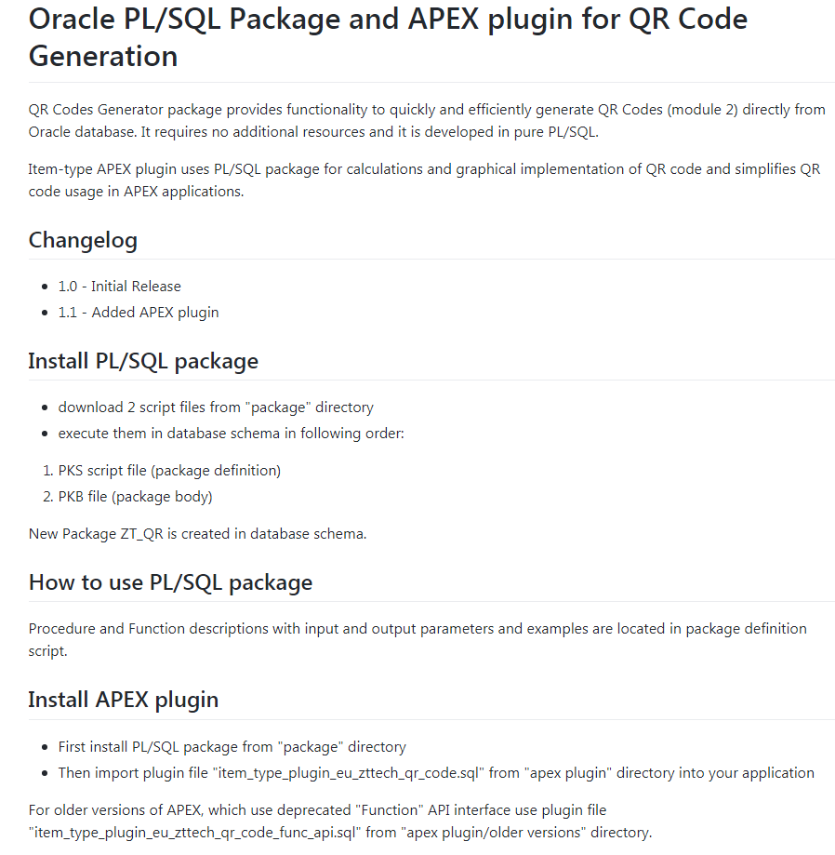
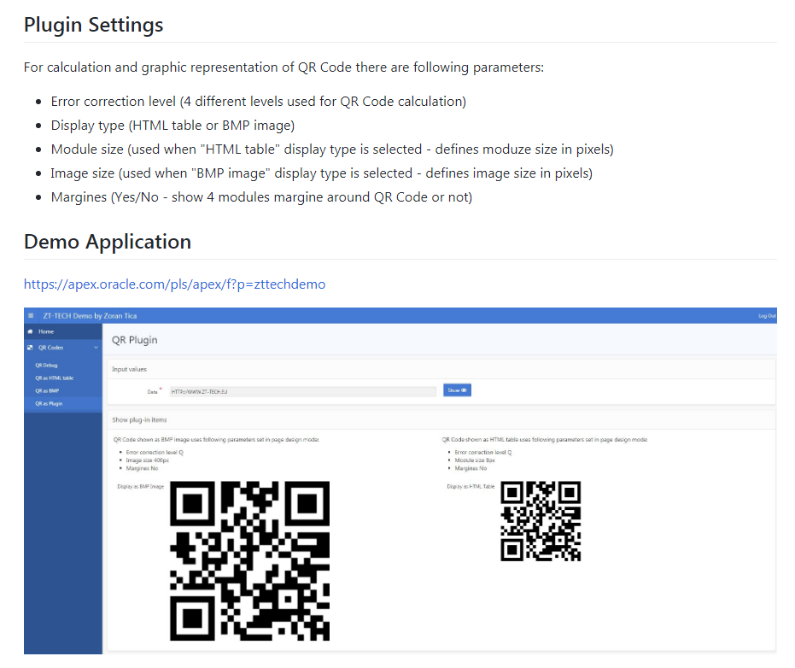
GitHub – Markdown Readme
https://github.com/

Slide 39
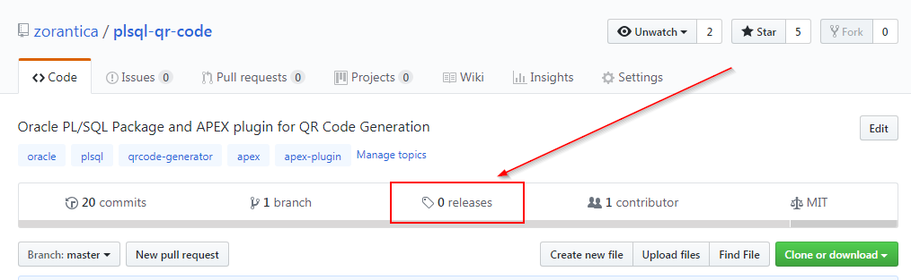
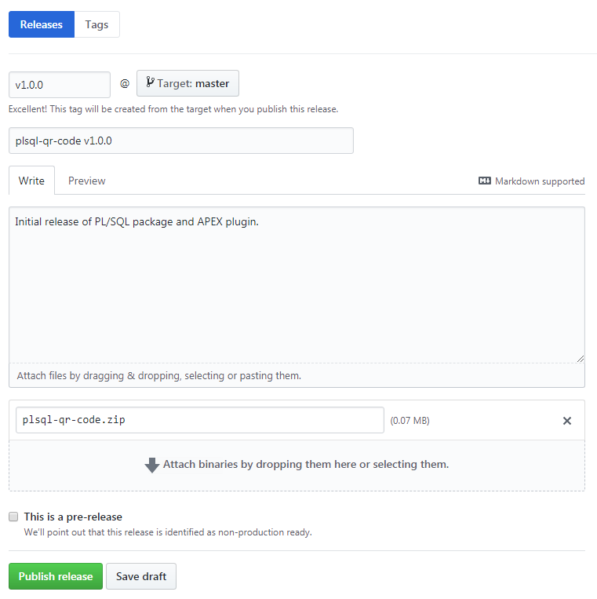
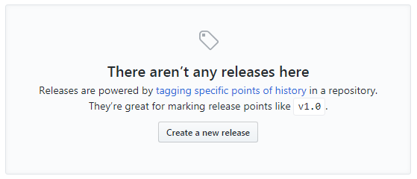
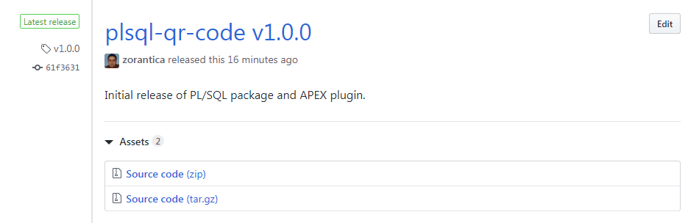
GitHub – Releases
https://github.com/

Slide 40

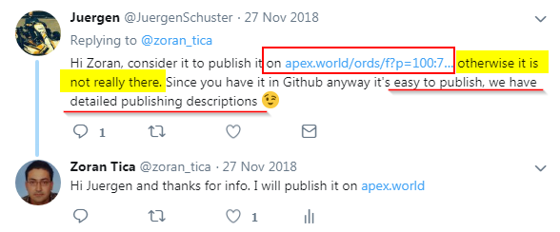
Announcement

Slide 41
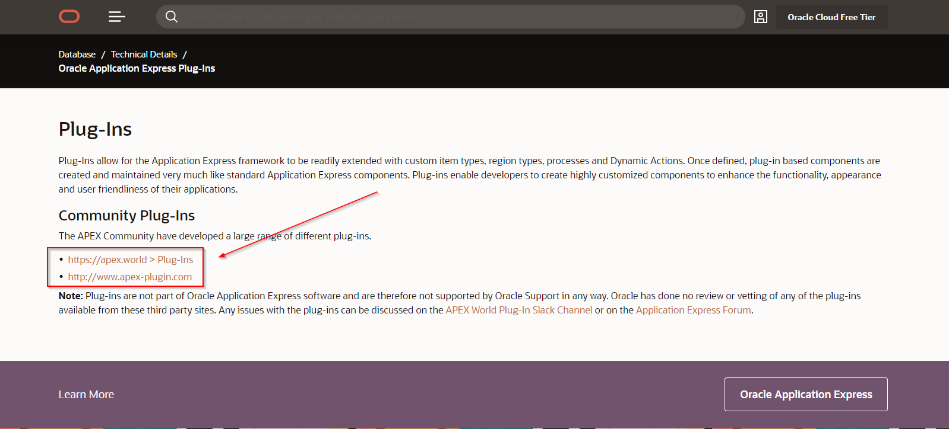
Oracle suggests...
https://www.oracle.com/tools/technologies/apex-plug-ins.html

Slide 42
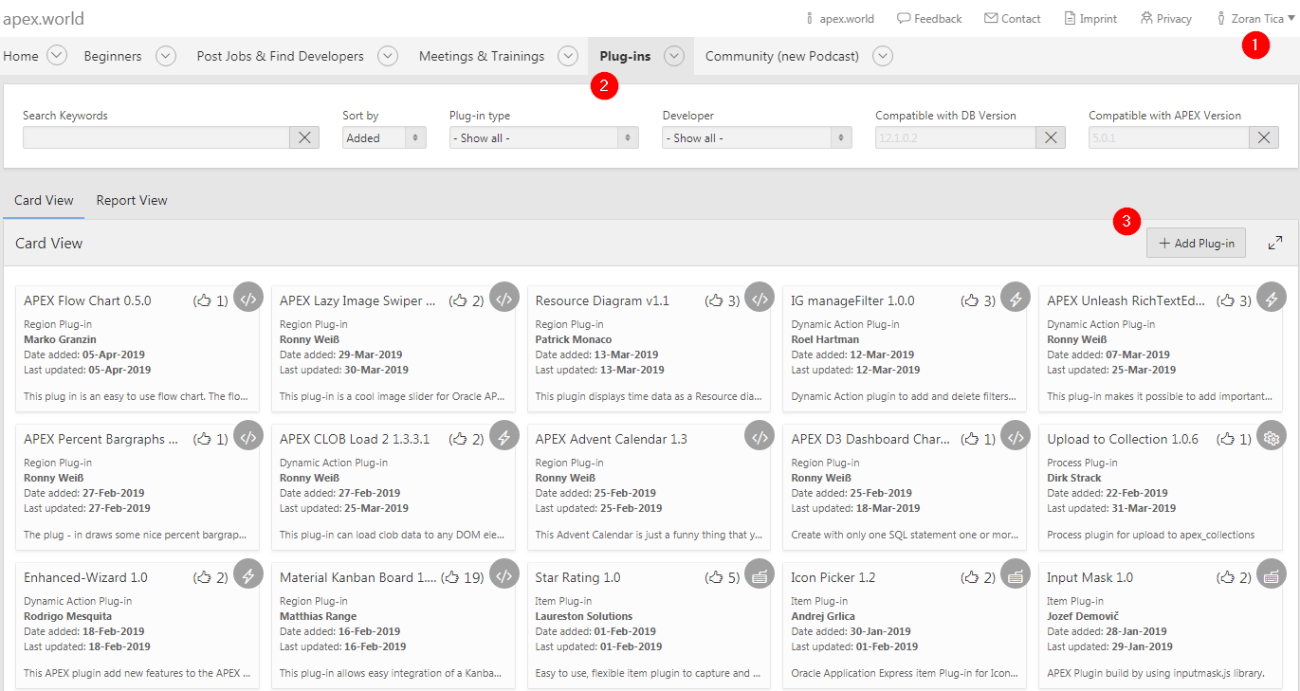
Publish to apex.world
Nice help:
https://apex.world/ords/f?p=100:750:::NO:::

Slide 43
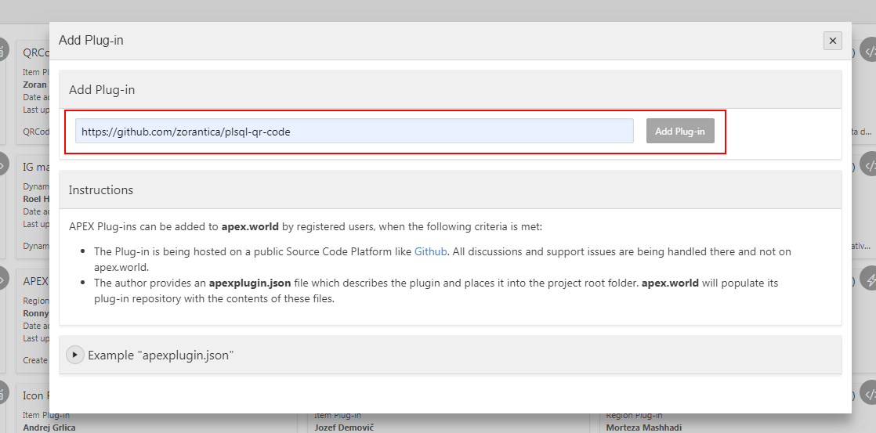
Publish to apex.world
Nice help:
https://apex.world/ords/f?p=100:750:::NO:::
* The author need to make a release in repository – without it a plug-in can not be added

Slide 44
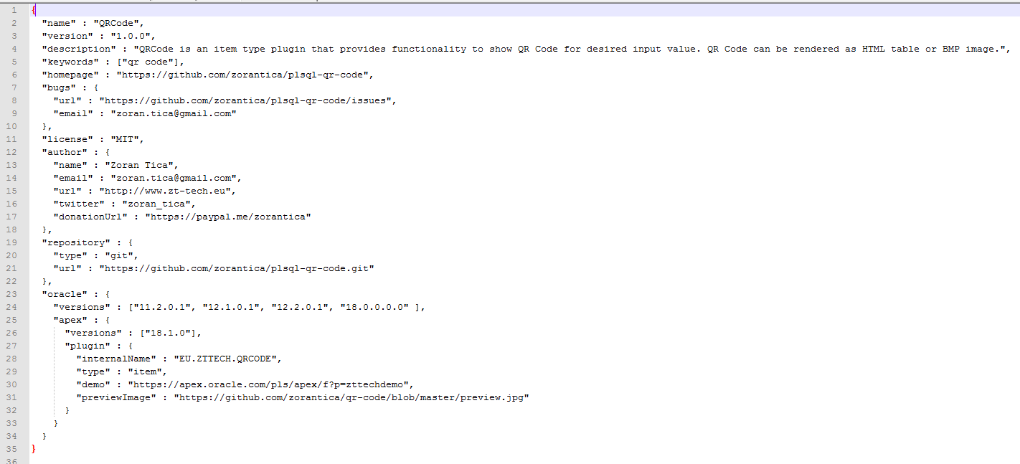
Publish to apex.world
apexplugin.json

Slide 45
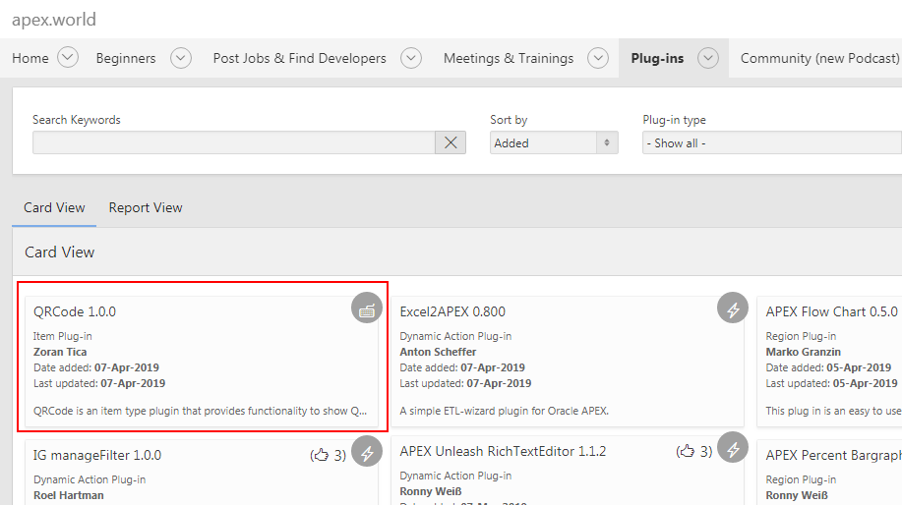
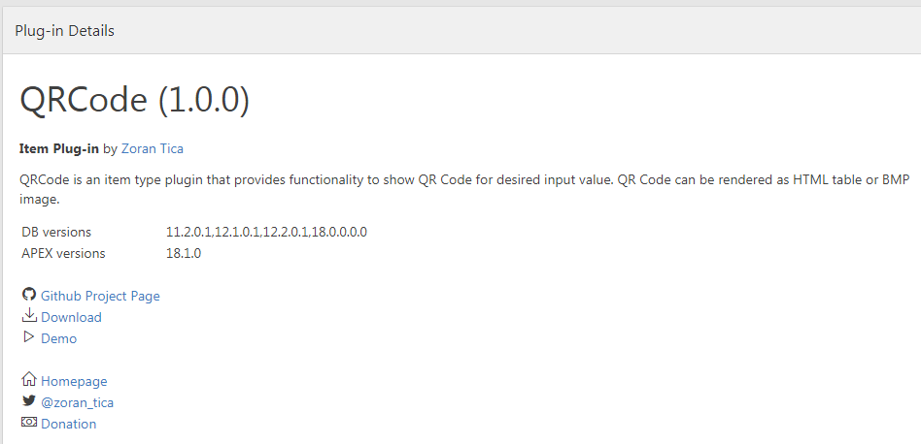
Publish to apex.world

Slide 46
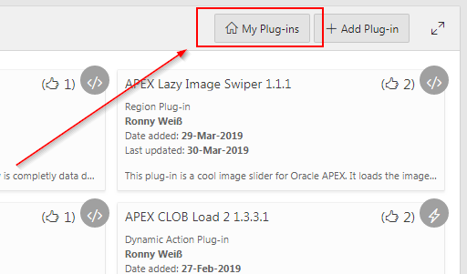
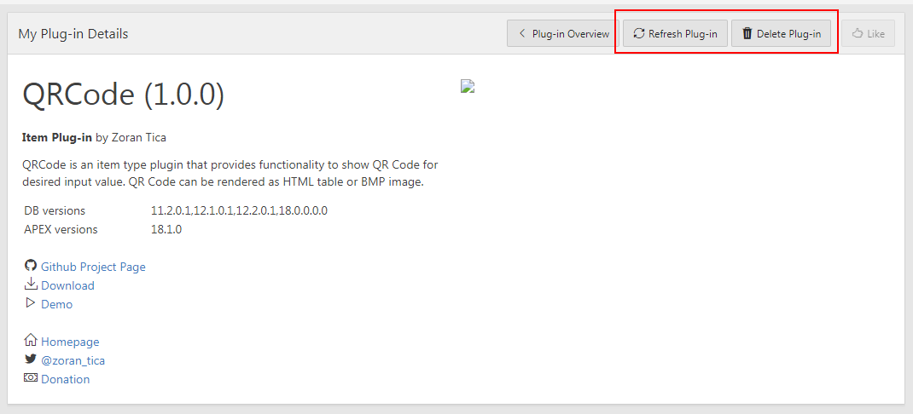
Publish to apex.world
To edit plugin data:
alter JSON document on GitHub
refresh plugin data on apex.world manually or wait until tomorrow (automatic refresh)

Slide 47
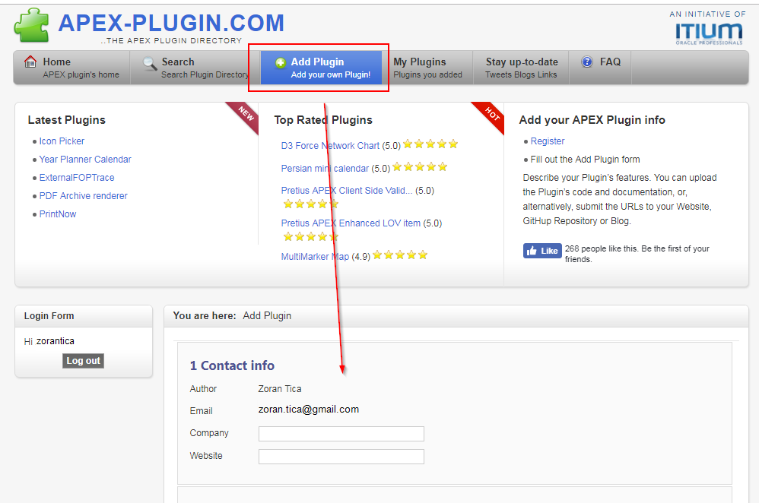
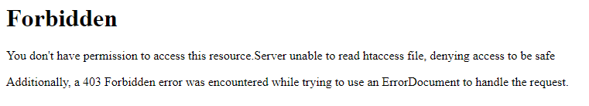
Publish to apex-plugin.com
http://www.apex-plugin.com/

Slide 48


Publish to apex-plugin.com

Slide 49

Publish to apex-plugin.com

Slide 50

Publish to apex-plugin.com

Slide 51

Conclusion

Slide 52
Conclusion
to provide developers an easy way of new functionality implementation
to add new functionality to APEX applications
to enable re-usability through pages and applications

Slide 53
Conclusion
create/edit a plug-in in app shared components
set name, type and unique internal name
define callback functions (render, validate...)
define standard and custom attributes
upload files
enter info, help and comments
export/import
use in pages as any other object (item, region...)

Slide 54

Conclusion
Publish to web page
Publish to GitHub
Publish to apex.world
Publish to apex-plugin.com

Slide 55

Conclusion
Publish to web page
Publish to GitHub
Publish to apex.world
Publish to apex-plugin.com

Slide 56


Slide 57


Slide 58
References
https://en.wikipedia.org/wiki/Oracle_Application_Express
https://github.com
https://apex.world
http://www.apex-plugin.com/
https://www.youtube.com/

