Slide 1
DEVOPS YOUR ORACLE DATABASE WITH LIQUIBASE IN LESS THAN 1 HOUR
Rafał Grzegorczyk
HROUG 2021, 13th October 9:30 am
rgrzegorczyk@pretius.com
@r_grzegorczyk
www.pretius.com

Slide 2
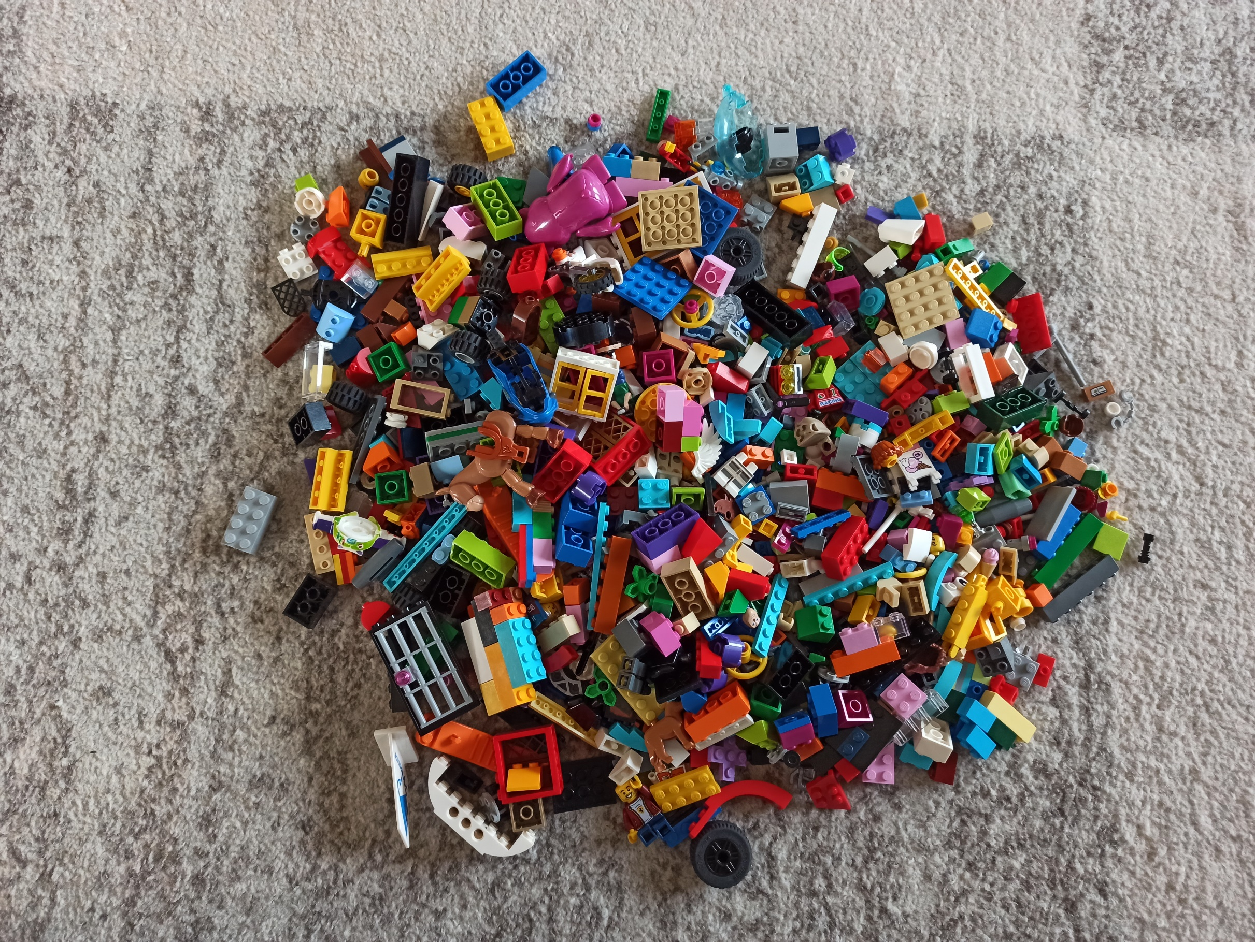
Database deployments scripts?

Slide 3
Open source JAVA based tool
Installation made by my kids ☺ All right reserved ©

Slide 4
Rafał Grzegorczyk
Oracle APEX & PL/SQL Developer
www.pretius.com
rgrzegorczyk@pretius.com
@r_grzegorczyk
linkedin.com/in/rgrzegorczyk

Slide 5
What is Liquibase?
=

Slide 6
What are your benefits?
Full control of database changes
Automated deployments / rollbacks
Code standarization and consistency
Quality releases (more frequent)
More time ☺

Slide 7
Command line
Integrate with
automation tools
SQLcl

Slide 8
How Liquibase works?
changesets
changelogs
tracking table

Slide 9
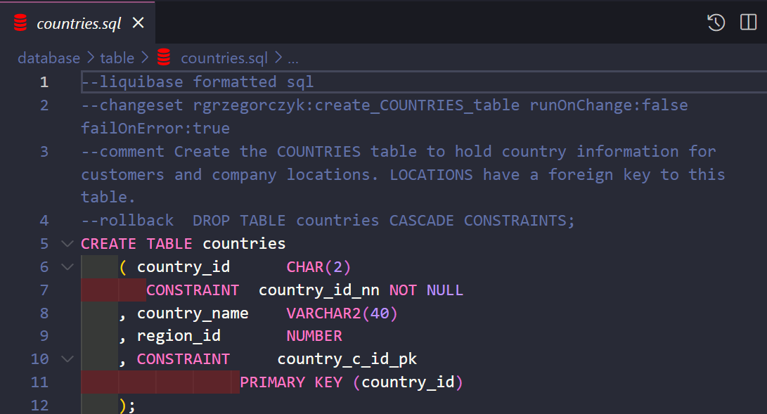
Changeset (unit of change)
single change to your database
uniquely identified by ID, author, directory and filename
XML, SQL, YAML or JSON

Slide 10
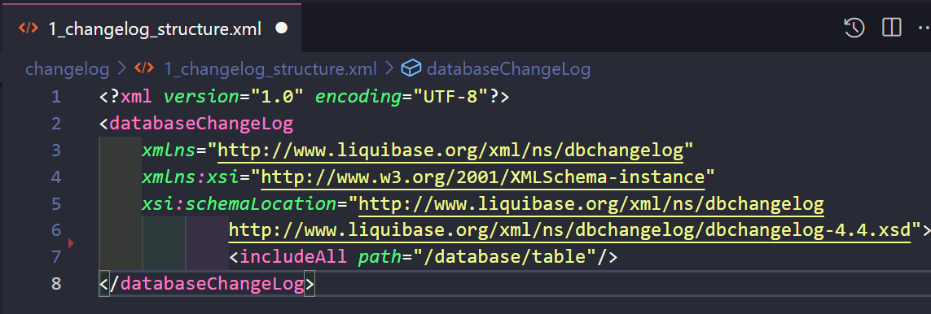
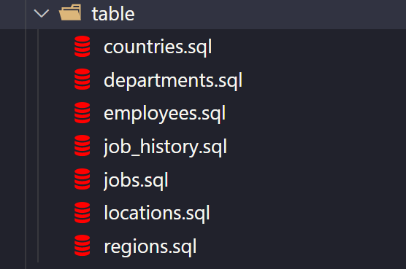
Changelog

Slide 11
DATABASECHANGELOGLOCK - prevent locks
DATABASECHANGELOG – tracking table
You can run only one Liquibase instance at once

Slide 12
Prepare your db objects repository

Slide 13
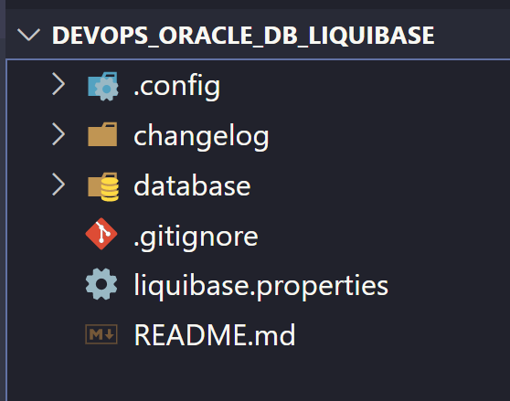
changelog
database objects
properties
Example GIT repository

Slide 14
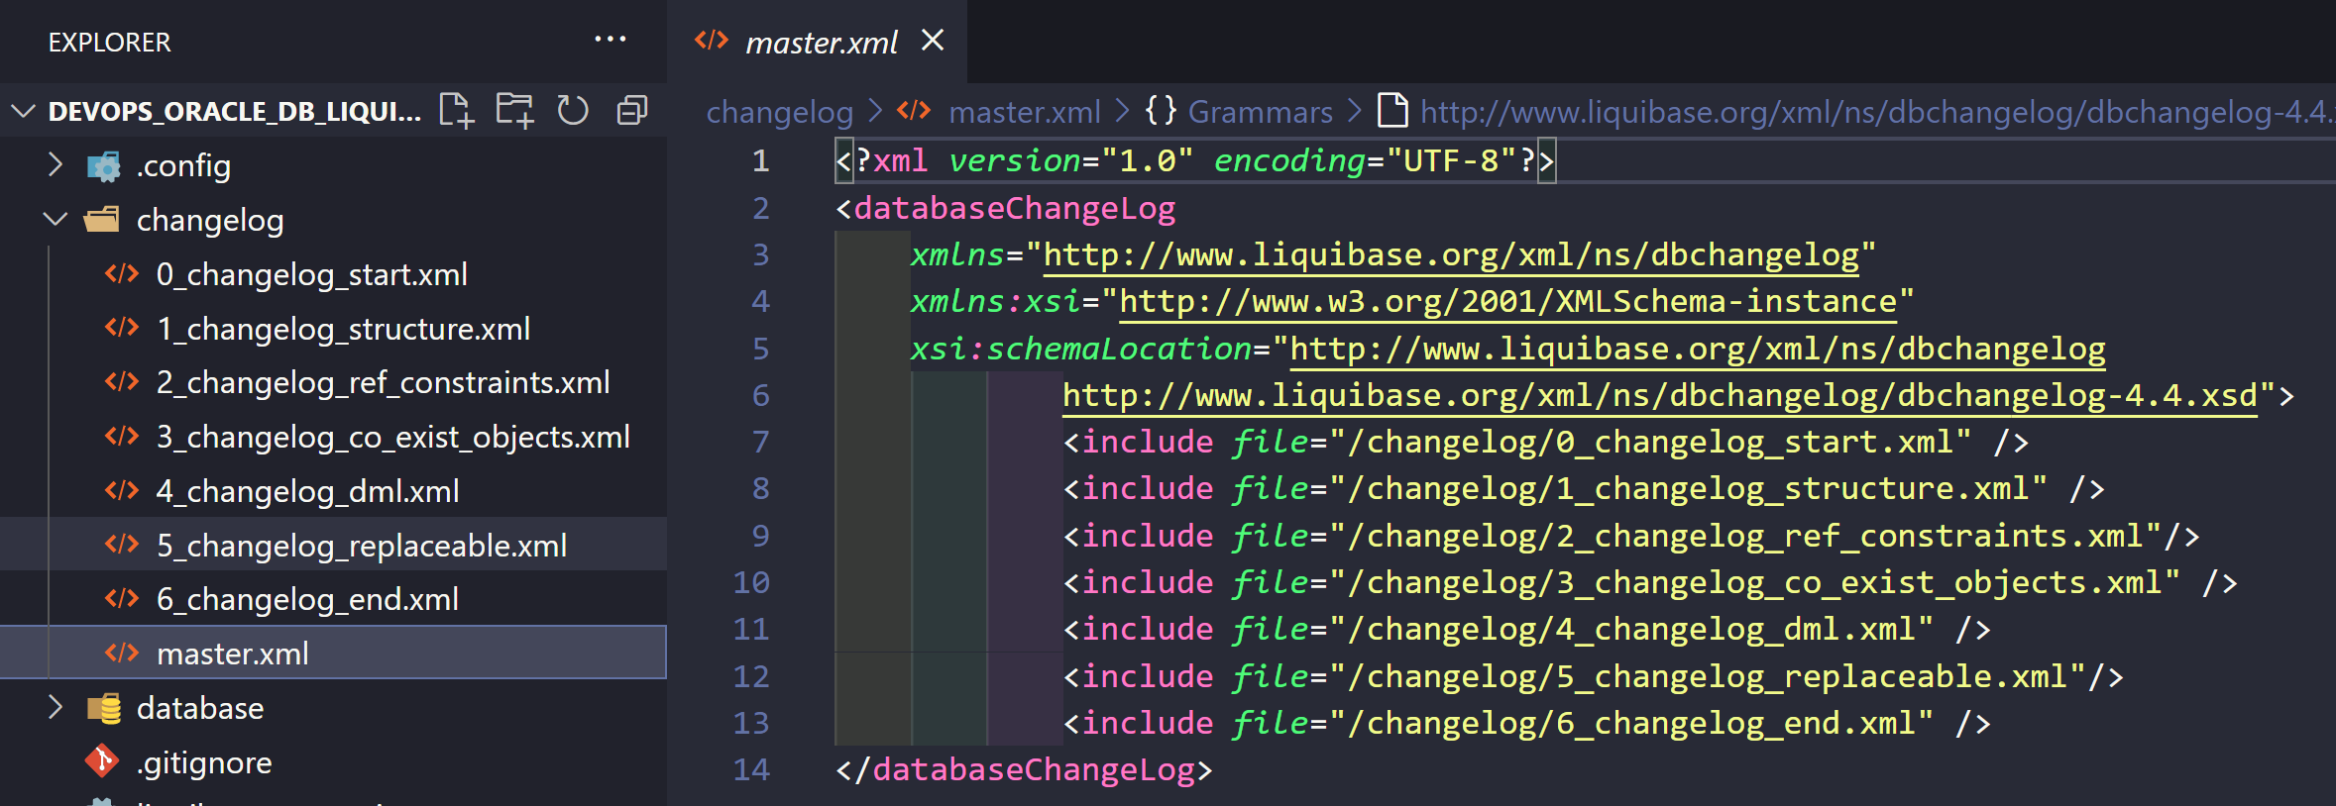
CHANGELOGS

Slide 15
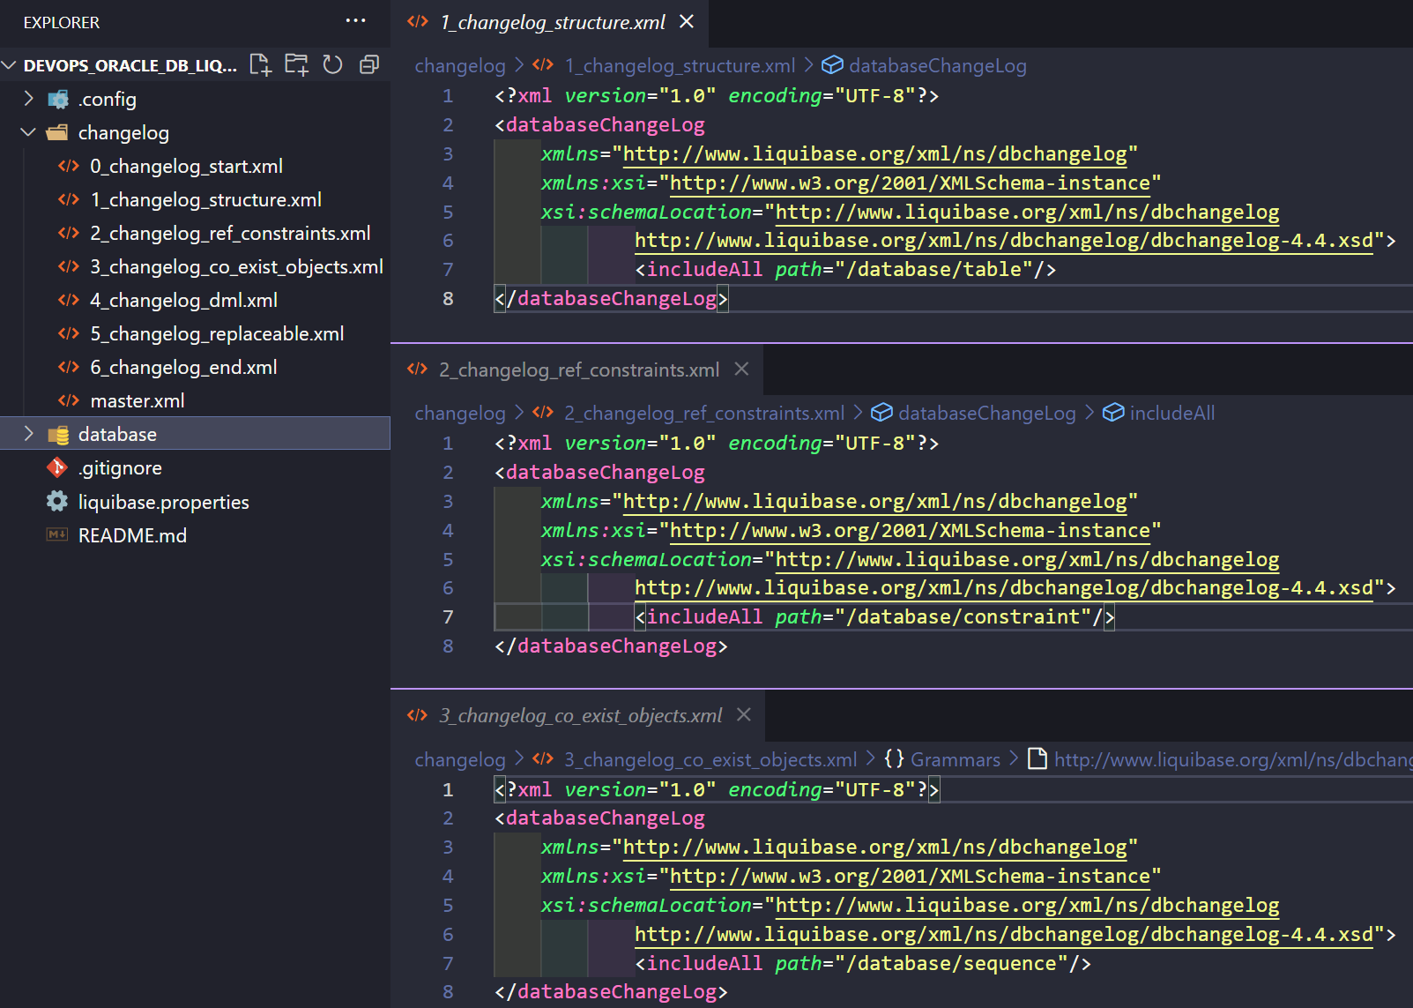
includeAll
+
path

Slide 16
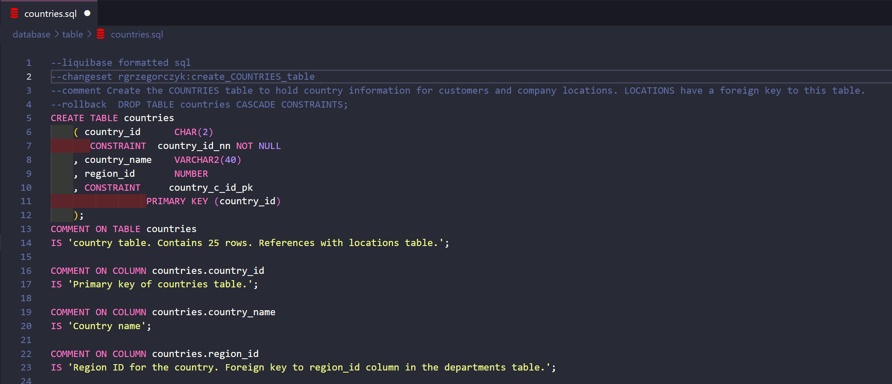
table/countries.sql

Slide 17
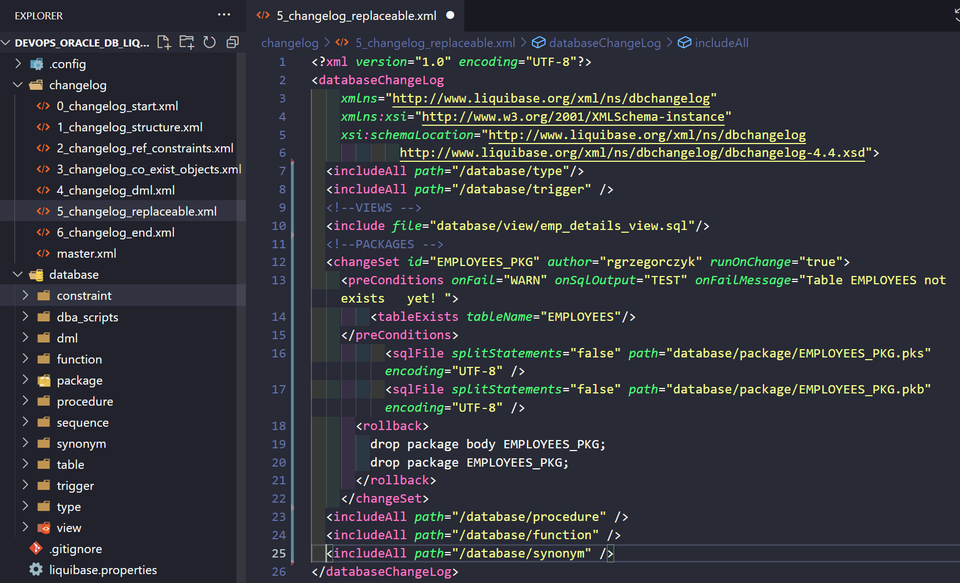
Replaceable objects

Slide 18
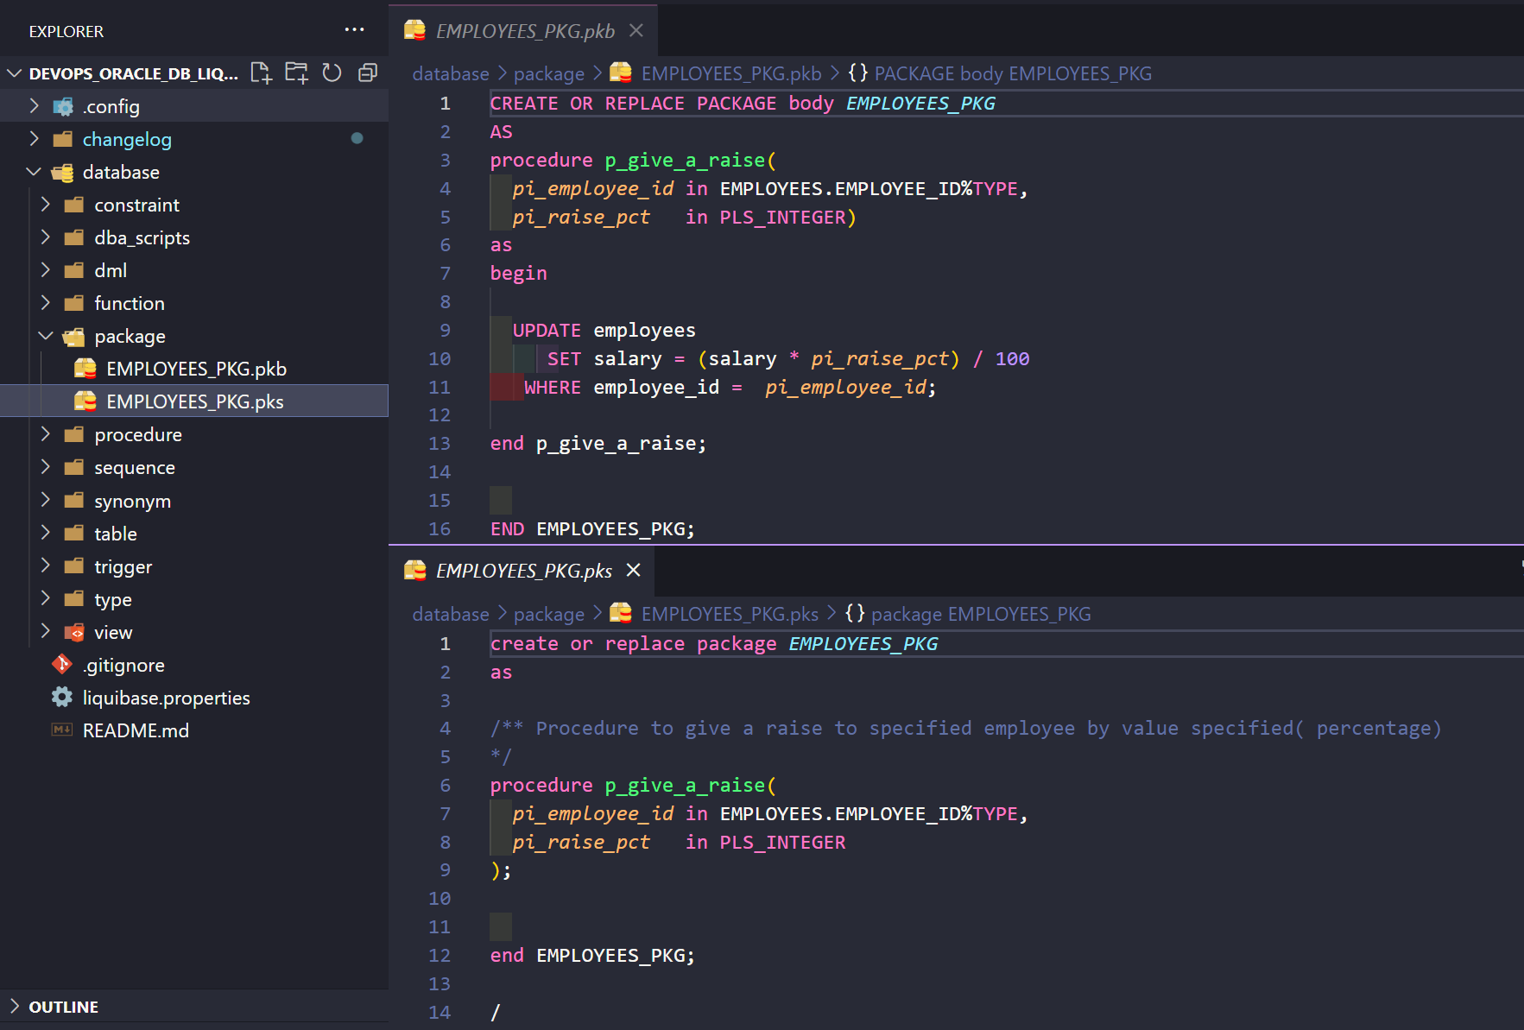
EMPLOYEES_PKG

Slide 19
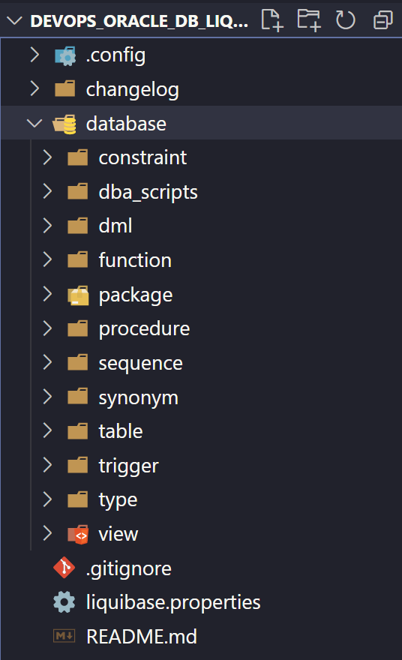
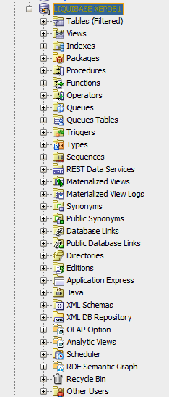
DATABASE SCRIPTS (objects)

Slide 20
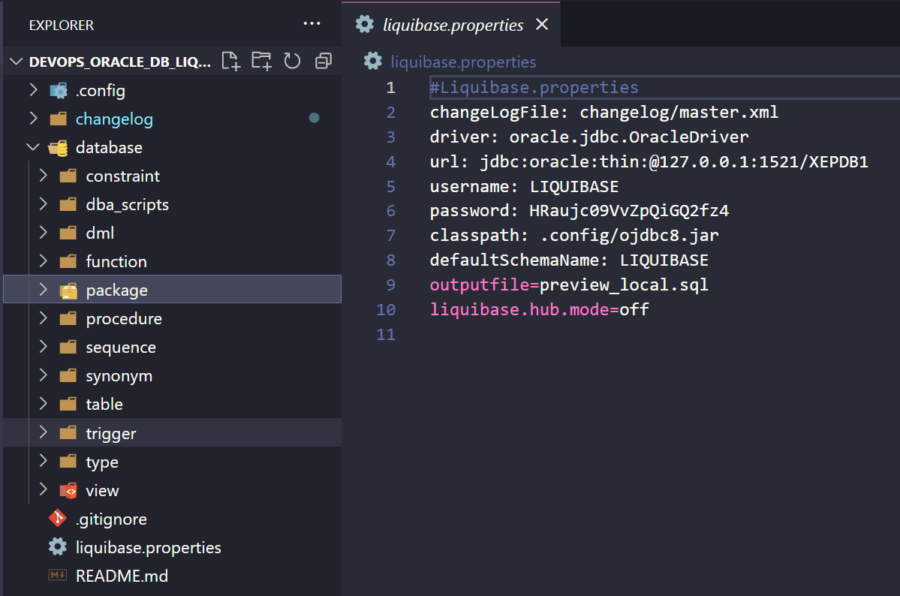
Liquibase.properties

Slide 21
Liquibase COMMANDS

Slide 22
liquibase update

Slide 23
Update
Deploys any changes that have not been deployed yet
Unique identifier DO NOT EXISTS
apply changeset
Unique identifier EXIST
re-apply the changest

Slide 24
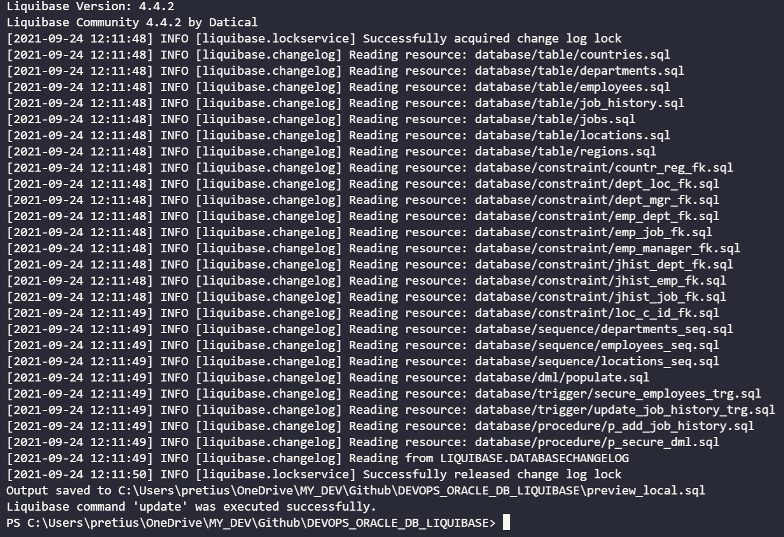
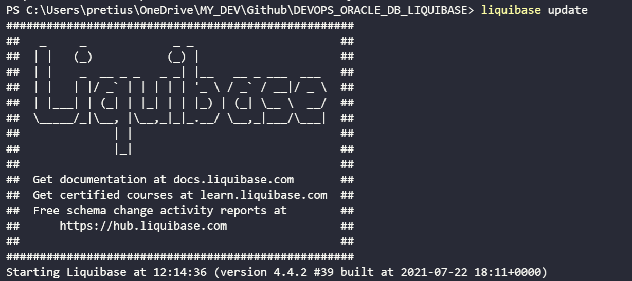

Slide 25
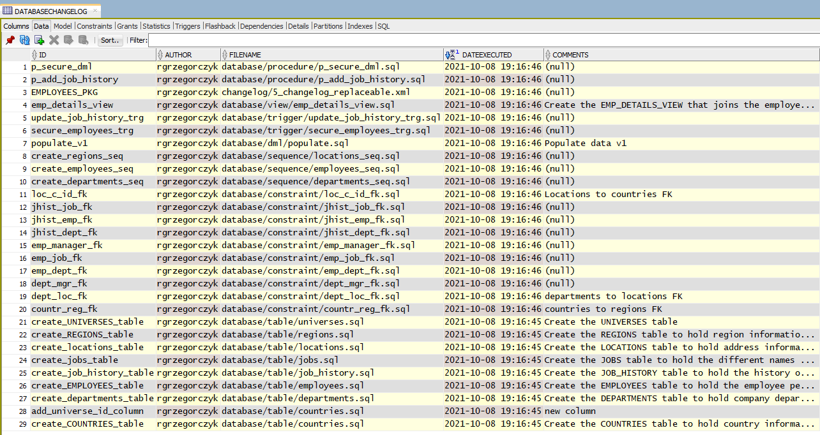

Slide 26
Something went wrong? Don’t panic.
https://www.pngitem.com/

Slide 27
liquibase rollback

Slide 28
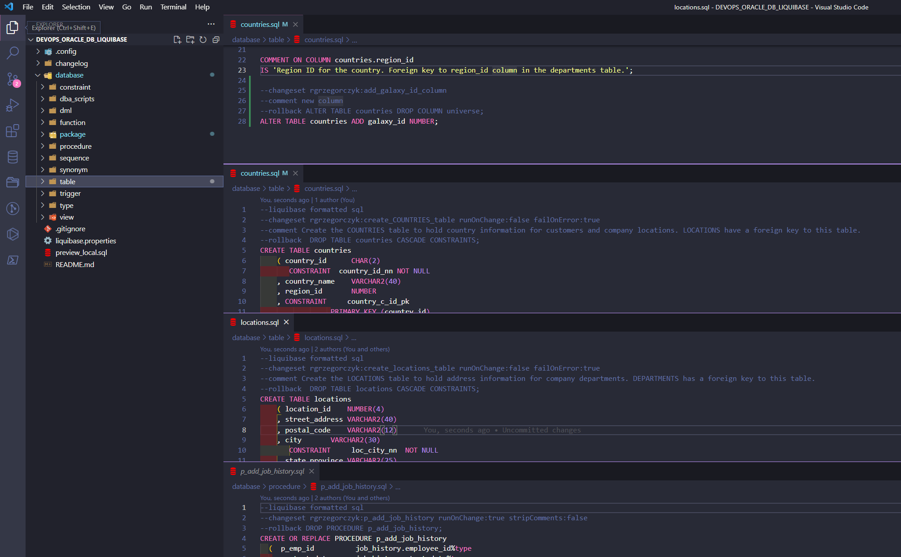

Slide 29
liquibase rollbackCount [value]
liquibase rollbackCount 10
liquibase rollbackToDate [value]
liquibase rollbackToDate 2021-10-12
liquibase rollbacktodate 2021-10-12'T'09:30:00

Slide 30
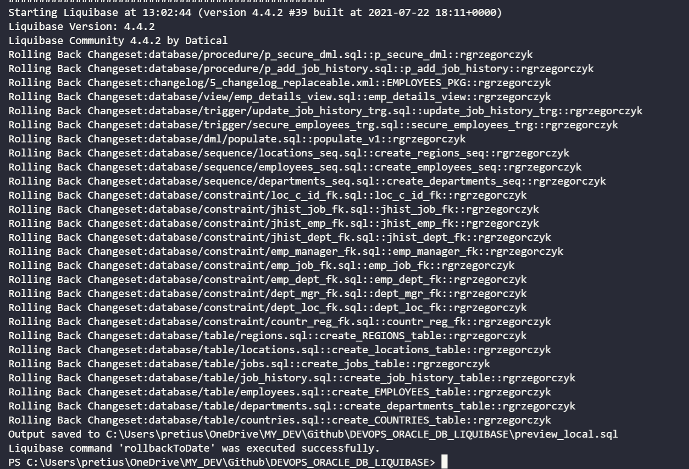

Slide 31
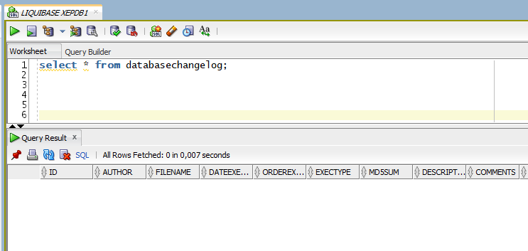
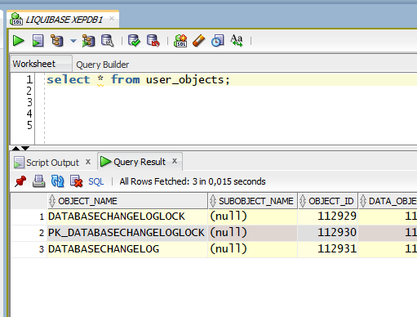

Slide 32
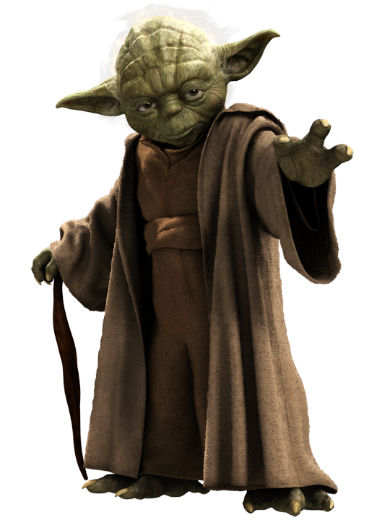
But what if…?
no production access
mad, suspicious DBA admin
client’s security policy

Slide 33
liquibase UpdateSQL
liquibase rollbackCountSQL 10
liquibase rollbackToDateSQL 2021-09-30

Slide 34
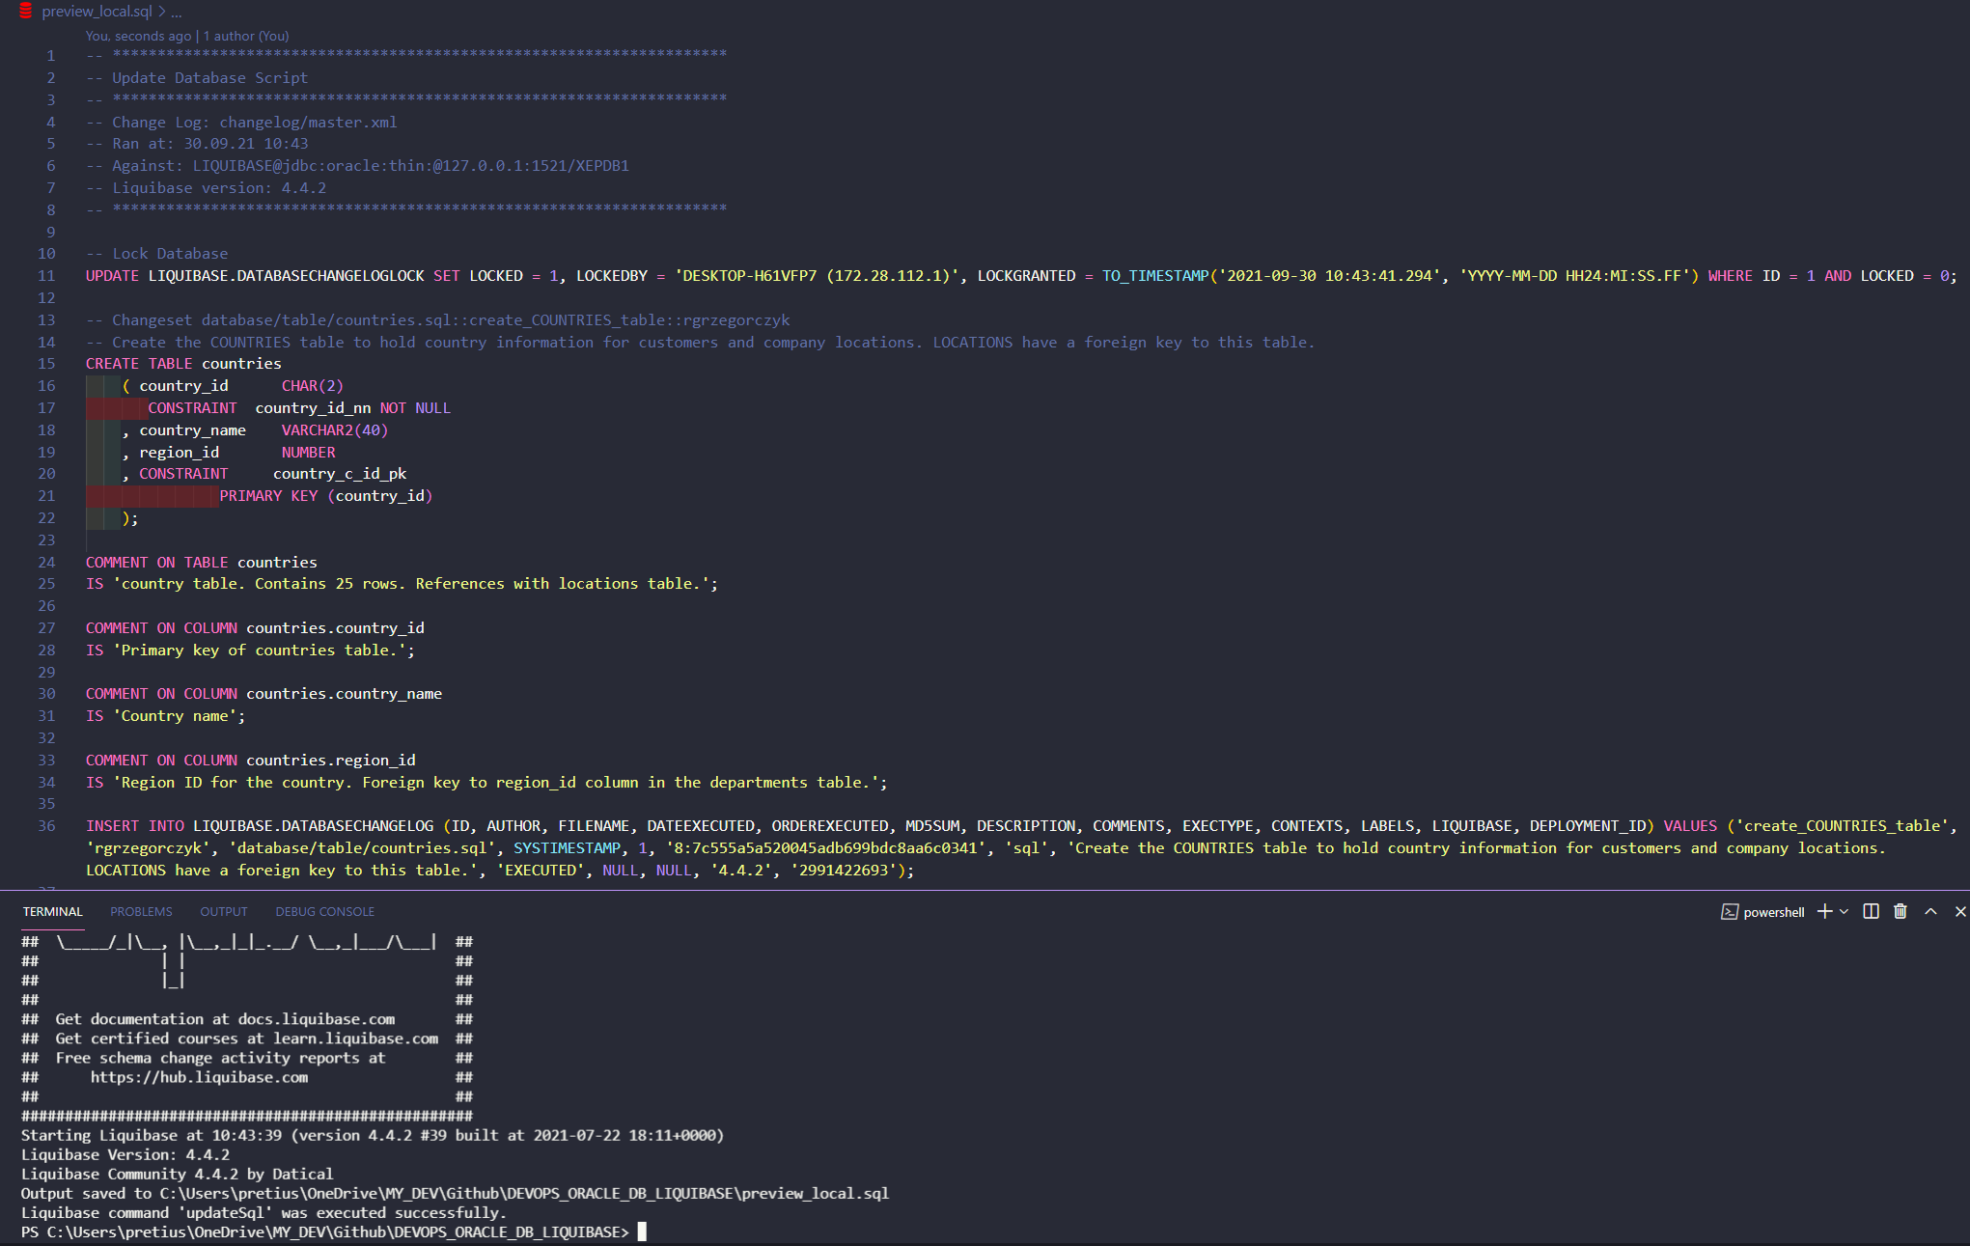
updateSQL

Slide 35
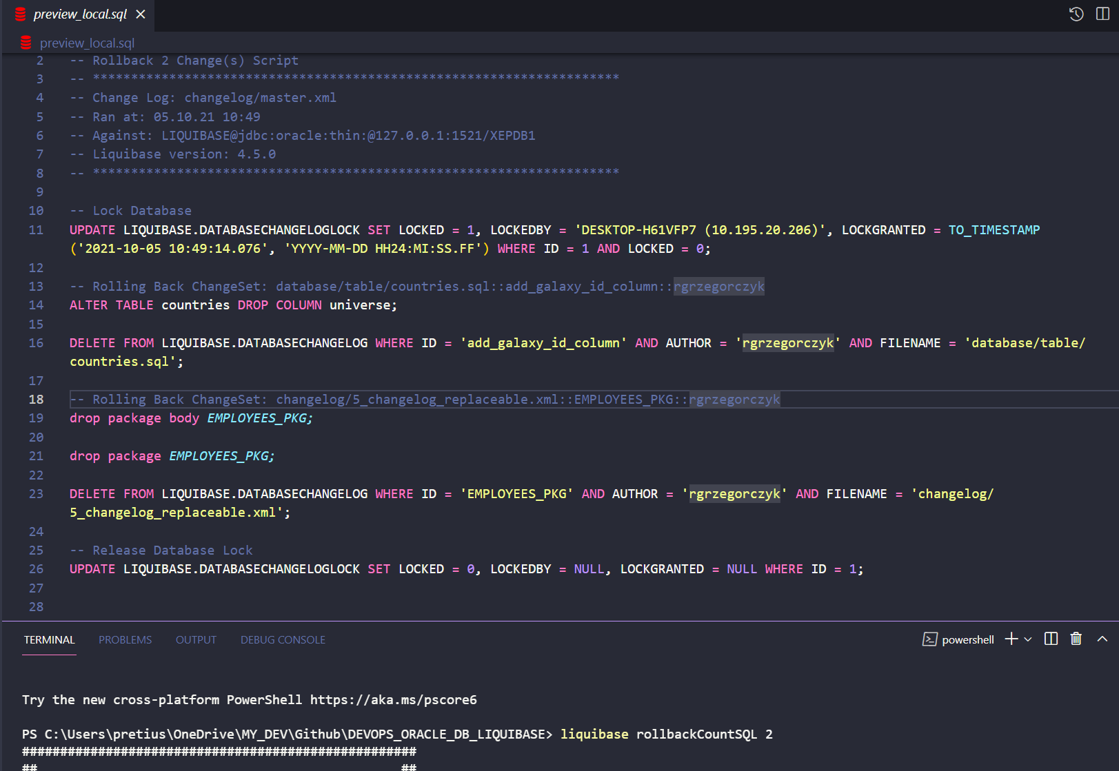
rollbackCountSQL 2

Slide 36
Let’s make some changes and spy them!

Slide 37
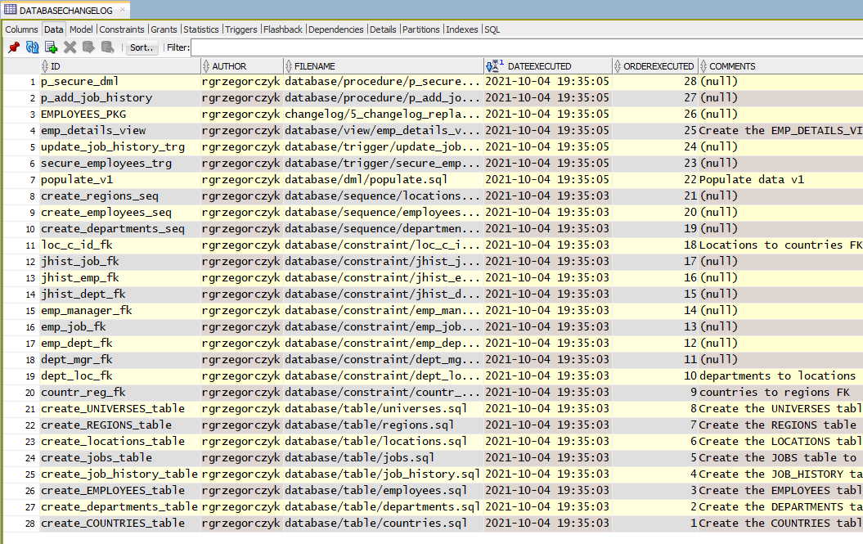
DATABASECHANGELOG

Slide 38
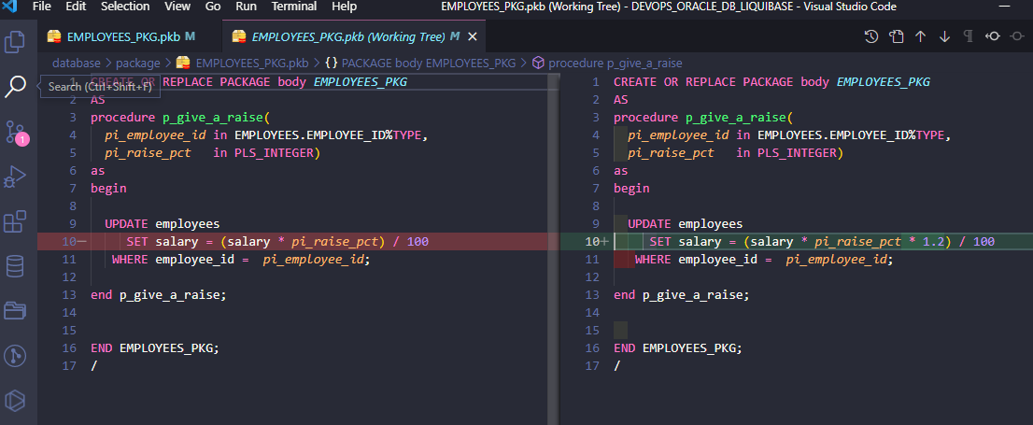
Give a raise!

Slide 39
liquibase Update

Slide 40
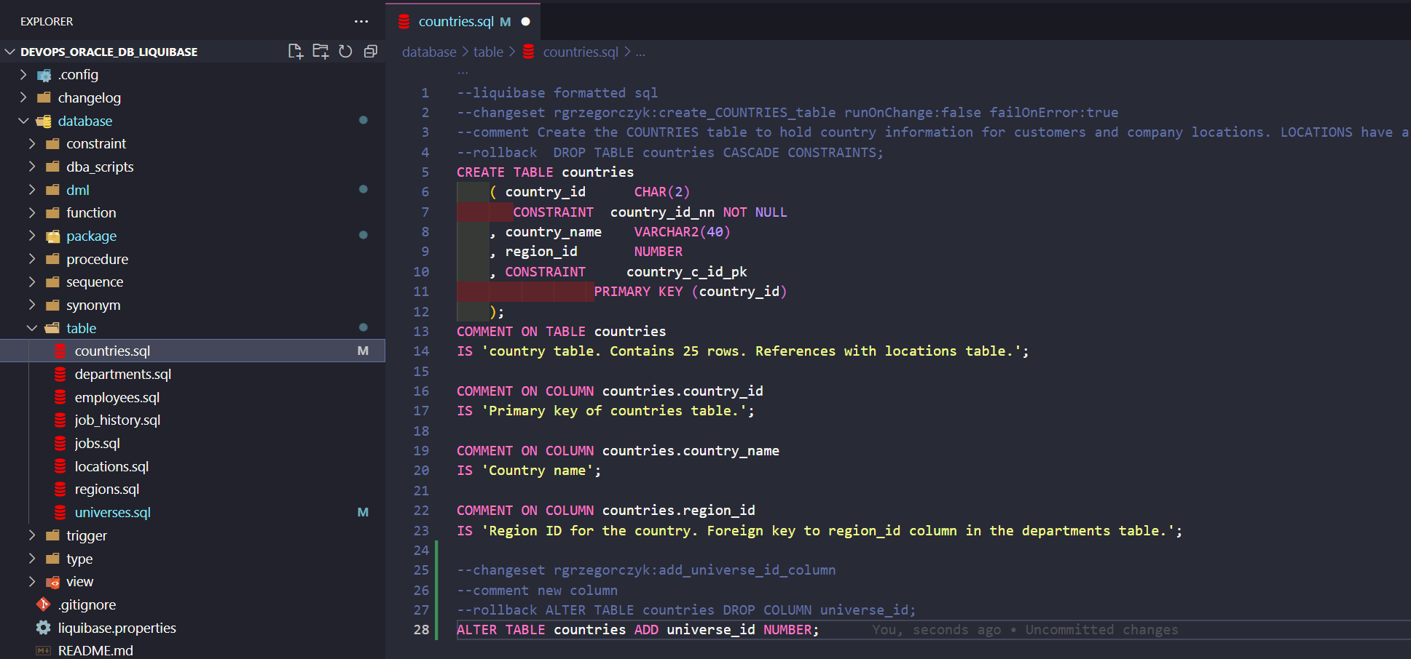
Table changes

Slide 41
liquibase updateSQL

Slide 42
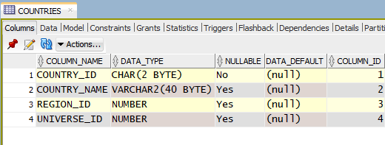
liquibase Update

Slide 43
DevOps your existing project…?

Slide 44
Simple steps to do:
prepare your repository
create changelogs and changesets
sync your objects

Slide 45
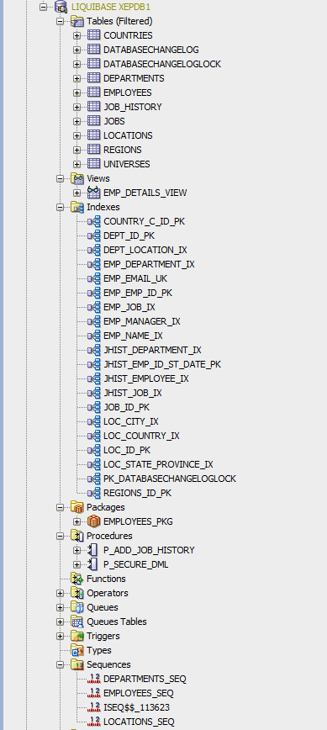
liquibase changelogsync
marks all changes as executed

Slide 46
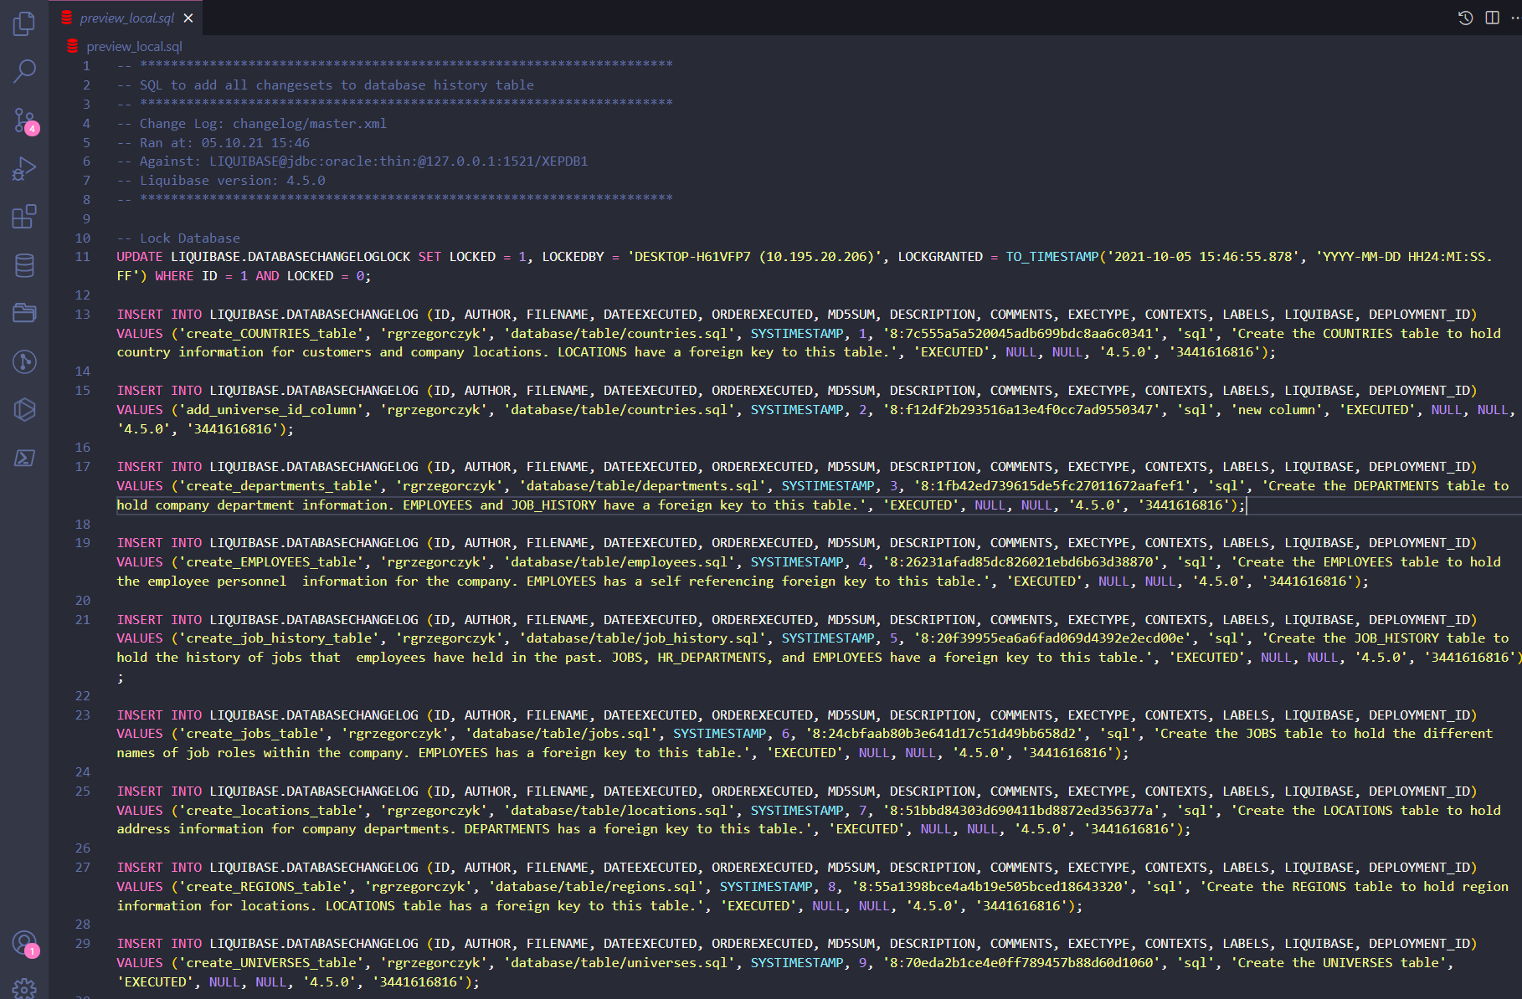
changelogsyncSQL
liquibase changelogsyncSQL

Slide 47
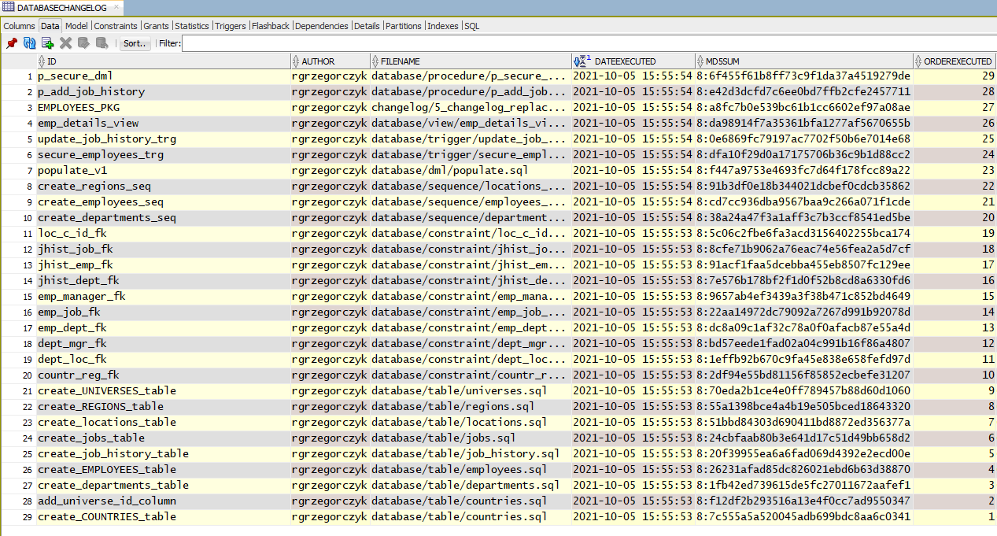
liquibase changelogsync

Slide 48
Your project is much bigger than this…?

Slide 49
simply export db objects as sql files
( probably you already have them in your repository)
create only changelogs and add path to sql files
sync objects with liquibase changelogsync
add changesets succesively during new tasks
Your project is much bigger than this…?

Slide 50
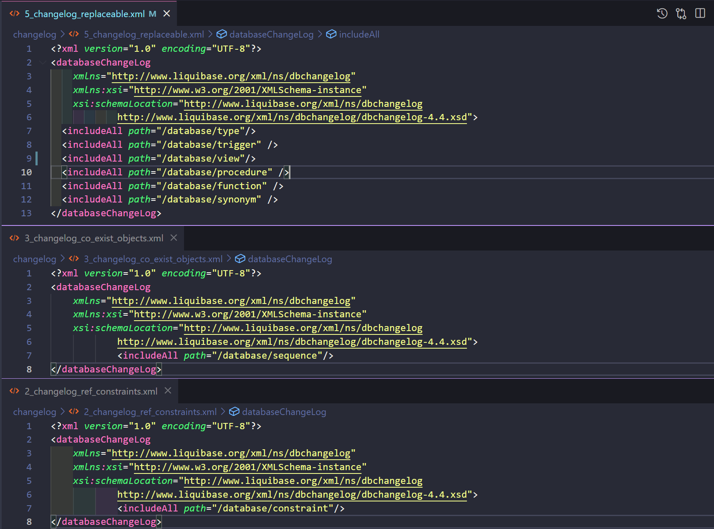

Slide 51
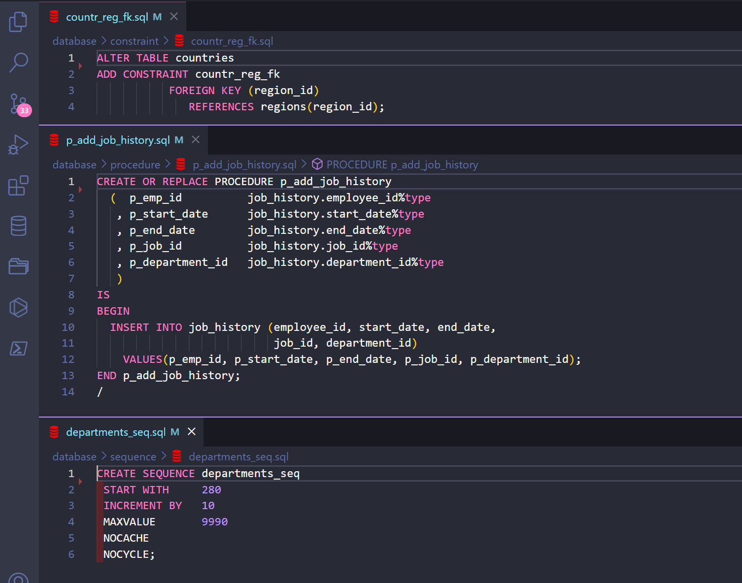

Slide 52
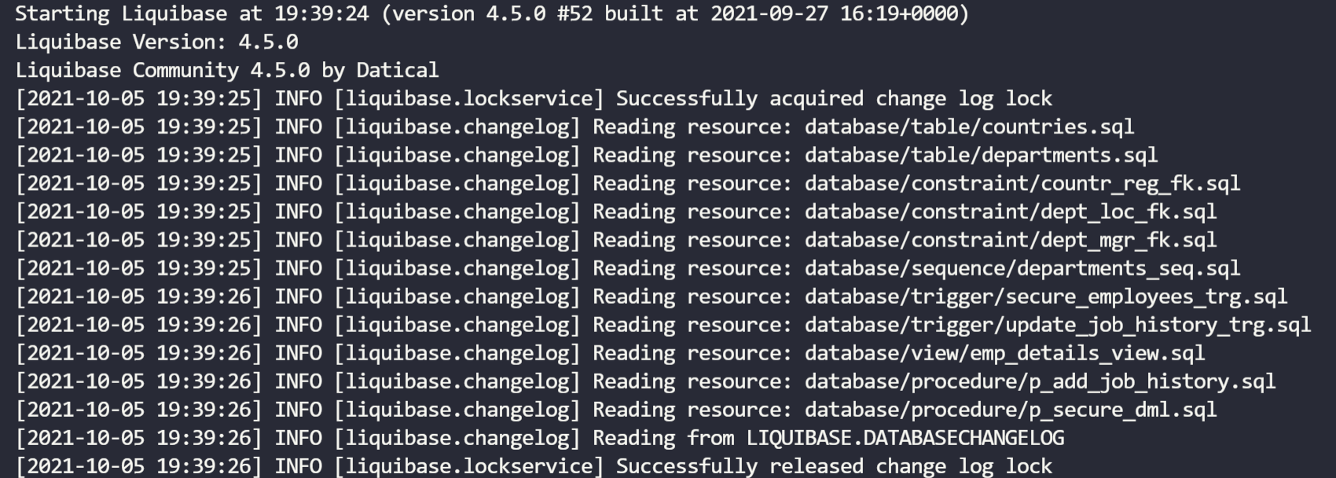
liquibase changelogsync
Those objects won’t be executed until you change them

Slide 53
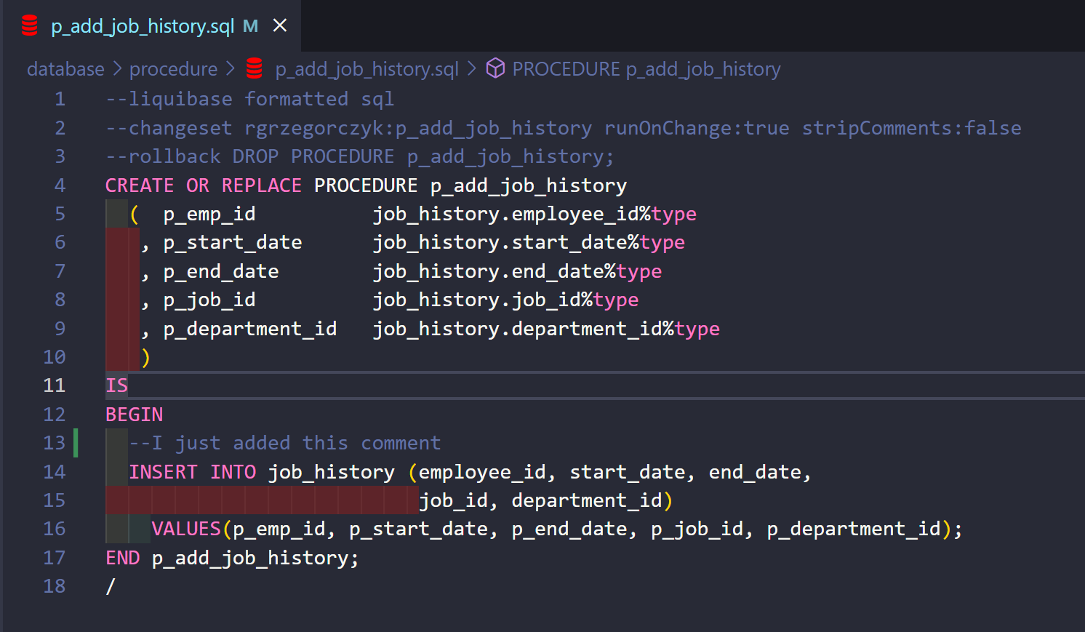
Adding your first changeset

Slide 54
liquibase update

Slide 55
PreConditions
sqlCheck (for SQL changesets)
many preCondition types for XML changesets

Slide 56
sqlCheck
The preCondition’s SQL must return a single row with a single value.

Slide 57
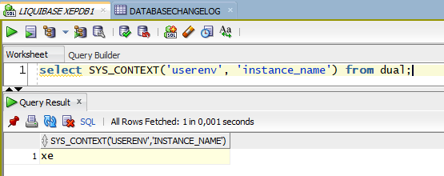
liquibase update

Slide 58
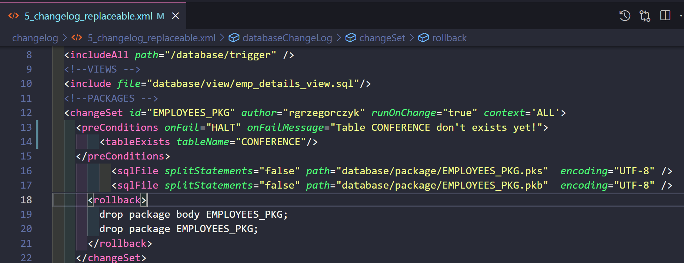
XML preConditions

Slide 59
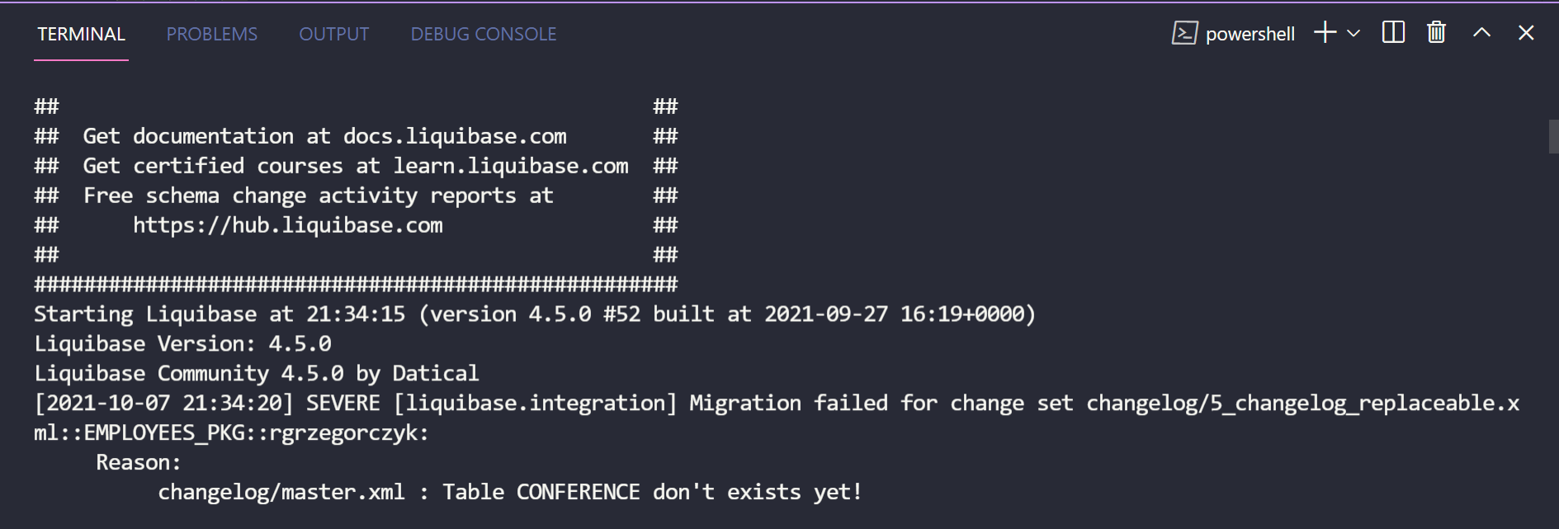
liquibase update

Slide 60
Popular XML preConditions
changeSetExecuted
columnExists
foreignKeyConstraintExists
indexExists
tableExists

Slide 61
Lots of environments?
Many developers?
Plenty tasks with different release dates?
Production bug fixing?

Slide 62
Automate it all !
Contexts & Labels

Slide 63
Live demo

Slide 64
Resources
https://pretius.com/liquibase-tutorial/
https://docs.liquibase.com/
https://learn.liquibase.com/catalog

Slide 65
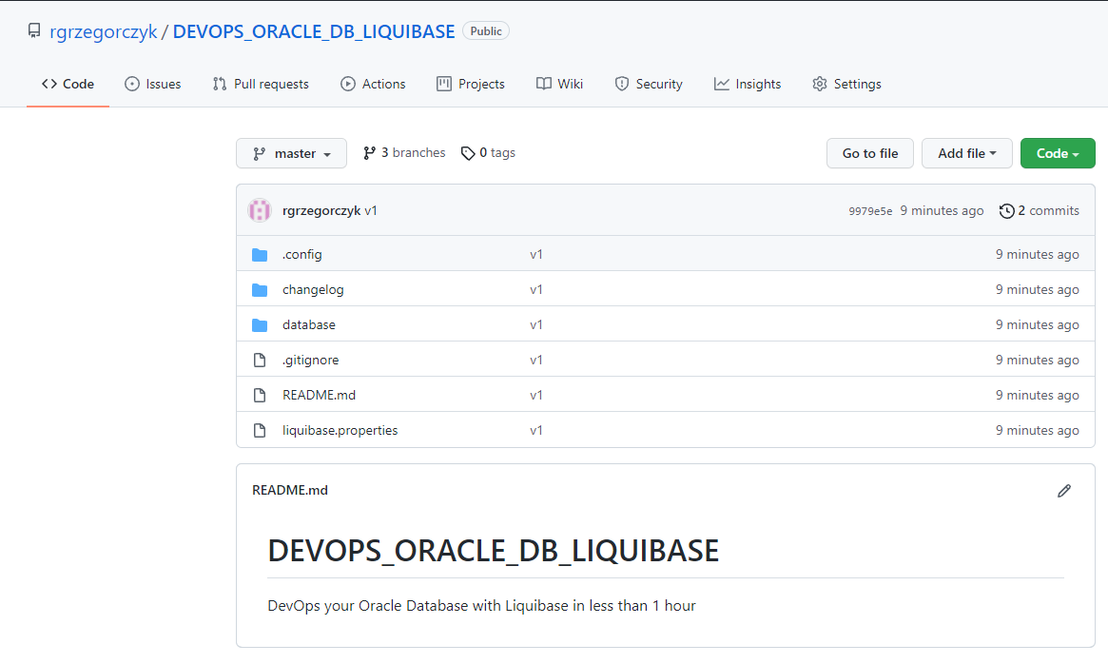
https://github.com/rgrzegorczyk/DEVOPS_ORACLE_DB_LIQUIBASE

Slide 66
www.pretius.com
Rafał Grzegorczyk
rgrzegorczyk@pretius.com
@r_grzegorczyk
linkedin.com/in/rgrzegorczyk
www.grzegorczykrafal.pl
Find more:
@PretiusSoftware
facebook.com/pretius
www.pretius.com

