Slide 1
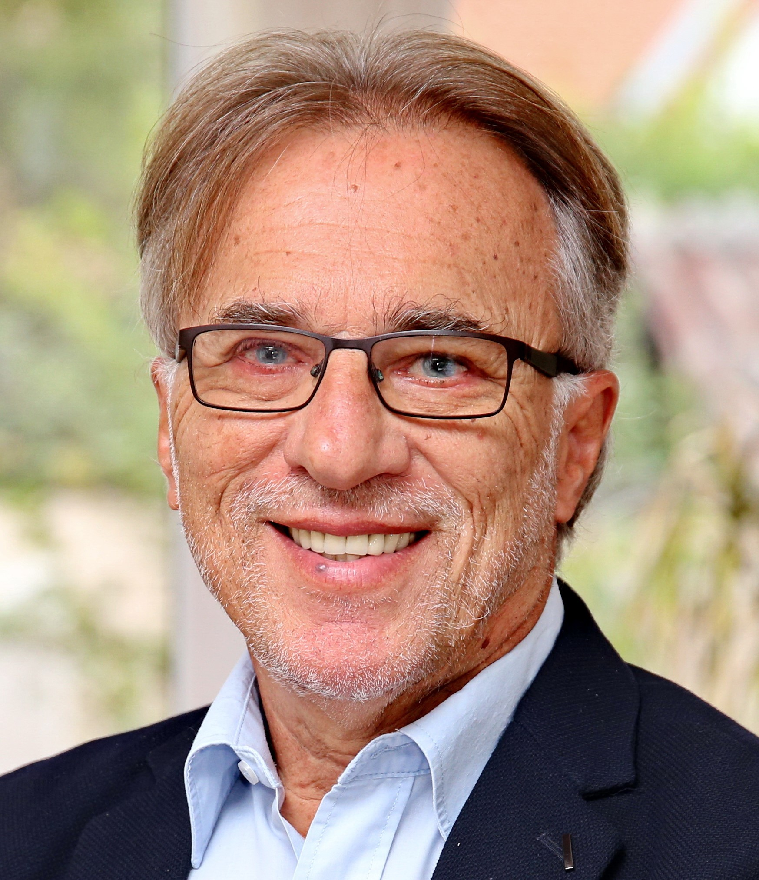

The World is Broken
How to Fix It
Velimir Srića

Slide 2
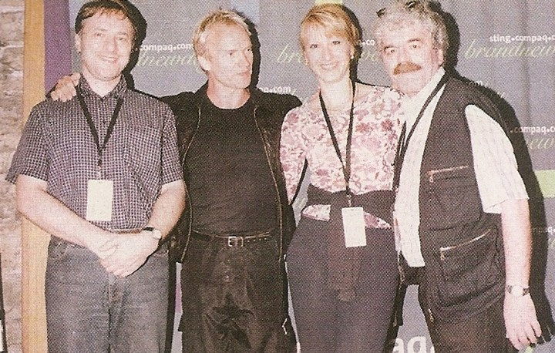
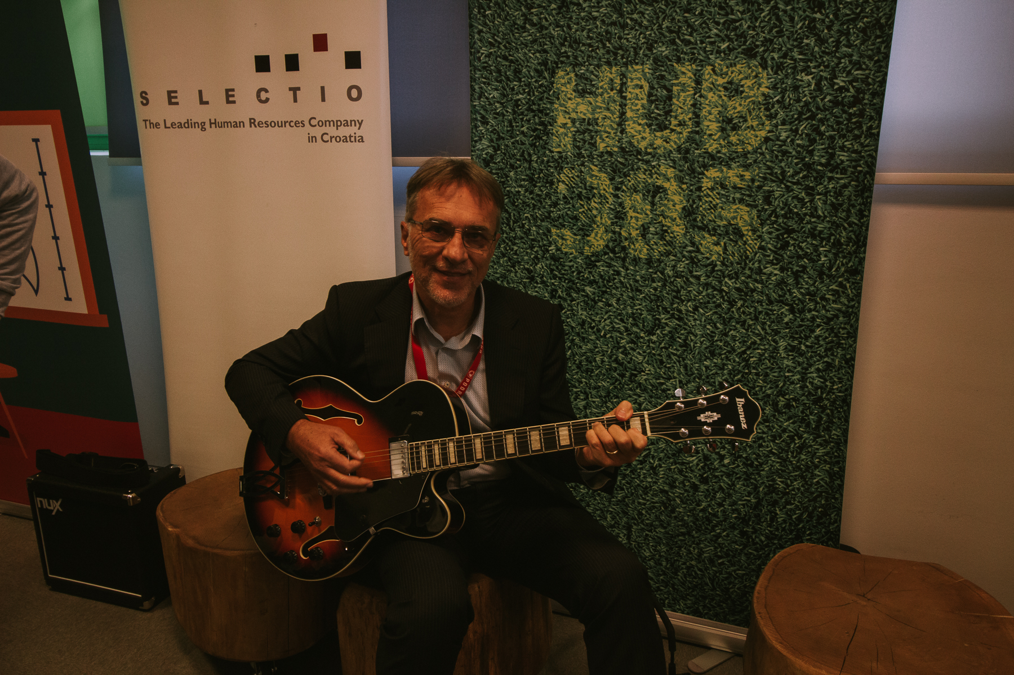
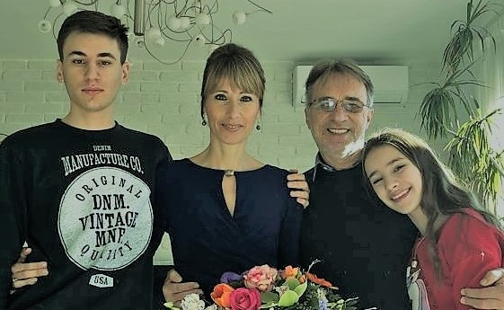
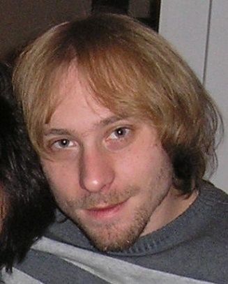
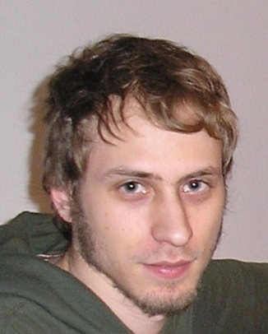
About me
EDUCATION
BBA, MS Electrical Engineering
MBA - Columbia University, New York,
PhD - Management Information Systems
PERSONAL STUFF
Guitar, foodball, chess, tennis, poetry, film, travelling, literature…
FROM CV
Visiting associate professor, UCLA, Los Angeles, guest professor in Beijing, Shanghai, B&H, Slovenia, Austrija, Montenegro, Hungary, Dubai, and SSBM
The Club of Rome, European Academy of Sciences and Arts, International Academy of Arts and Sciences B&H
World Bank expert for Change Management
Member of Croatian government; President Zagreb City Assembly;

Slide 3



Teaching:

Slide 4


























Consulting:
Ericsson Nikola Tesla
Končar, Infobip, FINA
Coca Cola, INA
Tisak, RBA, Hrvatska Pošta
Banca Intesa, PBZ, Pevex
UniCredit, Kraš, dm
SRC, Unior, Crosco
Iskratel, Gorenje, KD
Trimo, Prevent, NLB,
Krka, Triglav, ZZZS
Tilia, Vzajemna

Slide 5


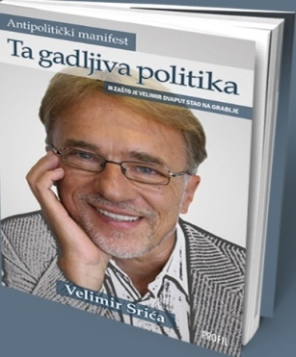



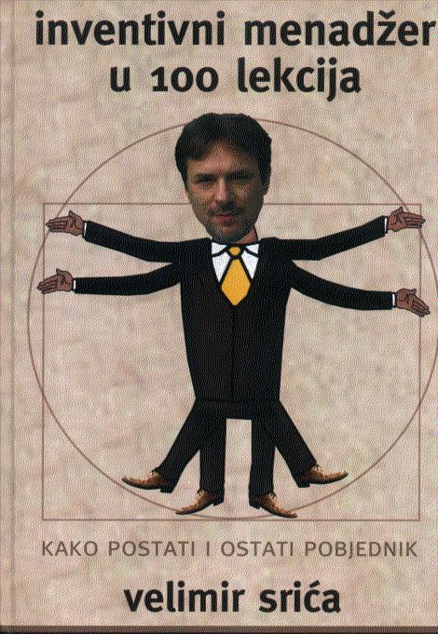








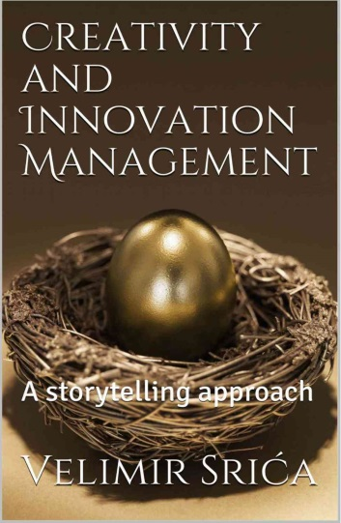

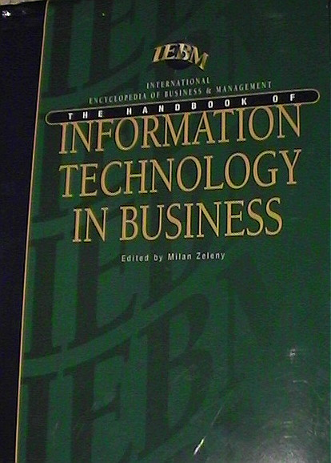






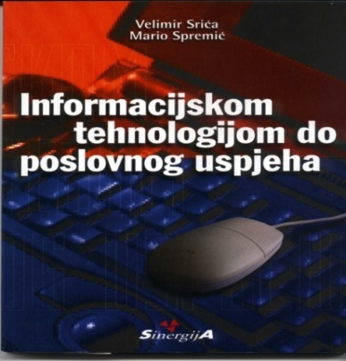


Books:

Slide 6
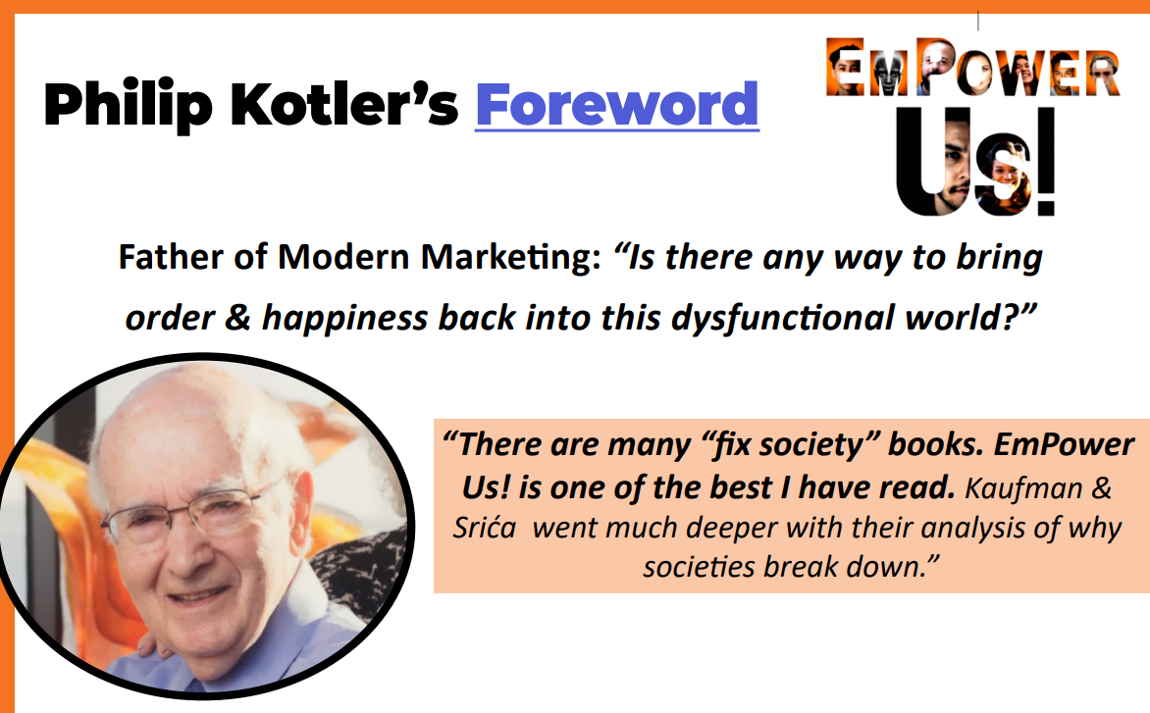
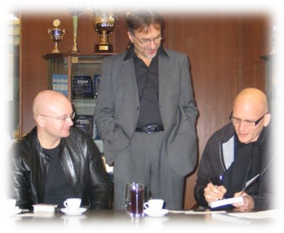
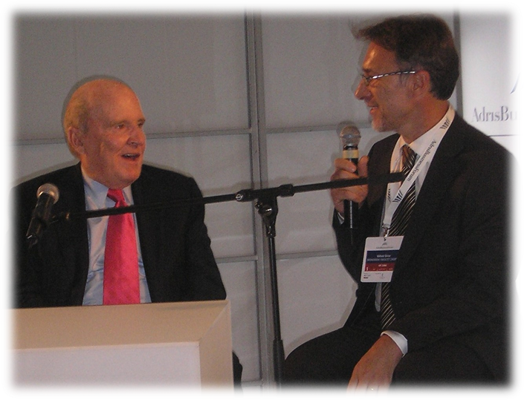
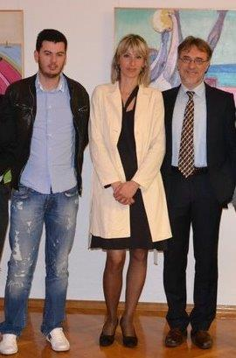
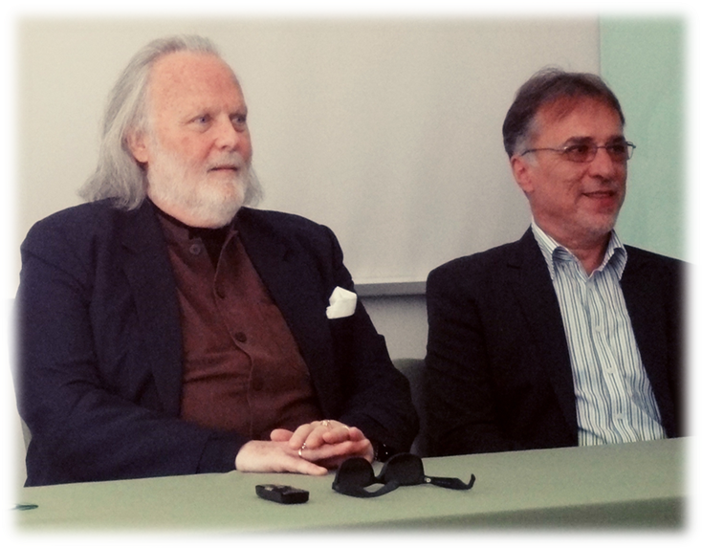
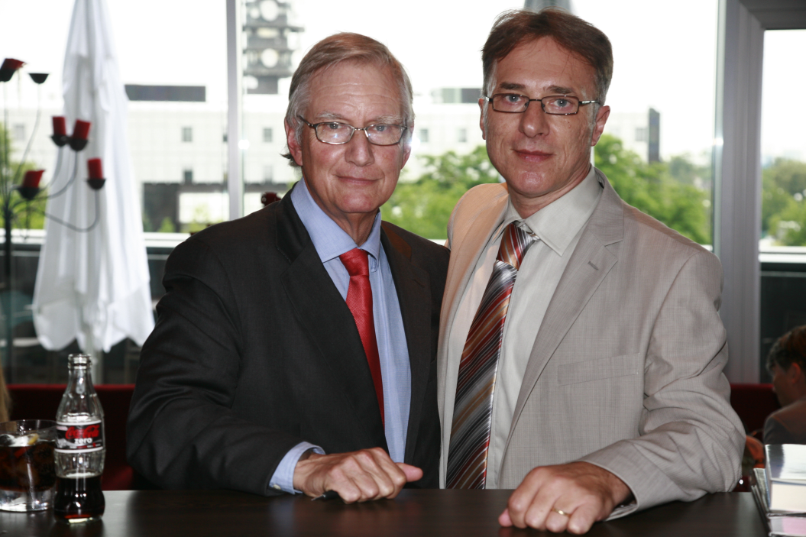
Inspiration:

Slide 7
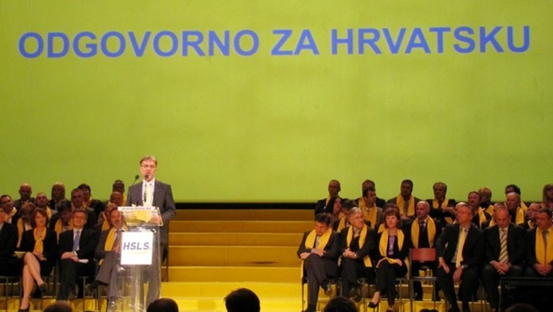
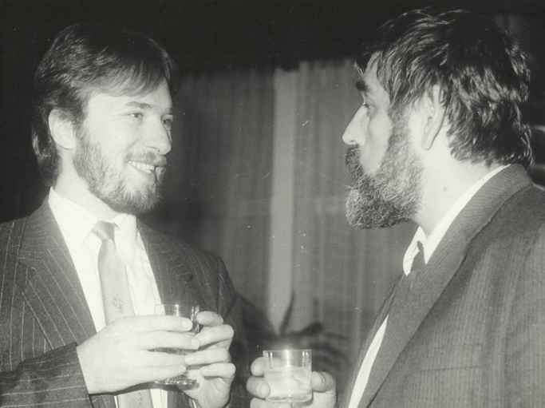
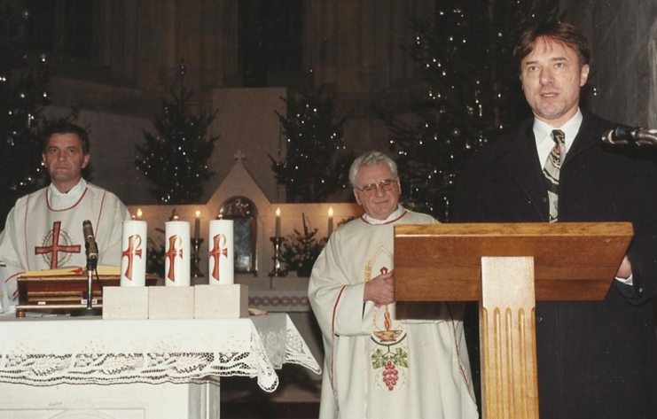
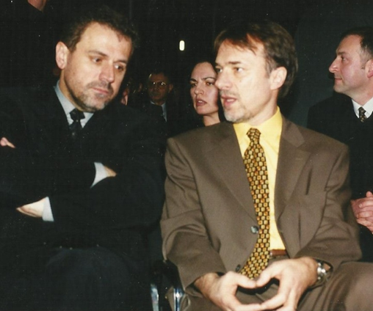
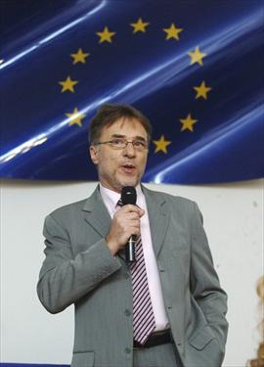
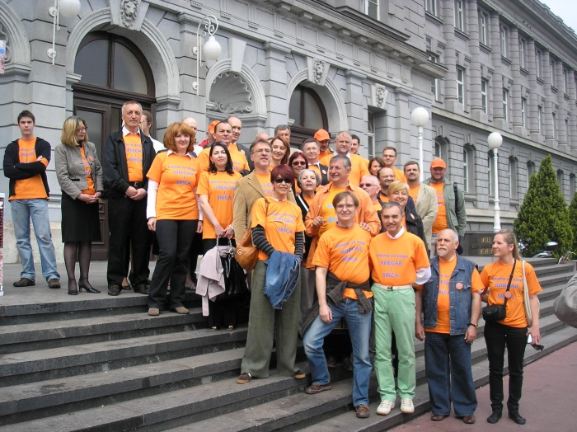
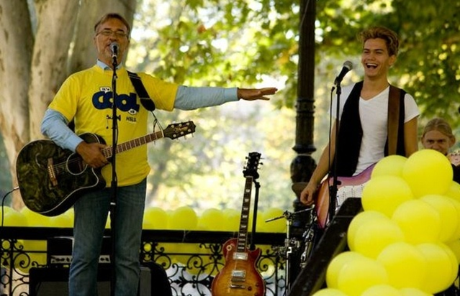
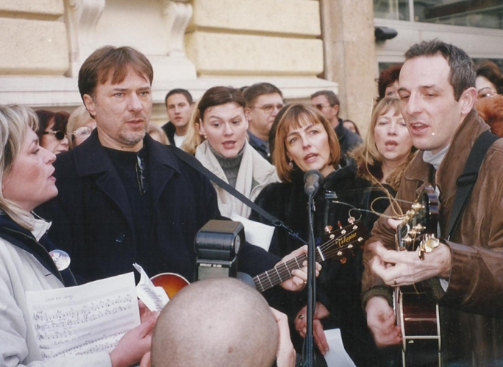
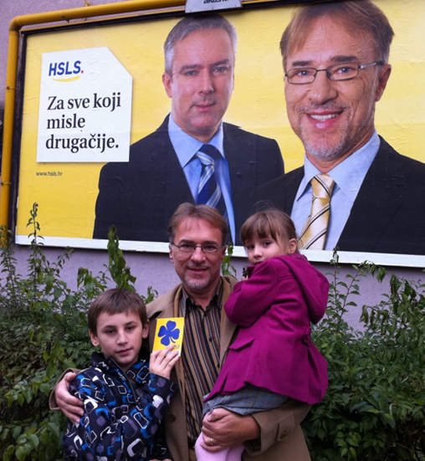
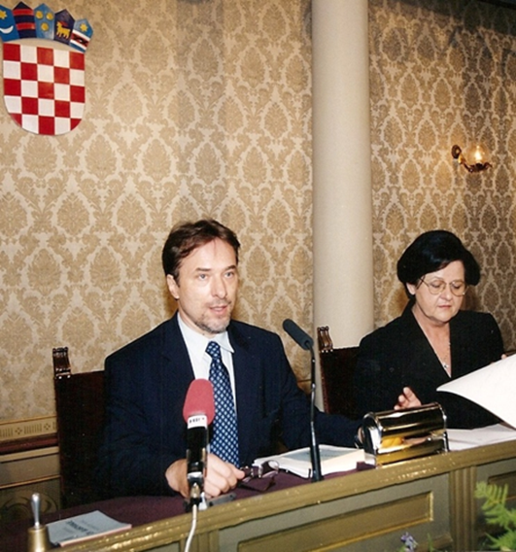
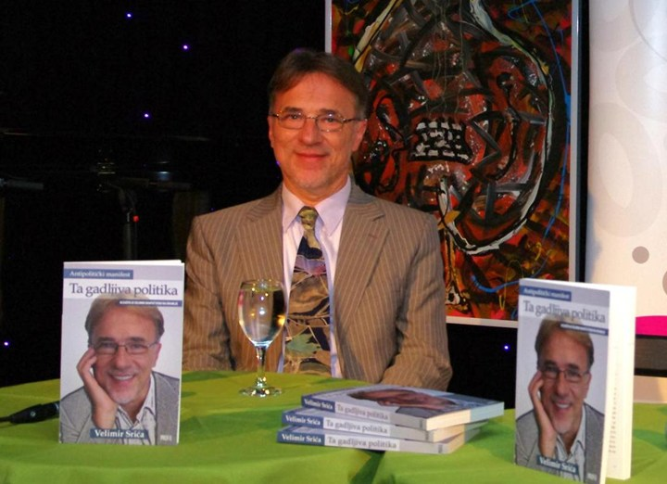
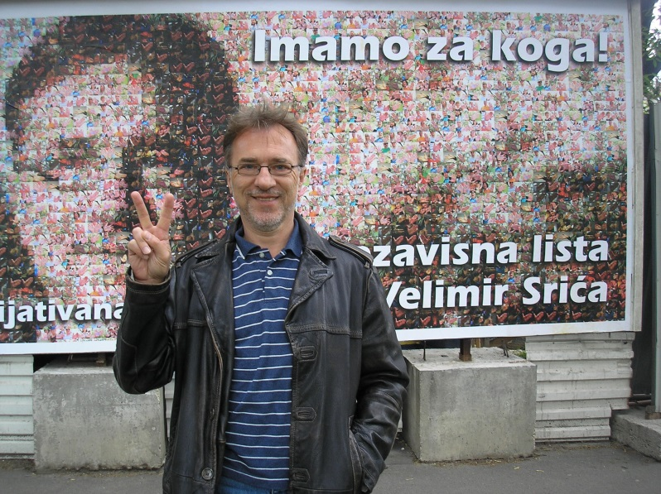
Politics:

Slide 8
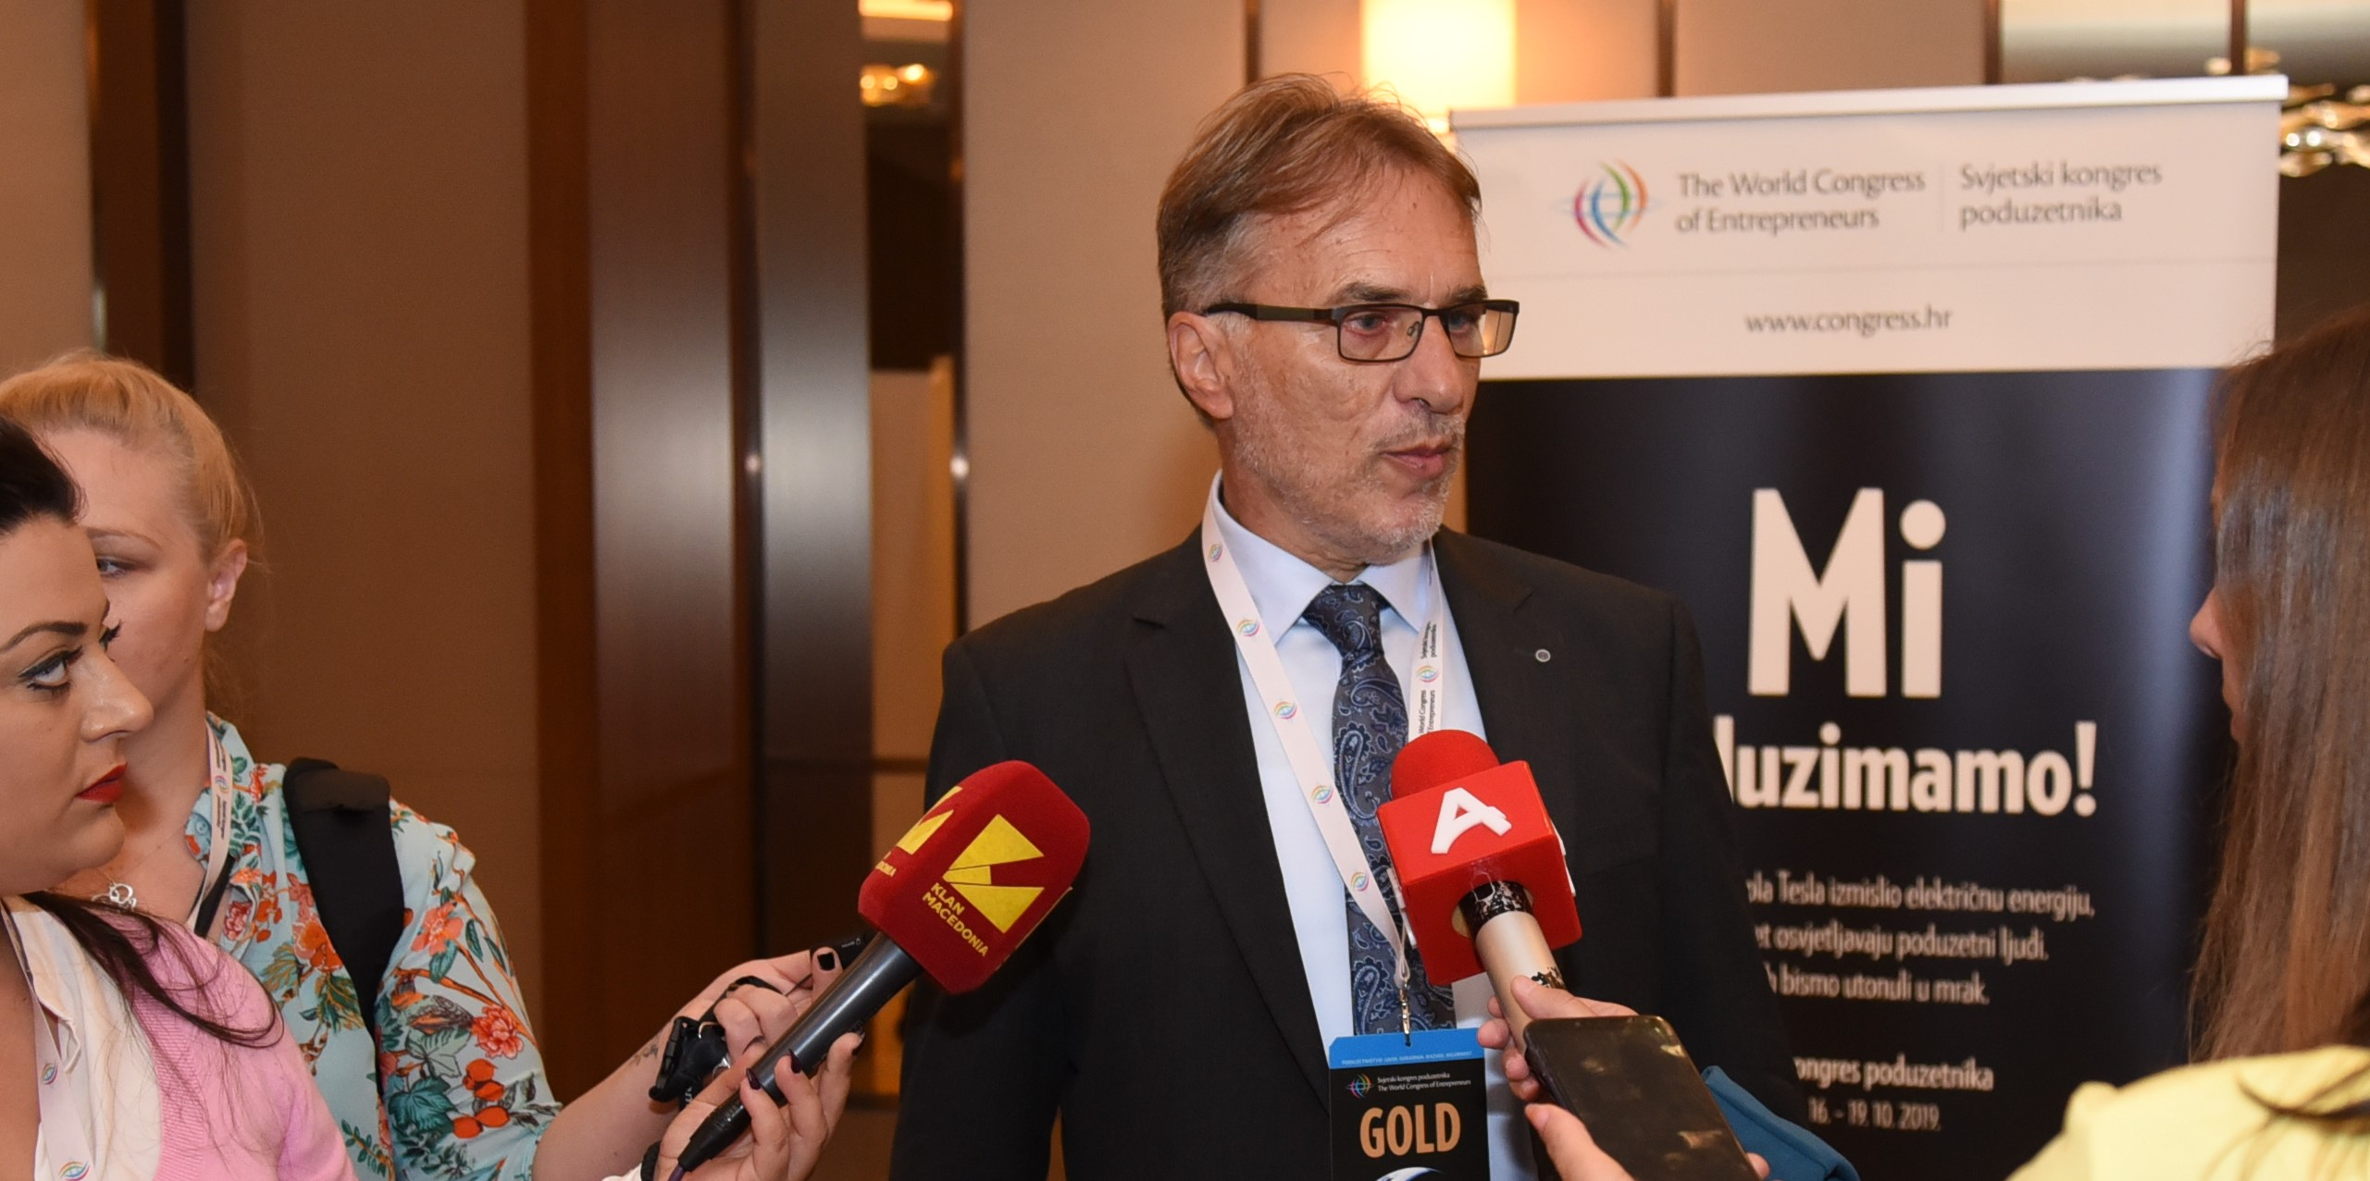
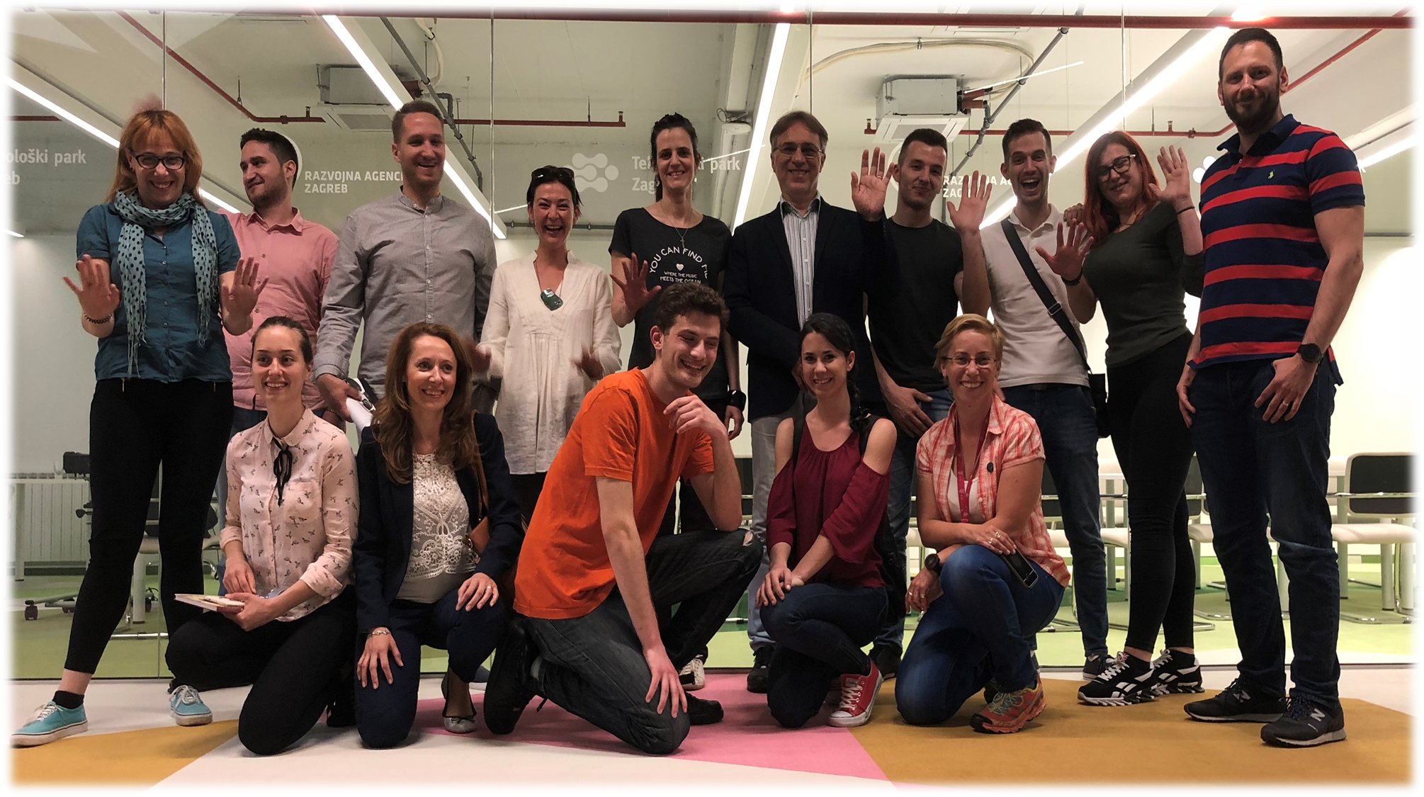

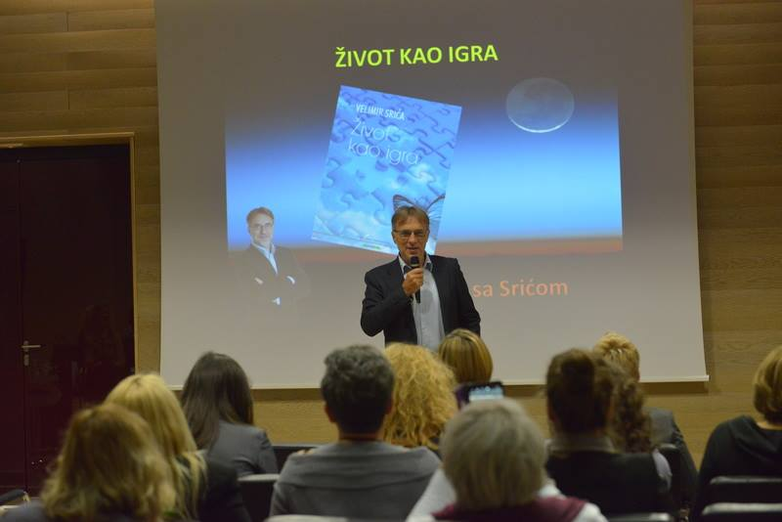
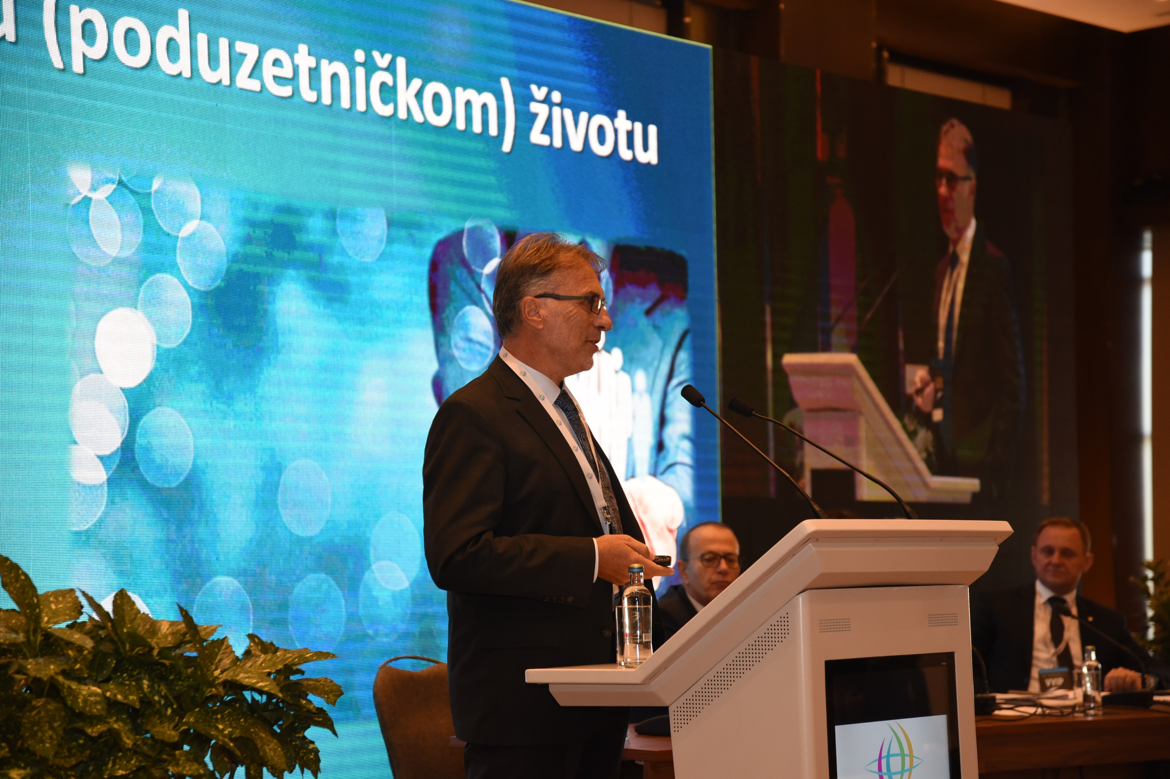

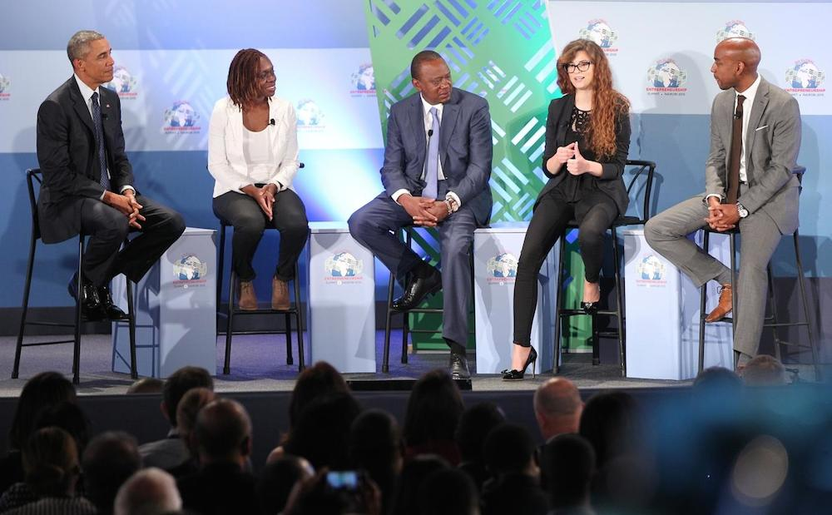

Afterwork and Leadership Academy

Slide 9
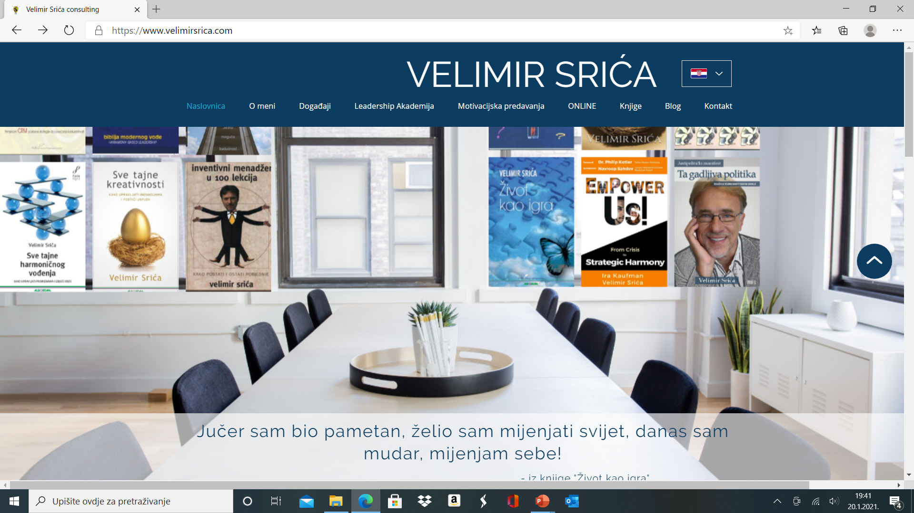
Contact:
Mail: velimir@velimirsrica.com

Slide 10
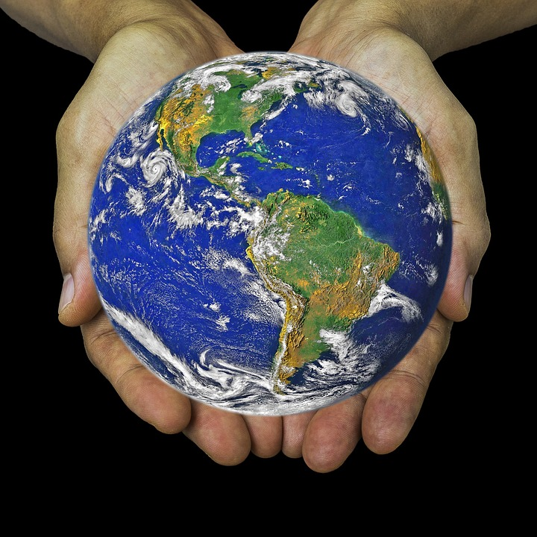
Living in the Broken World
We live in „interesting times” (VUCA):
Volatility
Uncertainty
Complexity
Ambiguity
Continuity is replaced by DISRUPTION
In Zulu, VUCA means “to wake up”

Slide 11
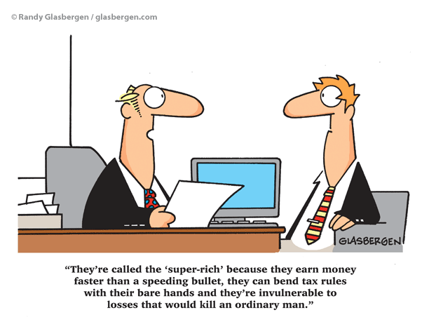
The New Normal
You can live a perfectly normal life if you accept the fact that your life will never be perfectly normal.

Slide 12
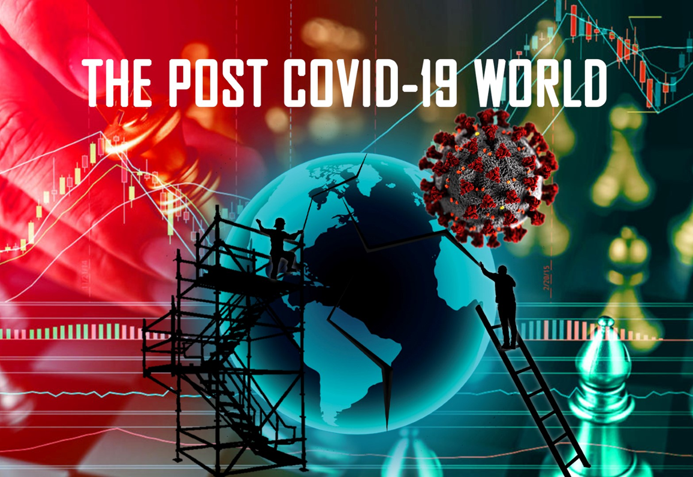
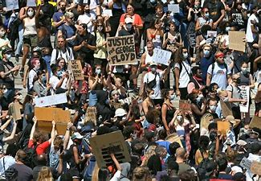
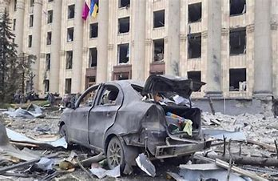
The Ukraine War
Fixing the New Normal
Two pandemics
„The Social Dilemma”
Broken capitalism
Broken democracy
Broken ecology
Growing inflation
Cold and warm war is back
Threat of nuclear war
Questioning the world order and purpose
Questioning values and moral compass

Slide 13

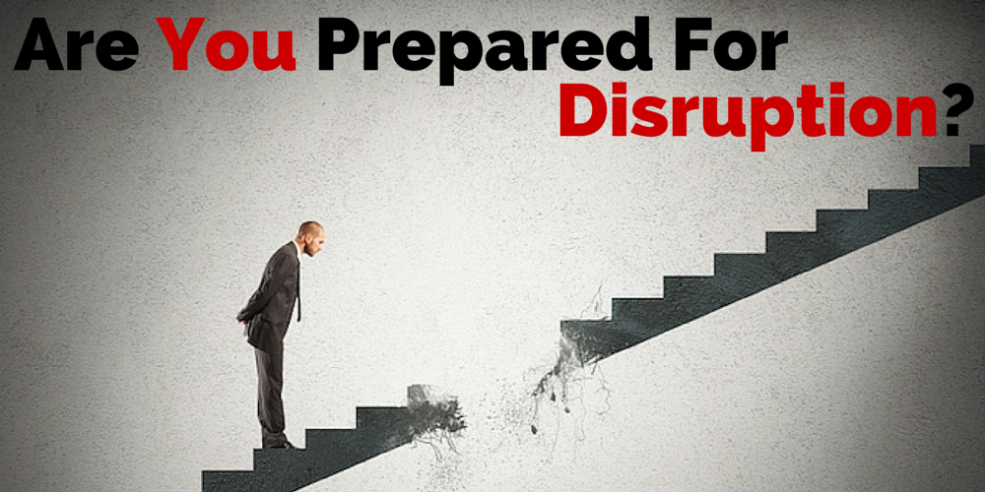
Disrupted Values
„Slow disruption” creeps 40 years:
Kids out of Wedlock - 15% to 70%
Trust in Government - 85% to 15%
Trust in Business Leaders - 65% to 18%
Trust in Media - 78% to 27%
Importance of religion - 60% to 20%

Slide 14
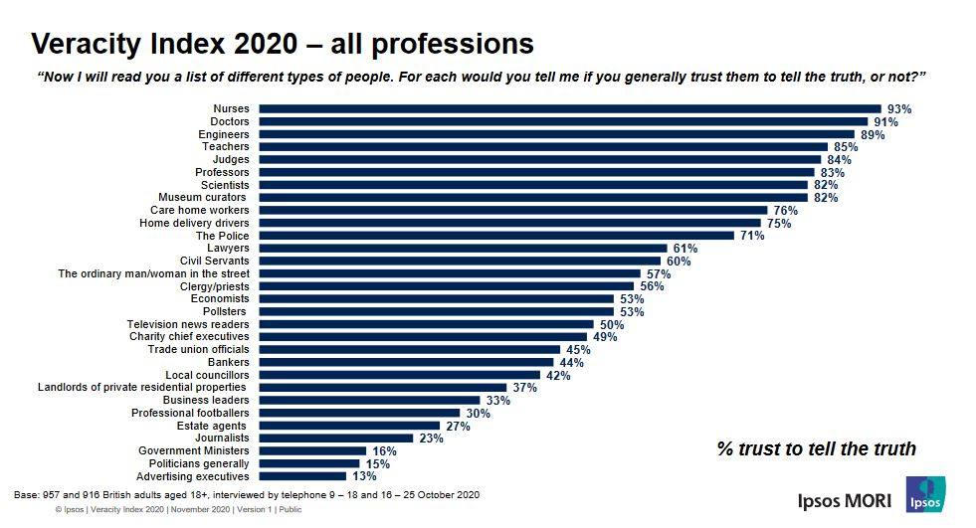
Mistrusted Leaders (3% per year „drop”)

Slide 15

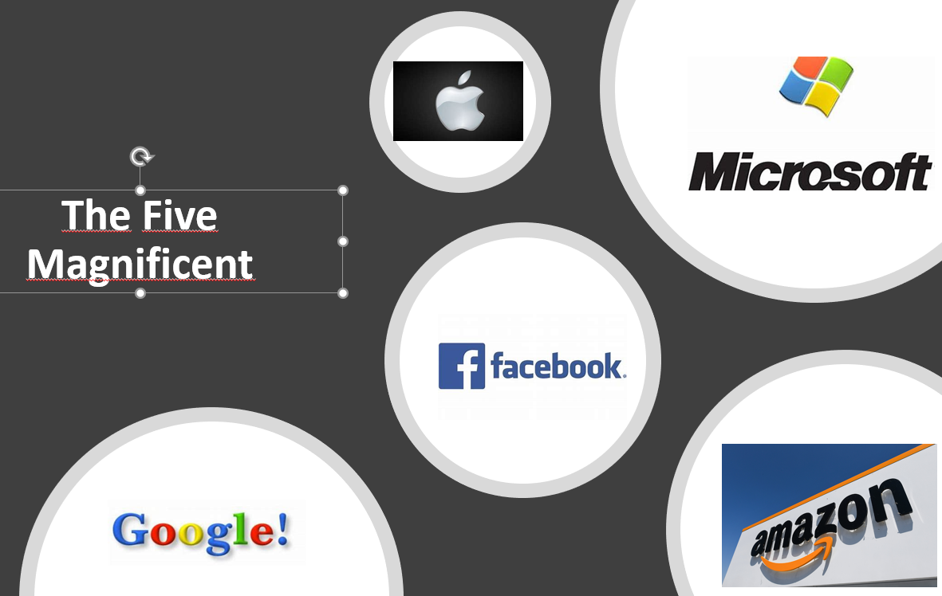
Digital Rules the World
It took 42 years for Apple to reach US$1 trillion market capitalization, and 20 weeks to double the value
Zoom = Top 7 airlines
Algorithms are altering the behavior of 1 billion workers
Teens spend 8:23 daily on smartphones

Slide 16
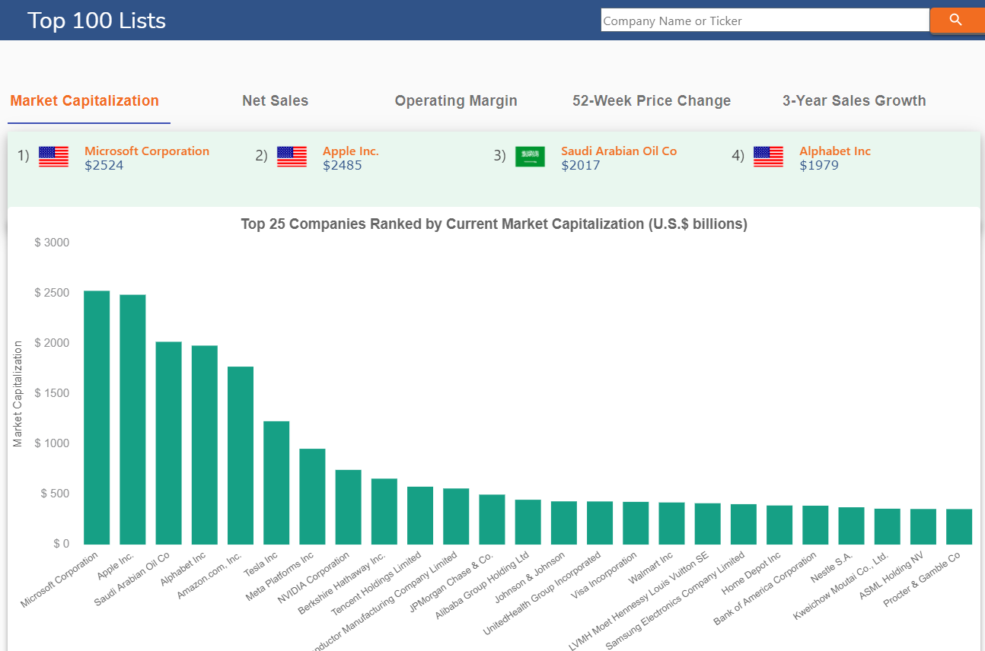
Digital rules the world – 3 months ago
Aktualna tržišna vrijednost

Slide 17
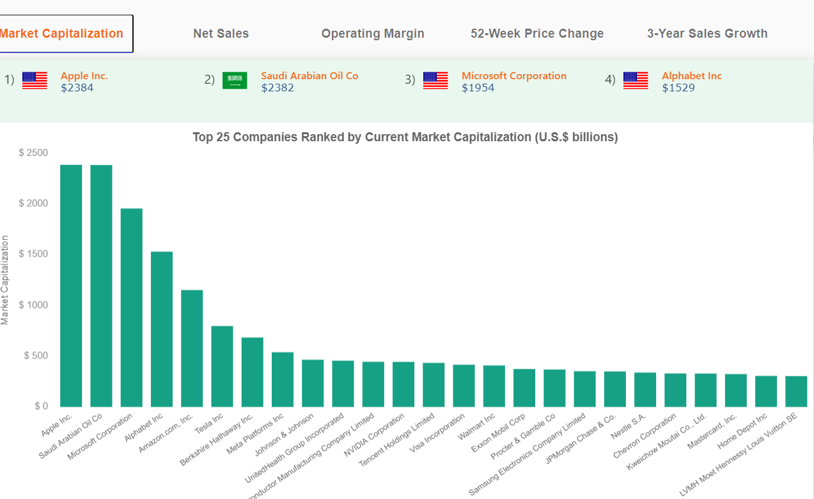
Digital rules the world a bit less – today
Aktualna tržišna vrijednost
-101
+375
-570
-250
-368
-619
-400
-211

Slide 18

Disruption Issues
Exponential pace of change in technology is taking place
Reaction cycle has shortened; decisions must be fast and agile
Traditional management methods are “overwhelmed”: they can’t handle the volume of information and change
Command and control vs. open-source and rapid response
Values and ethical compass are violated and broken
Bureaucracy is standing in the way of innovation

Slide 19


Motivational Disruption
Gallup’s State of the Global Workplace.
Survey of 142 countries, close to 1,5 billion workers
13% „engaged" – passionate to change the world
63% „nonengaged" – disinterested in job and company
24% „actively disengaged” – negative, come to workplace to „bother” others

Slide 20
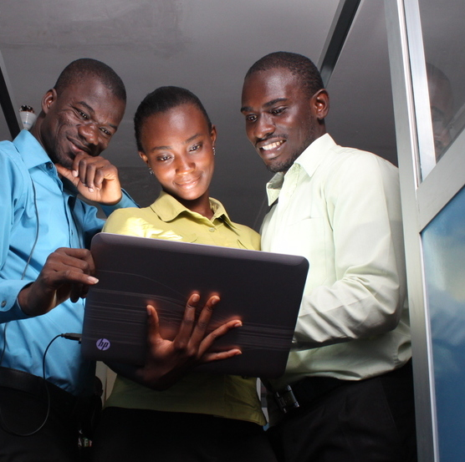
World Bank Study in Africa
Traditional MBA entrepreneur education (finance, purchasing, sales, accounting, marketing, production, statistics, HRM…) produces 11% profit growth
Mindset-oriented entrepreneur education (trends, leadership, teamwork, motivation, creativity and change management…) produces 30% profit growth

Slide 21

Not Adaptation but Transformation
New Mindset
The New Normal Calls for RESET

Slide 22
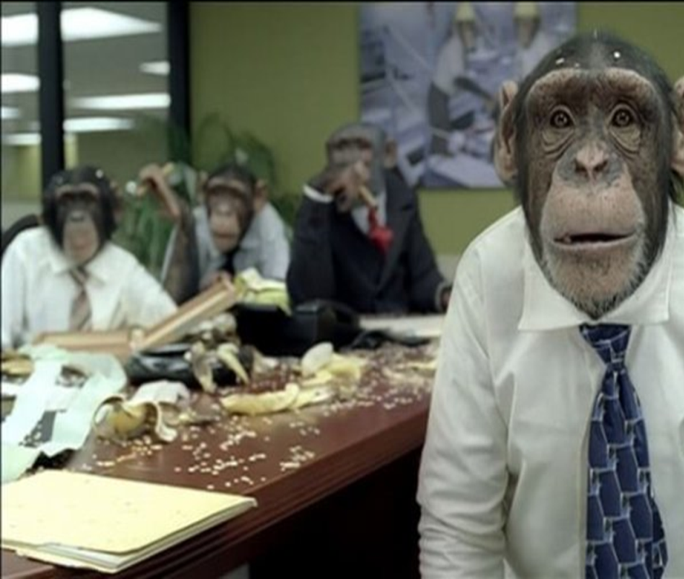
Why Mindset Shift?

Slide 23

Why Mindset?
Mindset = Values
Values Behavior
Behavior Outcomes
If we want better outcomes, we must change the values!

Slide 24

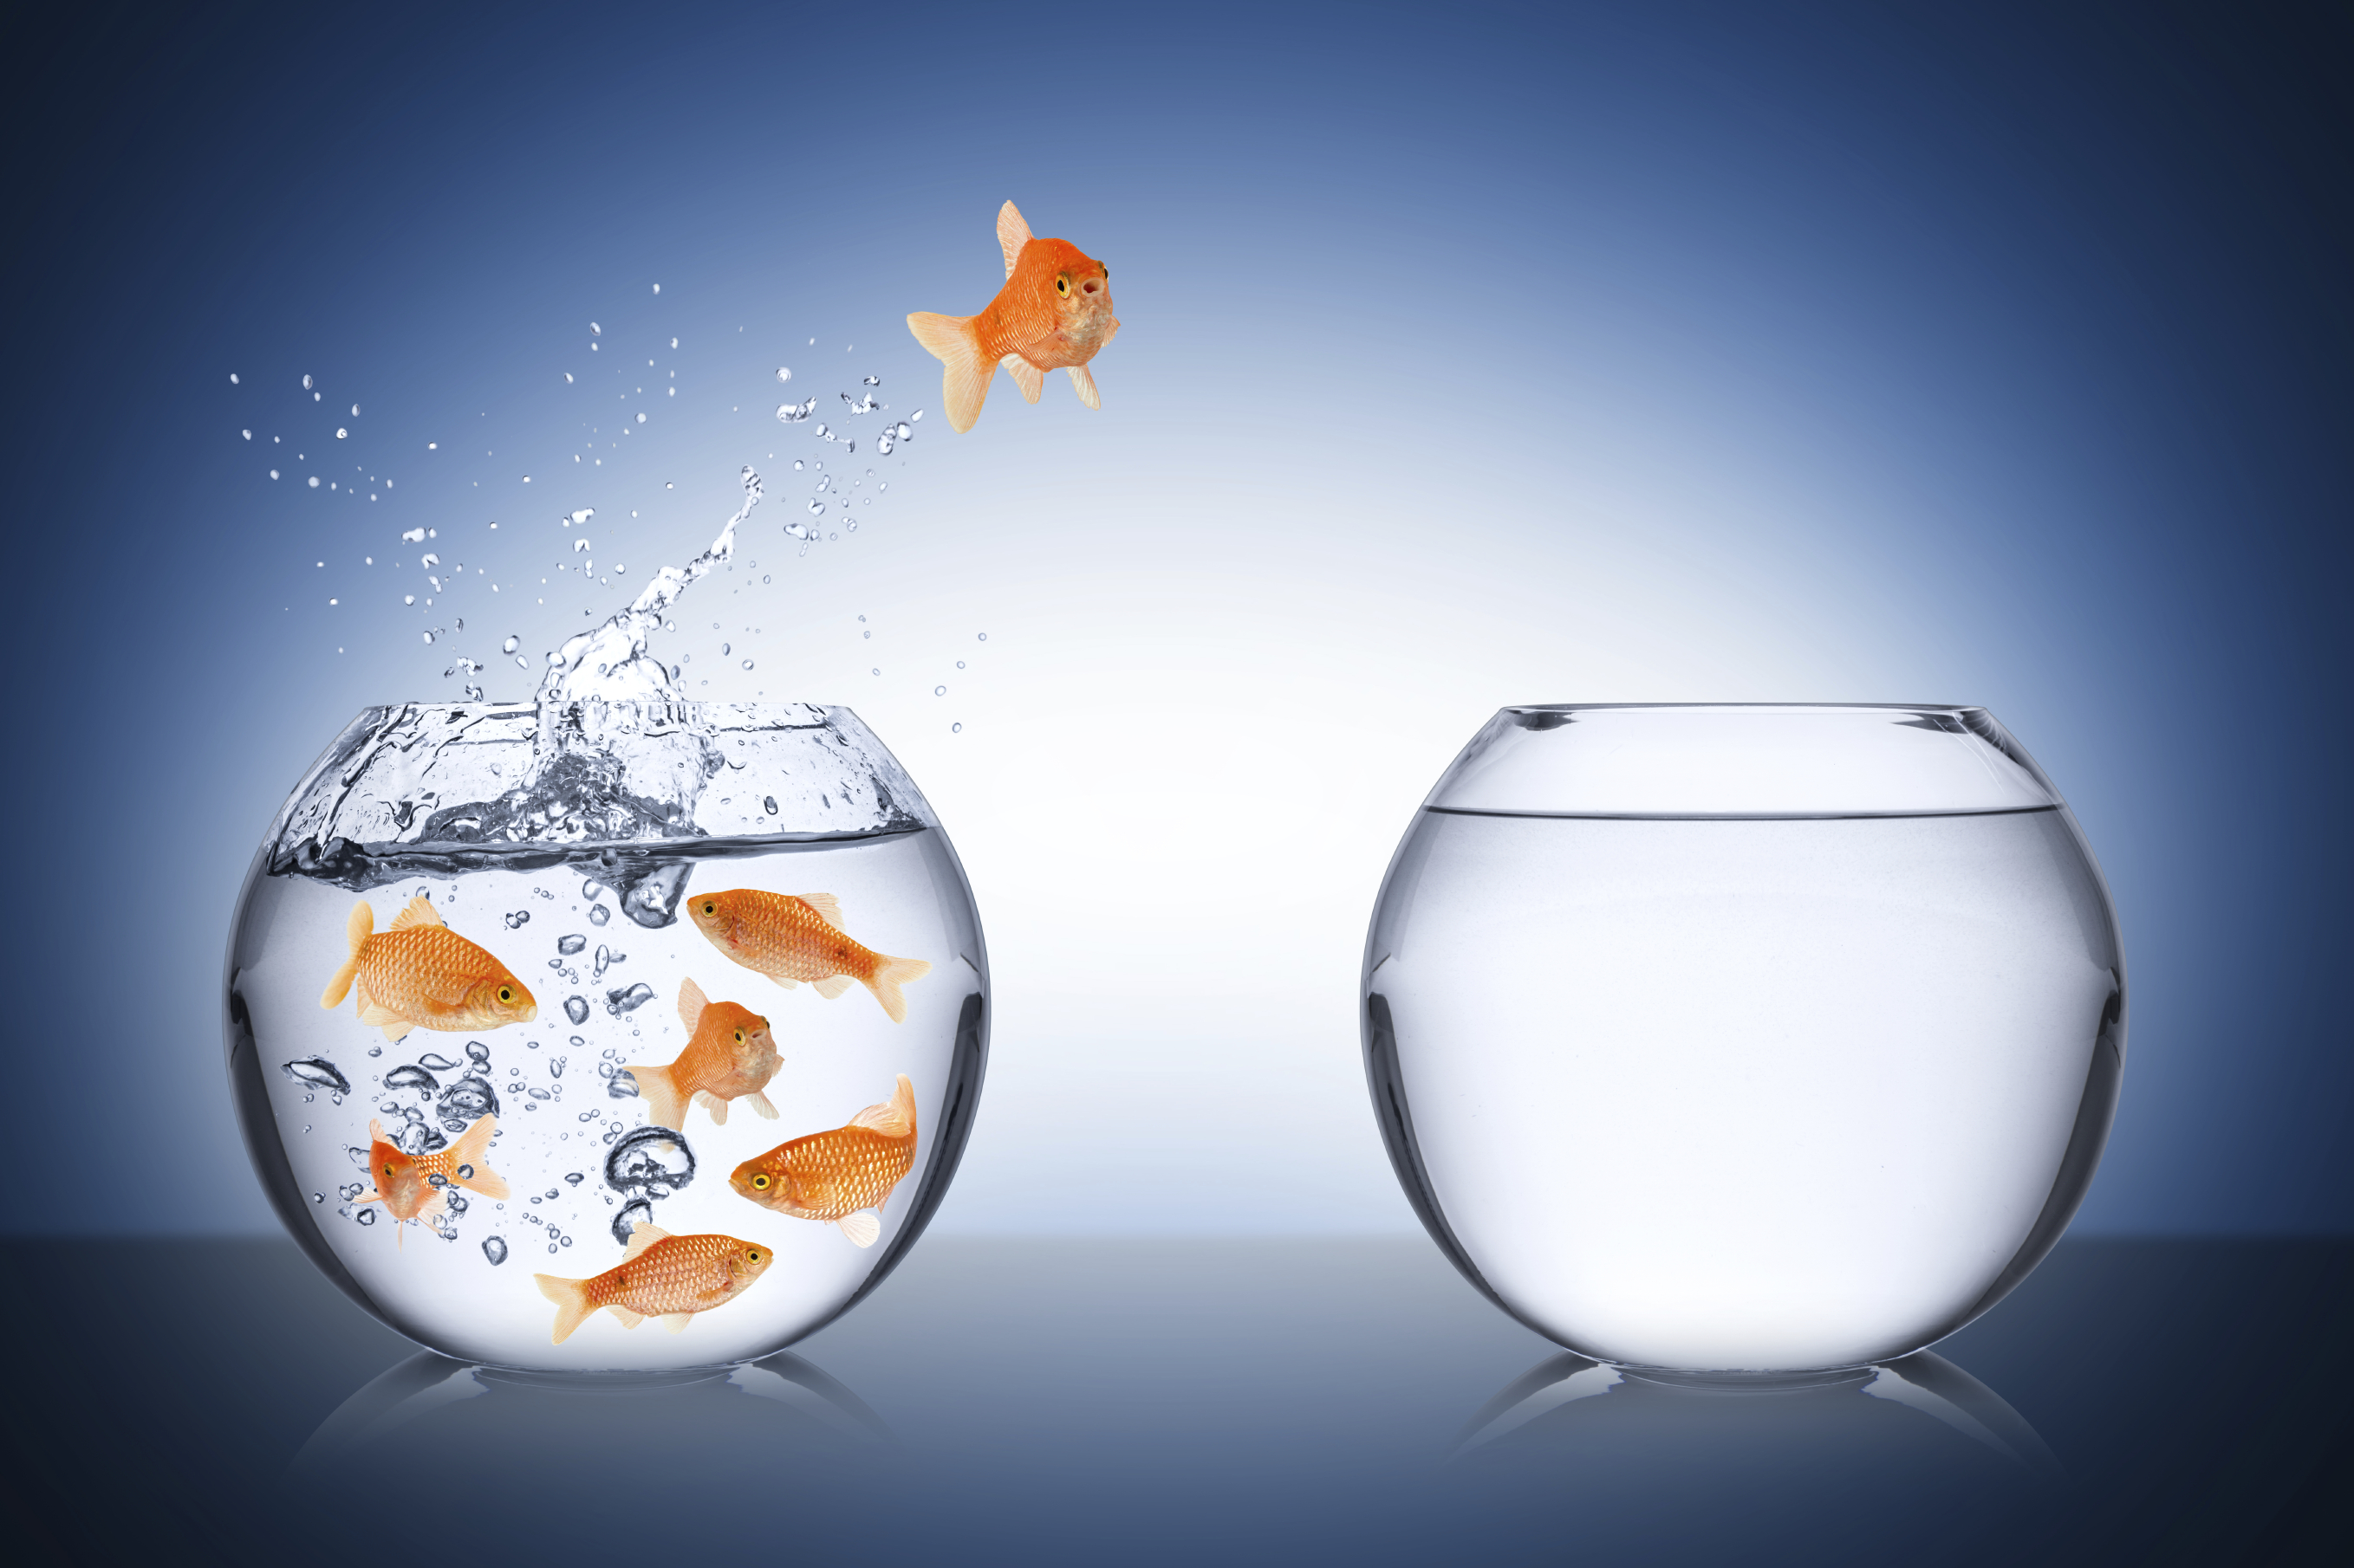
Change is Hard
We cannot solve problems with the same thinking that caused them!
Change is usually „imposed”, not „explained”!
We are all for change, but…

Slide 25
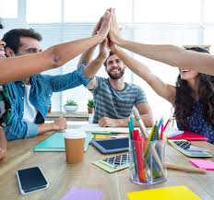
Fixing the World Values
Leaders: Catalyzers of Purpose
Learn and unlearn
Cherish candor and trust
Cultivate passion
Cherish empathy
Value initiative
Thinik Kaizen – Think Positive
Take calculated risk
Create the Win-Win spirit
Build Self-efficacy…

Slide 26
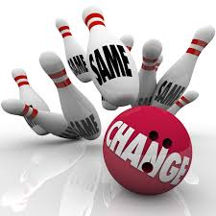
Leaders – Catalyzers of Purpose
Leadership is critical for change
Catalyzers deal with “sense making”
Such leadership is about vision, challenging goals, new values….
It goes beyond traditional mechanisms that influence behavior

Slide 27



Love of Purpose
Purpose is the key motivator

Slide 28

Learn and Unlearn!
The Nan-in story
The problem is not how to get new thoughts into your mind, but how to get the old ones out!

Slide 29

Think Kaizen!
It’s bad, we must change it!
It’s good but can be better, we want to change it!
Catch people in what they do right!

Slide 30
Harmony, not Conflict
  Personal harmony
  Organizational harmony
  Harmony with environment
  Harmonious democracy
  Harmonious economy
  Harmonious businesses
  Harmonious projects
  Harmonious families
  Harmonious friendships…
HARMONY
Head
Heart
Hand
Hope

Slide 31
Key Values
TEST
Trust
Empathy
Sustainability
Transparency
T E S T
Trust
Empathy
Sustainability
Transparency

Slide 32


Trust and Candor
Most people withold comments, sugarcoat bad news, avoid conflicts
Candor brings conversation and ideas, generates speed, helps problem solving, and cuts cost by eliminating meaningless meetings and reports
Confronting brutal facts is the best way to deal with problems

Slide 33


Truth and Transparency
„Lack of candor is the dirtiest LITTLE secret OF failure” (Jack Welch)

Slide 34


Criticism is Free Consulting
A man and his horse know more than a man alone!
Don’t criticize people but their actions!

Slide 35

Importance of Empathy
Ability to recognize and understand emotions, needs and thoughts of other people („be in their shoes”)
„The most valuable stuff they teach at Harvard Business School” (Global Empathy Index, Harvard Business Review)

Slide 36

Value Initiative
Nobunaga Lesson
Be proactive!
Two tools to change the world:
  Wallet
  Ballot

Slide 37

Think Positive!
Two shoe salesmen in Africa
Optimists don't focus on what they can't do, but on what they can do!

Slide 38

Abundance/Scarcity Mentality
Perception of „Limited resources”
Swedish table lesson
Reusable, and sharing economy

Slide 39

Trust and Self-confidence
Self-confidence is the key to success
Self-confident people are not afraid of change
They collaborate, and don’t undermine other people’s effort

Slide 40

Build Self-efficacy (Albert Bandura)
Person
Behavior
Outcome
Expected efficiency
Expected outcome
conviction to besuccessful in any situation

Slide 41

Fight the Enemy Inside
Shaolin story
Try to be a better person every day!

Slide 42

Take Calculated Risk
Encourage failure = Learn from mistakes!
Niki Lauda: “If everything seems under control, you’re not going fast enough”

Slide 43

Avoid Analysis Paralysis

Slide 44

Go for Win-Win!
Give up on your idea, I give up on mine, and then we can search for a solution that is better than either of our proposals!

Slide 45

Ignite Passion
Passionate people are energized by any challenge that stands in their way.
Enthusiasm, Appetite for Life, Engagement, Commitment, Great Causes, Determination to Make a Difference, Insatiable Appetite for Change… Otherwise, why Bother?

Slide 46

Be Ready to Work Hard!
I am successful because I am lucky. But I didn’t get lucky until I started working 50 hours a week.

Slide 47

Get Excited and Celebrate!
Keep being enthusiastic
Celebrate every idea, every accomplishment, it's all important
Nothing is too small to get excited about

Slide 48

Thanks for Your Attention!
velimir@velimirsrica.com
https://velimirsrica.com/

